Slide 1



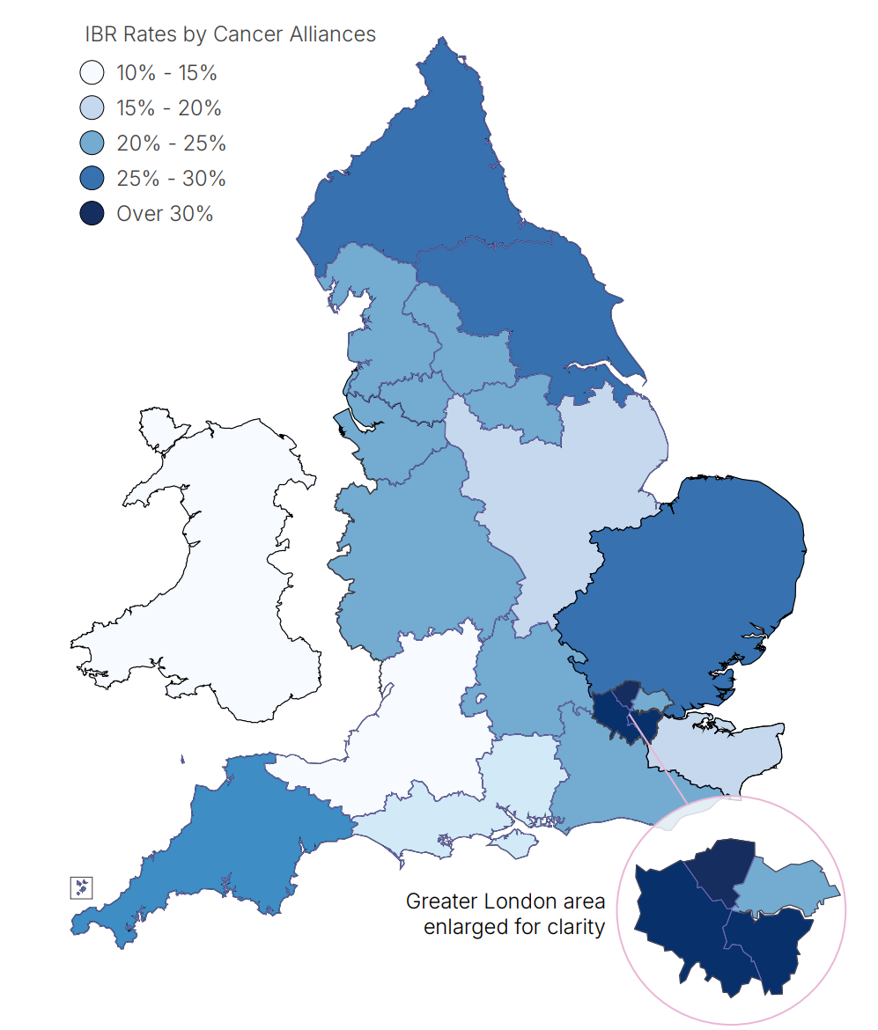

National Audit of Primary Breast Cancer: In-focus Impact Report 2025
In-focus: National Recommendation 4
Review rates of immediate breast reconstruction (IBR) and, where rates are lower than expected, act to improve access by ensuring it is offered to all women as part of a balanced shared decision-making process, unless precluded by comorbidity or adjuvant therapies.
Key Messages that Align with Recommendation #4
Across England and Wales, just under a quarter of women undergoing mastectomy have immediate breast reconstruction.
There is significant regional variation in uptake of IBR.
Adjusted IBR rate by Cancer Alliances and Wales. Women with early invasive breast cancer diagnosed in England and Wales, 2020-2022.
Notes: IBR = immediate breast reconstruction. Adjusted for case mix. Data were impacted by the COVID-19 pandemic and so will be atypical during 2020-2021. NAoPri SotN 2025.
The NAoPri Quality Improvement Intervention was launched in September 2025 with the aim of encouraging NHS providers to review their rates of Immediate Breast Reconstruction.
The intervention focuses on the following NAoPri performance indicator:
Percentage of patients who had an immediate reconstruction following a mastectomy (PI7)
Quarterly data dashboard
Results for all NHS Cancer Alliances and their constituent providers can be viewed on the NAoPri data dashboard, which is updated quarterly. The dashboard enables clinicians to assess performance and drive continuous quality improvement.
Active feedback and collaboration
NAoPri is presenting targeted feedback to NHS Cancer Alliances and, in particular, providers with low percentages of patients receiving immediate reconstruction following mastectomy. Engagement occurs primarily through data presentations at regional meetings, breast cancer conferences, and quality improvement workshops.
Engagement activities
National Guidance and Resources
NICE NG101 recommendation 1.5 Breast Reconstruction. Offer immediate breast reconstruction to women who have been advised to have a mastectomy, including those who need radiotherapy, unless they have comorbidities that rule out reconstructive surgery.
Breast Surgery GIRFT speciality Report
Brighton Breast Day (September 2025)
UK Breast Cancer Group (November 2025)
Pan Cancer Alliance Meeting (November 2025)
UK Interdisciplinary Breast Cancer Symposium (January 2026)
East Midlands Cancer Alliance Meeting (February 2026)
Thames Valley Cancer Alliance Meeting (March 2026)
December 2025
© 2025 Healthcare Quality Improvement Partnership (HQIP)

