Slide 1









National Pancreatic Cancer Audit (NPaCA) Impact Report 2026 In-Focus: Amplifying impact through collaboration
The National Pancreatic Cancer Audit (NPaCA) evaluates patterns of care and outcomes for people with a diagnosis of pancreatic cancer across England and Wales. It aims to support NHS pancreatic cancer services to identify and address areas for improvement.
Key to the audit’s impact has been its ability to add value across national initiatives, through successful collaboration with partners including Pancreatic Cancer UK (PCUK), the GIRFT Pancreatic cancer project team and NHSE’s Treatment Variation Working Group.
NPaCA data has supported Pancreatic Cancer UK to present localised data to Members of Parliament and Members of the Senedd to make the case for national
Getting It Right First Time (GIRFT) is a clinically led national programme within NHS England which supports improvement in NHS care by
NPaCA data have been used by Pancreatic Cancer UK to support discussions with both Members of Parliament and Members of the Senedd. This has enabled the charity to make the case for national and constituency level improvements.
NHS England’s Treatment Variation Working Group (TVWG) have used NPaCA generated data and performance indicators to identify priority areas for pancreatic cancer care, set performance targets and reduce variations in care across England.
During the GIRFT national speciality review of pancreatic cancer services, NPaCA findings were used by the GIRFT team to highlight both inter- and intra-network variation, supporting constructive discussions with clinical teams about access to disease-targeted treatment and pathway performance.
“We are proud of our strong partnership with NPaCA. NPaCA has delivered sorely needed disaggregated data about pancreatic cancer treatment and care. This has enabled us to better understand the true picture of the variation data in pancreatic cancer care in England and Wales and has provided the granular evidence we need to support individual providers to improve their services.”
Johanna Taylor
Policy and Health Improvement Manager,
Pancreatic Cancer UK
“NPaCA data has been invaluable in identifying variations in diagnostic pathways, non-surgical oncology provision and chemotherapy delivery resources that were otherwise unseen, which has enabled us to provide recommendations and support to pancreatic networks to address these.”
Professor Daniel Palmer
Joint GIRFT Clinical lead for pancreatic
Cancer
www.natcan.co.uk/audits/pancreatic Pancreaticcanceraudit@rcseng.ac.uk

Slide 2




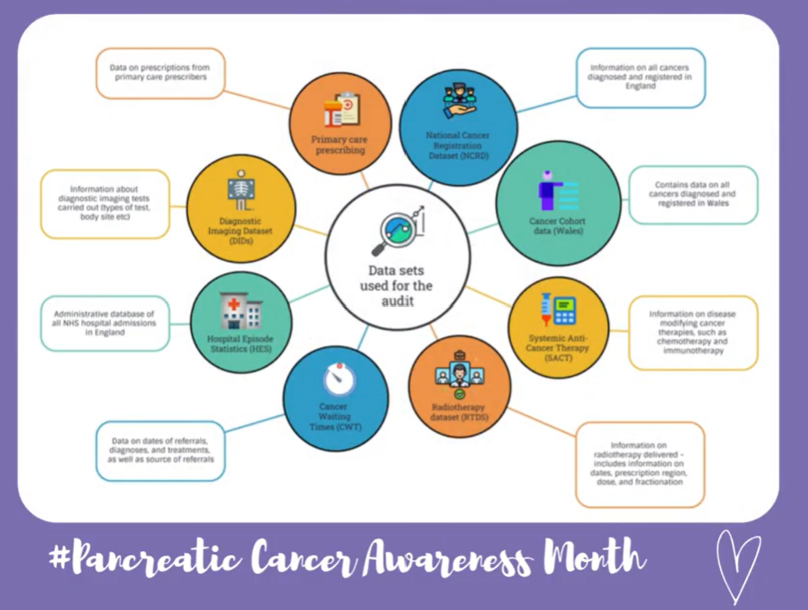

National Pancreatic Cancer Audit (NPaCA) Impact Report 2026
The National Pancreatic Cancer Audit (NPaCA) evaluates the quality and outcomes of care for people diagnosed with pancreatic cancer. Its overarching aim is to: support pancreatic cancer services provide high quality of care, to share examples of good practice, and to highlight areas where care might be improved.
NATIONAL How the project provides evidence of quality and outcomes of care nationally | SYSTEM How the project supports policy development and management of the system
LOCAL How the project stimulates project improvement | PUBLIC How the project is used by the public and the demand for it
The NPaCA’s second annual State of the Nation (SotN) Report was published in September 2025. The report:
Includes ten performance indicators that were selected based on NICE guidelines, NICE Quality Standards and expert clinical input. These were developed in consultation with the audit’s Clinical Reference Group, which includes representation from people with lived experience of pancreatic cancer
Highlights variation in care across NHS organisations
Identifies priority areas for improving pancreatic cancer care, providing national-level clinical recommendations
Informing national initiatives
GIRFT is using the audit data to inform
deep-dive discussions at trusts,
leading to recommendations on best
practice, including discussions with NICE on
where guidelines need updating.
Engaging the clinical community
The NPaCA has disseminated its findings to key clinical audiences via events including:
NATCAN SotN Webinar- Exploring Key findings from the latest State of the Nation Reports 13th October 2025
NATCAN Audits Webinar hosted by Royal College of Radiologists (RCR) 17th October 2025
AUGIS Scientific Meeting 24-25th October 2025
London Global Cancer Week Webinar 27th November 2025
Key results are published on the NPaCA's interactive web-based data dashboard. The State of the Nation report results are refreshed annually and a subset of performance indicators are reported quarterly. The dashboard is publicly available and is designed to be accessible to a wide range of users – clinicians, public, policy makers and commissioners.
Supporting services to act on recommendations
The Audit has developed a local Quality Improvement Action Plan Template which outlines suggested actions and approaches that NHS organisations may adopt when planning local quality improvement activities
Social media
Public engagement is supported through regular updates on Bluesky (@npaca-natcan.bsky.social), LinkedIn (@National Pancreatic Cancer Audit), and X (@NPaCA_NATCAN).
Website
• Over 4,200 visits were recorded for the audit’s webpages, including State of the Nation report views
• Over 1,400 unique users accessed the Quarterly and State of the Nation Dashboards
A focus on local quality improvement
NPaCA has developed a Quality Improvement intervention which aims to increase the rates of treatment among people with pancreatic cancer.
This entails providing bespoke feedback to Cancer Alliances about their trusts’ treatment rates, sharing examples of good practice and publishing cancer alliance and trust-level information on a quarterly basis to support monitoring of progress.
Pancreatic Cancer Awareness Month
During November, the NPaCA contributed
to the global Pancreatic Cancer
Awareness Month campaign by using its
social media channels to share posts to
help raise awareness of the disease.
This included contributions from NPaCA’s
PPI Forum members and engagement
with charity partners Pancreatic
Cancer UK and Pancreatic Cancer Action.
www.natcan.org.uk/audits/pancreatic Pancreaticcanceraudit@rcseng.ac.uk

