Slide 1


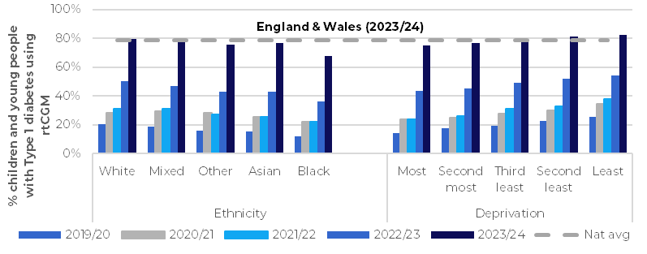
NPDA
National Paediatric Diabetes Audit
Impact Report – March 2025 Overarching Improvement Goals
To reduce the national median HbA1c by 3 mmol/mol over three years.
The percentage of children and young people receiving all key health checks for Type 1 or Type 2 diabetes to increase by 4% each audit year.
The percentage of those with Type 1 diabetes (T1D) living in the most deprived areas/ of Black and Asian ethnicity using an insulin pump to increase 3% per audit year.
The NPDA will develop a minimal staffing dataset to monitor equity of staffing.
The NPDA to host at least two events per year where audit findings and best practice are shared.
The NPDA to engage CYP in the review of audit results and in planning strategies to improve them
National How the project provides evidence of quality and outcomes of care nationally
System How the project supports policy development and system management
The NPDA has stimulated and evidenced an improvement in completion rates of key health checks for T1D. 66% of those with T1D aged 12 and above received all six ‘key’ annual health checks in 2023/24, compared to 63% in 2022/23.
The NPDA collaborates with the National Diabetes Audit (NDA) to produce analysis of the care of adolescents and young adults.
NPDA data informs Best Practice Tariff payments, is included in the National Clinical Audit Benchmarking platform, and the NHS England Getting It Right First Time programme.
The national median HbA1c for T1D has fallen consistently over the past 11 years, from 72 mmol/mol in 2010/11, to 60.0mmol/mol in 2023/24.
NPDA outlier data informs CQC inspections and is fed back to the Welsh Government.
Routinely collected staffing data supports reduction in inequity of resourcing.
The NPDA supports the National Children and Young People’s Diabetes Network by hosting national meetings, and through collaboration with the working groups of this organisation.
The NPDA has commissioned Children’s North East to deliver Poverty Proofing training to all PDUs in England, Wales, and Jersey in 2025.
Access to continuous glucose monitors (CGMs) has increased to 79% in 2023/24, from 49% in 2022/23. Inequalities in access to CGMs are narrowing.
However, inequalities in HbA1c by ethnicity and deprivation persist.
Since 2023/24, the has NPDA supplied data to NHS England to facilitate the reimbursement of ICBs for the partial costs of hybrid closed loops as part of their implementation strategy.
Local How the project stimulates quality improvement
Public How the project is used by the public and the demand for it
The NPDA enables benchmarking at unit, Trust, ICB/LHB, network, region, and country level via interactive reporting tools: the NPDA frequent reporting dashboard and NPDA Results Online.
Unit-level posters for display in patient waiting areas detail the PDU’s performance in the NPDA core audit. Posters with national results are available for each State of the Nation report.
Prospective data entry into the NPDA Data Capture System allows units to get real time feedback on core audit metrics and assure the quality of their data.
In 2024/25, the NPDA has commissioned RCPCH&Us to engage with CYP with diabetes to develop age and stage appropriate information about the NPDA. This has received a lot of interest, with 48 self-referrals from CYP. This learning will also contribute to a wider resource bank for PDUs.
All paediatric diabetes teams receive a detailed PDF report on their annual performance. Outlier data is produced to identify units in need of support for improvement and escalate concerns to senior management.
In 2024/25, the NPDA has commissioned DigiBete to work with families with diabetes to produce shareable content explaining what they wished others knew about what it is like to manage the condition, based on the findings of the 2023 AYPH report (commissioned by the NPDA) and the Poverty Proofing in PDUs Report.
PREM feedback support units to make positive changes based on parent and patient views. Over 3400 responses from newly diagnosed young people and their families were received for the 2023 First Year of Care survey.
Parent and Carers posters and animations produced for social media support understanding of the audit and the importance of good diabetes care.
NPDA data is also highly valued by researchers due to its completeness and quality. In 2024, the NPDA participated in a research collaborative with registries across Europe and the USA looking at treatment regimens and glycaemic outcomes.
NPDA events including conferences and webinars bring MDT staff together to share best practice. Feedback from the 2025 national conference showed that 99% of respondents had learned one new thing.
Support for the NPDA amongst families with diabetes was strongly established in 2023 in a series of ‘clinic chats’ commissioned from the RCPCH &Us team in 2023 as part of the NPDA’s application for exemption from the National Data Opt-Out (NDO).

