Slide 1



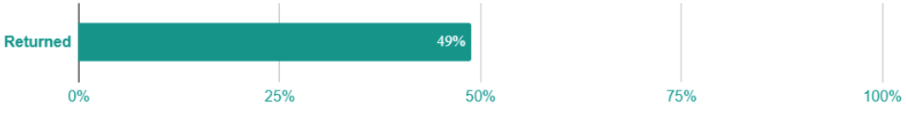
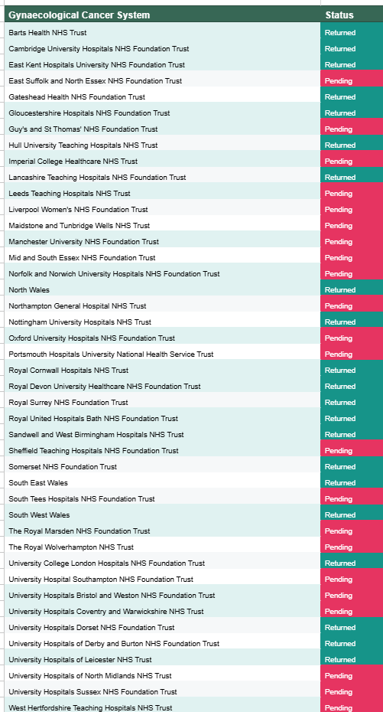
Impact of the National Ovarian Cancer Audit 2025-2026
NOCA Quality Improvement initiative
Improving Treatment Rates for Emergency Admissions
Why this matters
Two in five women diagnosed with ovarian cancer are diagnosed following an emergency admission.
Two in five women in England and three in ten in Wales who had an emergency admission 28 days prior to ovarian cancer diagnosis did not receive any treatment.
NOCA data shows variation in both emergency admissions & receipt of treatment across the gynaecological cancer systems (GCS).
Higher rates of treatment following emergency admissions are associated with higher survival.
Member of the Patient and Public Involvement (PPI) forum endorsed the proposed initiative.
What we have done
Feedback letters to all the GCSs.
Aggregate data report to all the GCSs.
Sharing best practice: examples of potential actions presented by high-performing GCSs in a webinar organised with the British Gynaecological Cancer Society.
Providing provider-level results through the NOCA dashboard.
Requested formal response from all the GCSs – see live response log.
Responses will be collated in an anonymised summary and will be shared in 2026.
Response log (as of March 2026)
Improvements in data completeness
Dissemination/feedback activities and impact
NOCA referenced at & invited to attend parliamentary event by APPG on Women’s Health
NICE guidelines and recommendations underpinned by NOCA findings
NOCA QI intervention poster & response log on NOCA’s website
NOCA – BGCS Webinar to share QI plans & best practice examples
Patient and Public Version of the State of the Nation 2025 Report
Plenary presentations of NOCA key findings at BGCS annual meeting 2025 & UKGOM 2025
NOCA’s State of the Nation 2025 findings presented at an RCR & NATCAN webinar
Presentation of NOCA’s research activity at BGCS annual meeting 2025

