Slide 1



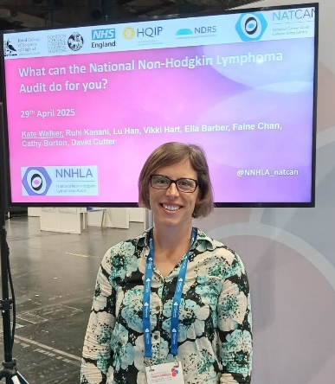
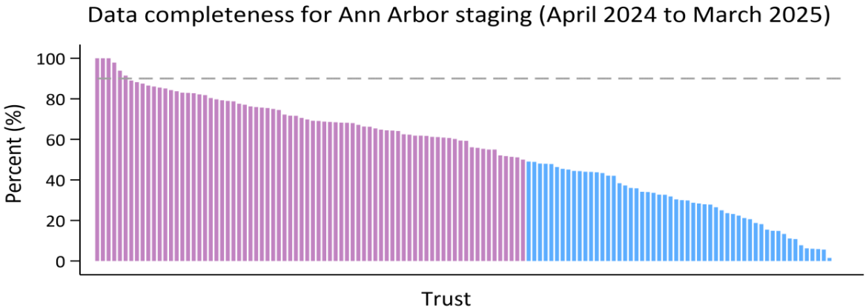
National Non-Hodgkin Lymphoma Audit (NNHLA) Impact Report 2025
The NNHLA evaluates the quality and outcomes of NHS non-Hodgkin lymphoma (NHL) services across England and Wales, providing insights that help healthcare providers strengthen the delivery of care.
NATIONAL
How the project provides evidence of quality and outcomes of care nationally
The NNHLA’s second State of the Nation (SotN) Report, published in September 2025, included ten performance indicators and highlighted wide variations in diagnosis route, care process and treatment pathways.
The report included 15,433 patients in England (2022 data) and 729 patients in Wales (2023 data) who were diagnosed with non‑Hodgkin lymphoma. For the first time, the audit reported on route to diagnosis, identifying that 28% (range 0-75%) of patients in England presented as an emergency. Among patients with high grade lymphoma, 55% (0-100%) in England and 48% (8-91%) in Wales began chemotherapy within 62 days of referral. Following the completion of first line chemotherapy, 33% (0-100%) of patients in England started radiotherapy within 8 weeks. Approximately 2% (0-15%) of patients in England were recorded as having received care as part of a clinical trial, though the audit noted limitations in data completeness. Overall, 81% of patients in England and 83% of patients in Wales survived for at least one year, and 74% patients in England survived for at least two years after diagnosis. After risk-adjustment, variations across providers were largely within expected range, except one positive outlier.
SYSTEM
How the project supports policy development
and management of the system
The NNHLA shared findings from the audit at a range of national events, including the following webinars:
• NATCAN SotN Webinar- Exploring Key findings from the latest State of the Nation Reports 13/10/2025
• NATCAN Audits Webinar hosted by Royal College of Radiologists (RCR) 17/10/2025
• London Global Cancer Week Webinar 27/11/2025
Recordings of these webinars are available online and expand the audit’s reach beyond the live audience. To date, the webinar recordings have received over 240 views. Please click the links above to access the recordings.
Members of the NNHLA project
team delivered presentations
at the British Society of Haematology (BSH) Conference; held in Glasgow between 27 and 29 April 2025. The presentations were well received by delegates, helping to raise awareness of the audit and generating further interest in its work.
The NNHLA provides quarterly performance reporting via an online data dashboard for NHS trusts and Cancer Alliances in England, offering timely insights that help build a national picture of performance nationally.
LOCAL
How the project stimulates quality improvement
The NNHLA helps drive local quality improvement by providing NHS organisations with performance data to monitor progress and understand the impact of interventions. This is delivered through:
PUBLIC
How the project is used by the public and the demand for it
The audit engages the public through a range of activities designed to ensure that people affected by NHL can access information, contribute their perspectives, and stay informed.
Focus: Quality Improvement (QI) activities
How the project supports more robust and equitable data reporting
Patient and Public Involvement (PPI) Forum and PPI Report:
NNHLA’s PPI Forum was developed in partnership with our charity collaborators, bringing together representatives from patient and carer groups. It ensures that the experiences and views of people affected by NHL help to shape the audit’s direction and delivery. The group meets at least twice a year and, alongside our charity partners, contributed to the development of the Patient and Public Report. This report complements the SotN report, by presenting key findings in an accessible format for a more general audience.
The SotN data dashboard: This dashboard provides NHS organisations with tabular and graphical summaries of their local results across data quality measures and performance indicator outcomes.
Quarterly reports: This online interactive dashboard offers updates every three months; delivering timely feedback to NHS trusts and Cancer Alliances in England. It displays performance indicators over a three‑year period in quarterly increments, allowing healthcare providers to monitor their performance consistently and assess change over time. The introduction of data and report download functions supports local reporting and more detailed analysis.
Social media platforms:
Public engagement is supported through regular updates shared on the audit’s social media channels: Bluesky (@nnhla-natcan.bsky.social), LinkedIn (@National Non-Hodgkin Lymphoma Audit), and X (@NNHLA_NATCAN).
A local Quality Improvement Action Plan Template outlines suggested actions and approaches that NHS organisations may adopt when planning local quality improvement initiatives; which are aligned with the five key recommendations detailed within the SotN report.
Local engagement is supported through regular communications and events. Three newsletters were circulated to over 400 recipients, providing updates on the audit’s progress.
Website:
• Over 1,110 webpage visits were recorded for the audit’s pages, including SoTN report views
• Over 1,200 unique users accessed the Quarterly and SoTN data dashboards.
The NNHLA launched a targeted QI intervention in October 2025; designed to strengthen the completeness of key clinical data items—an essential foundation for accurate audit reporting, equitable benchmarking, and understanding where care pathways may require improvement.
The intervention includes:
• Focused support for data completeness: 51 trusts with <50% completeness for Ann Arbor staging received bespoke feedback, benchmarking information, and signposting to further resources
• Collaboration with NDRS: Trusts are offered tailored support through NDRS via a referral pathway, alongside additional guidance in response to any specific queries
• Engagement activities: A dedicated webinar focussed on launching the intervention and improving data quality. This was co-delivered with colleagues based at the National Disease Registration Service (NDRS).
• QI resources- a dedicated webpage provides supporting materials, including a recording of the webinar, an intervention poster and case studies.
The QI intervention aims to support improved data accuracy, reduces unwarranted variation, and more reliable reporting across NHS organisations.
Email: NHLaudit@rcseng.ac.uk.
Website: https://www.natcan.org.uk/audits/non-hodgkin-lymphoma/
Impact report produced in March 2026.

