Slide 1








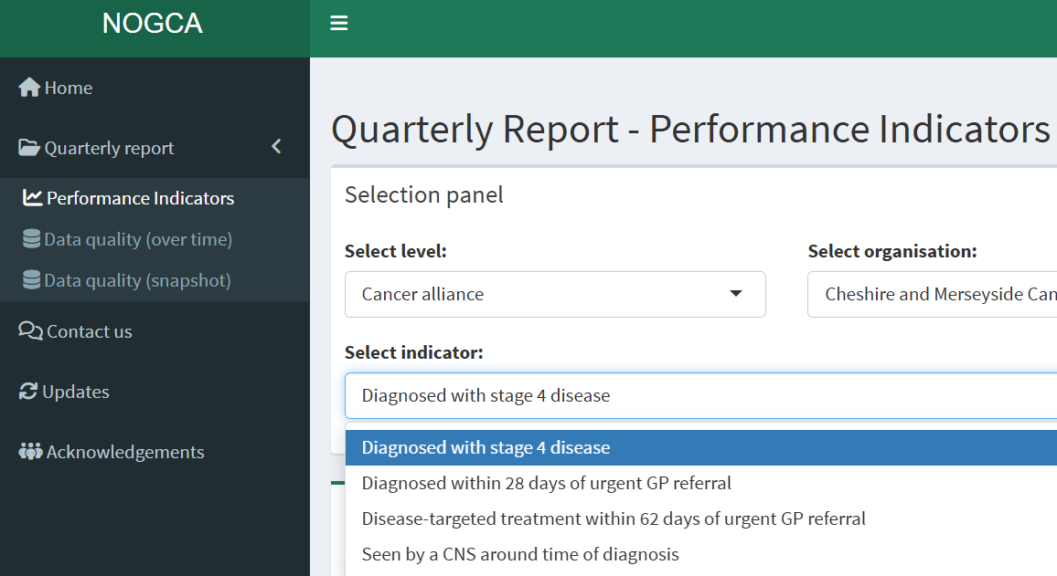
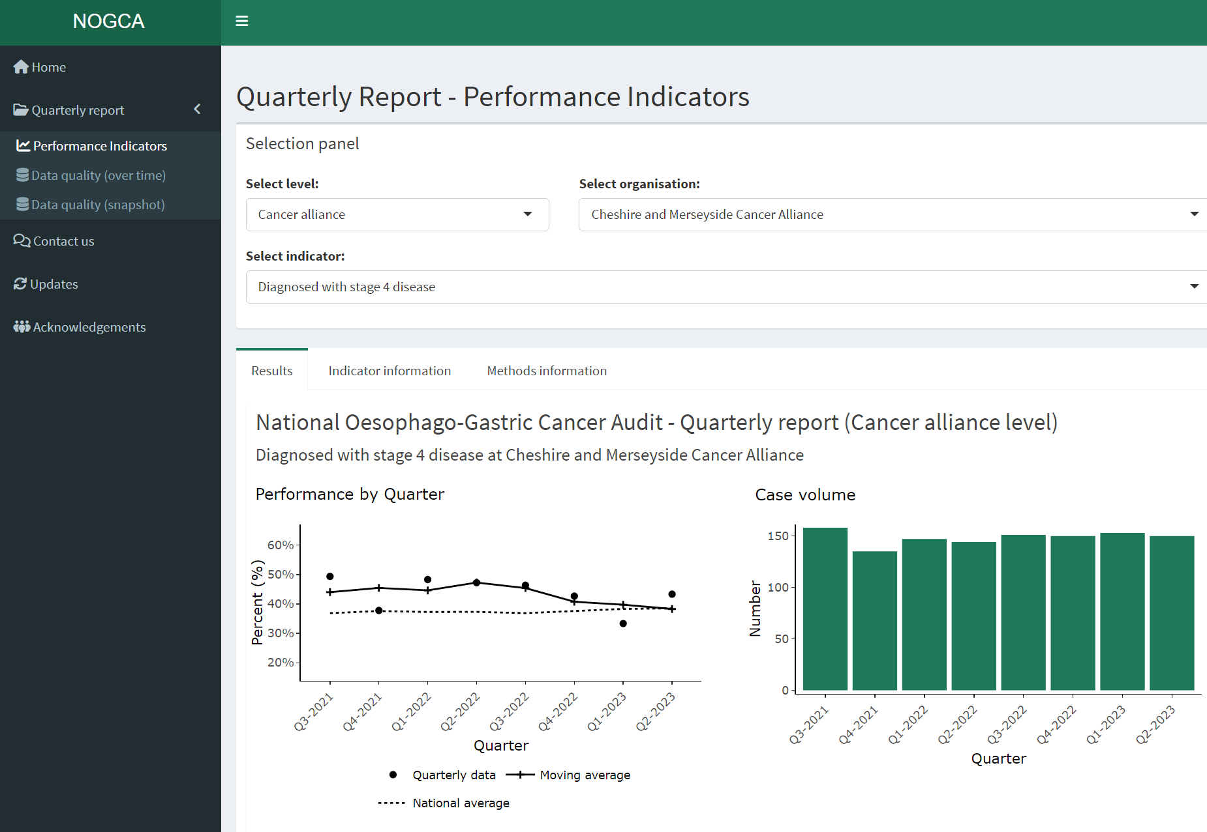
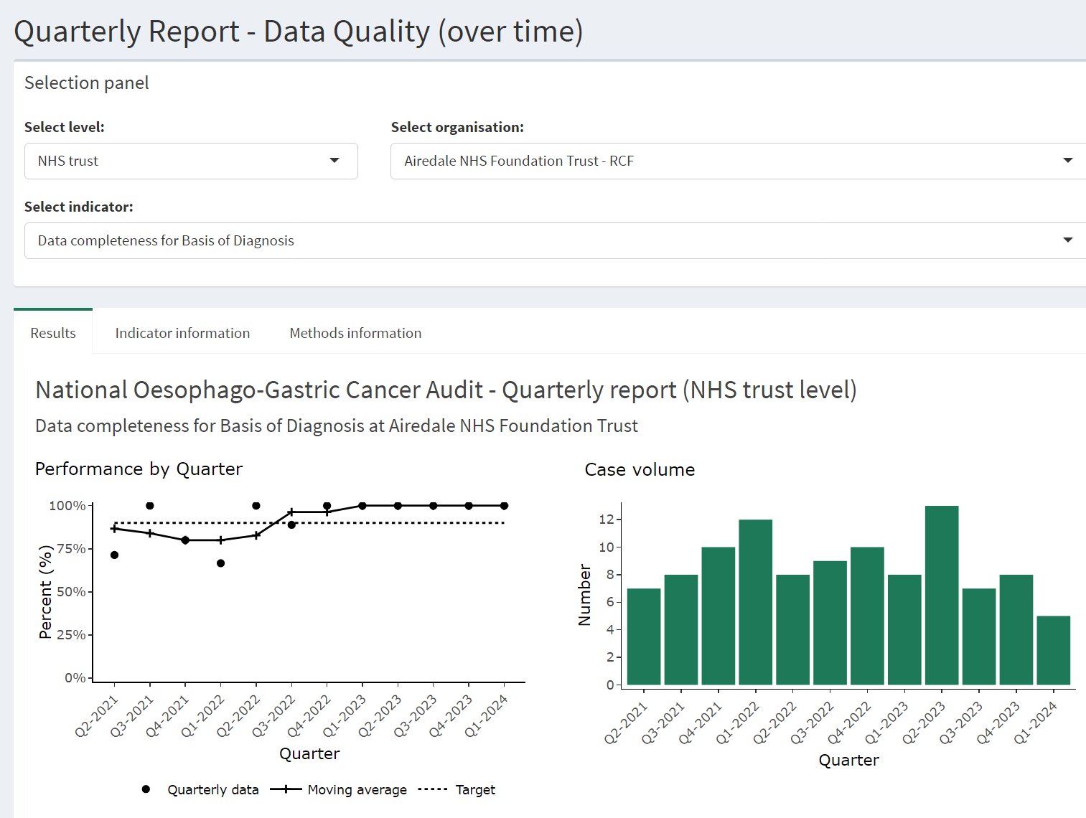
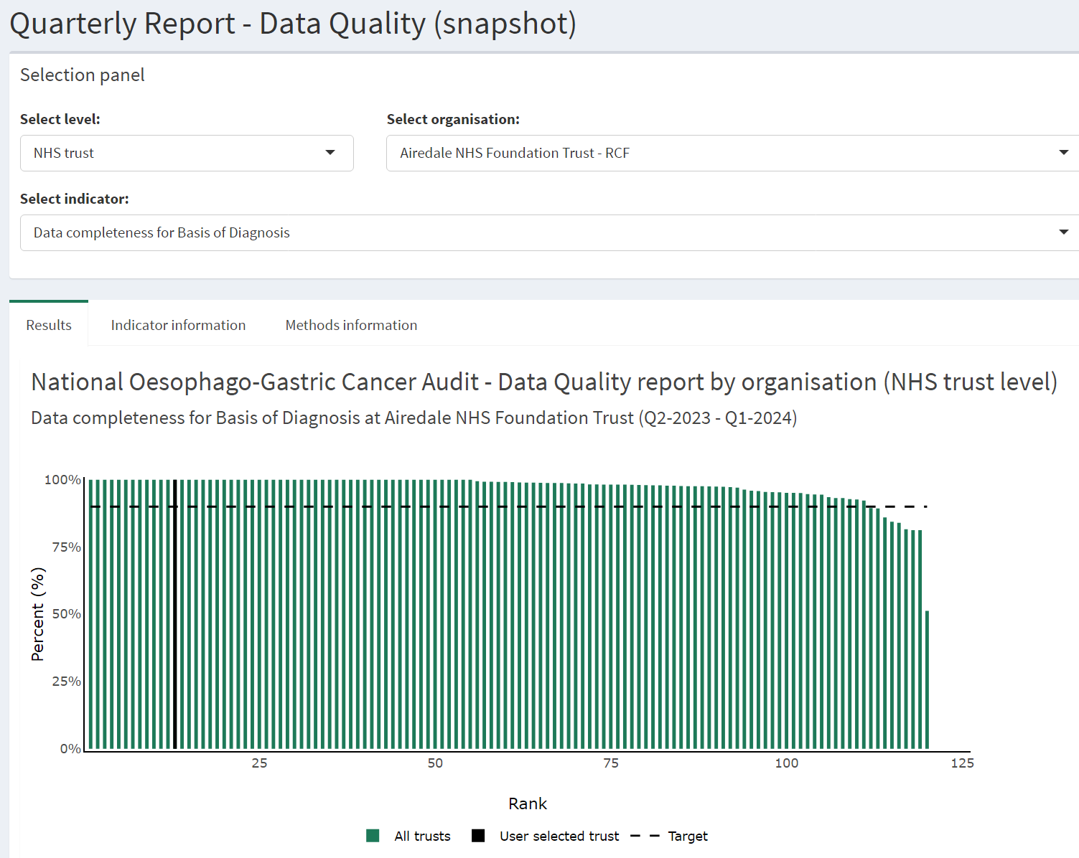
NOGCA Information Sheet 2025
The introduction of an online interactive dashboard for quarterly reports
Introduction
The aim of the National Oesophago-Gastric Cancer Audit (NOGCA) is to evaluate the care and outcomes for people diagnosed with oesophageal or gastric (OG) cancer in England and Wales
An online dashboard was launched by the NOGCA team in January 2025 that displays information on selected performance indicators by NHS Trust and Cancer Alliance in England*
Overview of the online dashboard (https://rcs-ceu.shinyapps.io/NOGCA)
The interactive dashboard allows users to review the performance of NHS services over time
The dashboard is updated every three months. It provides up-to-date insights, and supports continuous improvement activities by NHS services providing care to patients with oesophageal and gastric cancer
Users can explore information about the performance of NHS services and the quality of data provided in national cancer datasets
The information is produced using the Rapid Cancer Registration Dataset (RCRD) linked with other national cancer datasets
Data quality
Reports on the completeness of key data items in the Rapid Cancer Registration Dataset and the Cancer Outcomes and Services Dataset (COSD)
Engagement with dashboard
Over 1200 contacts received the link via email.
Over 200 views in first 4 weeks (source: google analytics).
“We are planning to improve our data completeness collection for the audit”
- Feedback from a data analyst at an NHS Trust Cancer Services based on using the dashboard
“The dashboard is very useful to access data and easy to navigate”
- Feedback from a cancer alliance clinical delivery group
Going forward
Further development is planned for 2025
We will seek feedback from a wide range of stakeholders to inform revisions and ensure the dashboard meets the needs of users
Click here to view the dashboard:
nogca.org.uk/reports
*Data from Wales is not available on a quarterly basis at this time.

