Slide 1



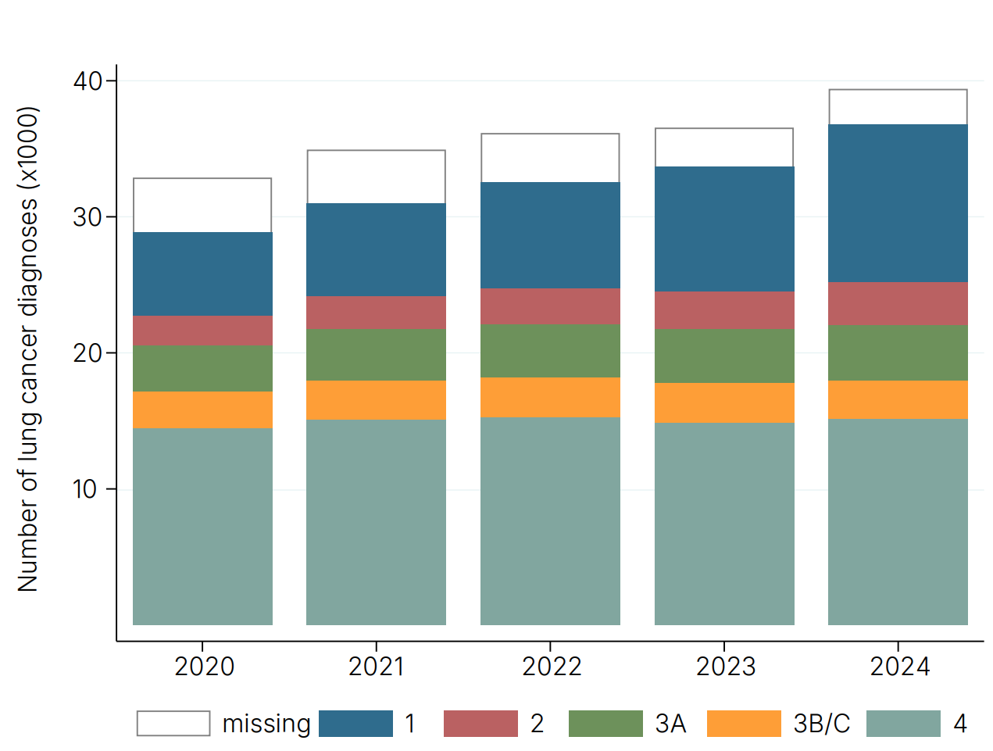
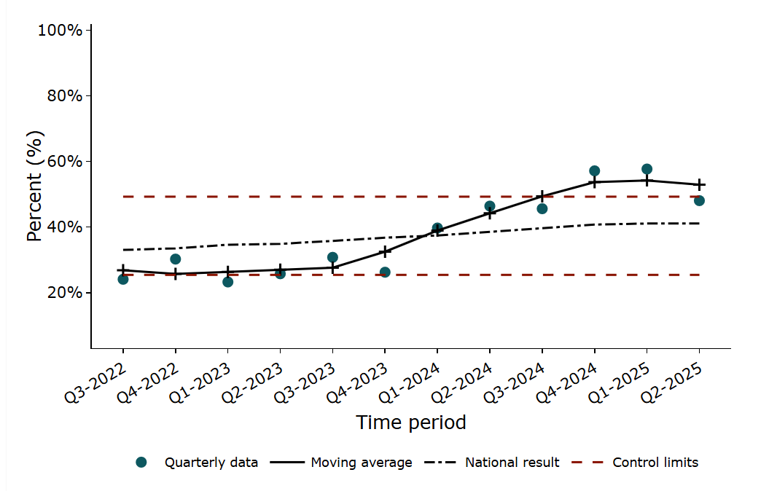
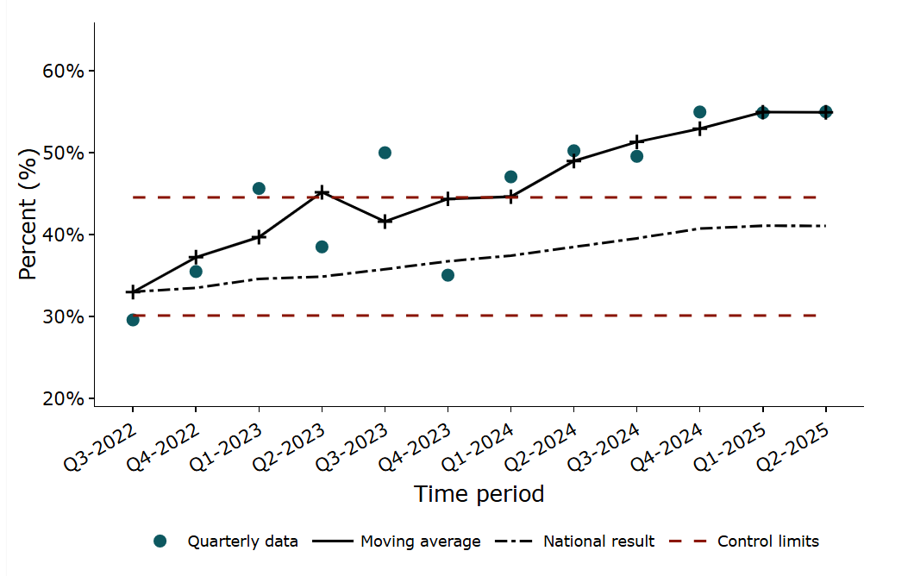
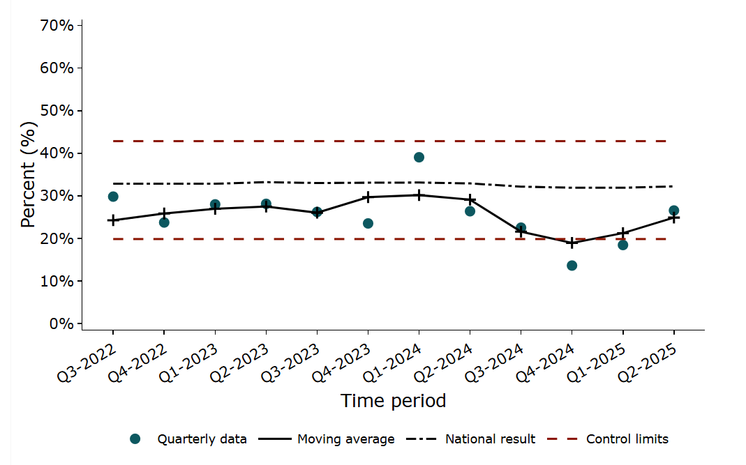
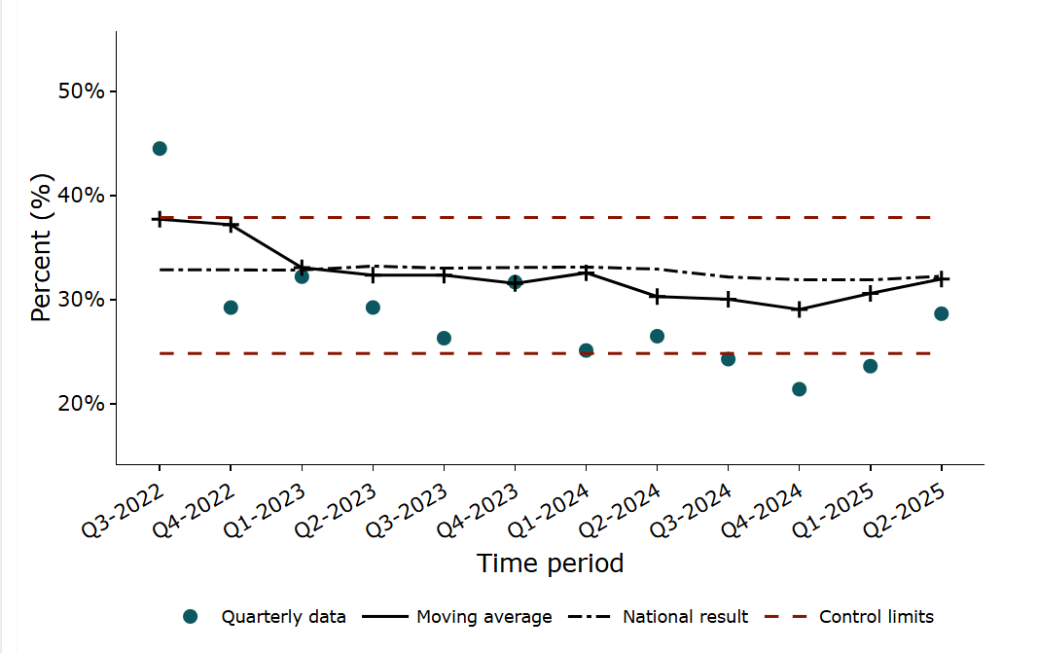
Improving early diagnosis of lung cancer
Impact of the NLCA 2025-2026
The first NLCA Quality Improvement (QI) goal is to improve the early diagnosis of lung cancer.
With the roll out of the national lung cancer screening programme in England, the NLCA has been instrumental in monitoring the change in stage of diagnosis on a national, cancer alliance and trust level.
Furthermore, the NLCA also monitors other related indicators such as proportion of patients diagnosed after emergency presentation.
Cancer alliances and trusts can access their own data via our online dashboards.
Proportion of lung cancer patients diagnosed with stage I-II disease: Example at Trust X
Proportion of lung cancer patients diagnosed with stage I-II disease: Example at Cancer Alliance X
Proportion of lung cancer patients diagnosed after emergency presentation: Example at Trust X
Proportion of lung cancer patients diagnosed after emergency presentation: Example at Cancer Alliance X
NLCA referenced in the Quality and Innovation (CQUIN) for lung cancer
Annual NLCA - BTOG podcast to share latest findings, over 350 downloads of 2025’s podcast of the webinar
Quality Improvement tools available on NLCA website
NICE guidelines and recommendation underpinned by NLCA findings
NLCA work closely with UK Lung Cancer Coalition and publish an annual blog post
NLCA Patient and Public Forum with Roy Castle Lung Cancer Foundation ensures patients are at the centre of the audit
Plenary presentations of NLCA key findings at BTOG Conference 2026 & SCTS Annual Meeting 2026
Patient resources, including a ‘Patient Guide to NLCA Statistics’ on NLCA website
Patient and Public Version of the State of the Nation 2026 Report
NCLA results fed back to Care Quality Commission (CQC) and Welsh government
Interview with Video Journal of Oncology to discuss NLCA findings

