Slide 1
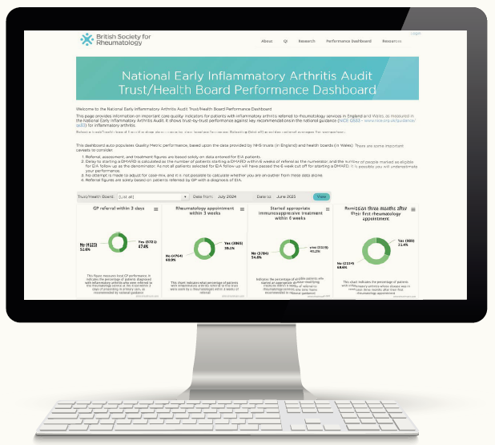

NEIAA
Driving local improvement
Building practical knowledge
Informing national policy
NEIAA data reveal threefold variation in remission between hospitals, ranging from 24% to 51%.
Near real-time performance dashboards enable every trust to benchmark against neighbouring services and identify areas for improvement.
NEIAA routinely collects occupation, Patient-Reported Outcome Measures (PROMs), and clinical outcomes, enabling unique research. Analysis of 1,662 employed adults shows employment loss is predictable, with 83.5% driven by structural factors, such as job characteristics, workplace policies, and practices.
Insights from NEIAA inform national standards, commissioning priorities, and national policy, ensuring decisions reflect real clinical practice.
IN FOCUS IMPACT REPORT 2026
Seven years of
driving quality
improvement
From audit data to prediction tool
Using NEIAA data, a proof-of-concept employment loss prediction tool has been developed. This aligns directly with the UK Government's Get Britain Working programme.
646,000 economically inactive due to MSK across the UK
£259m WorkWell rollout across England
1 in 10
14.1%
Impacts of the National
Early Inflammatory Autoimmune
Diseases Audit (NEIAA)
lose their job within
3 months of diagnosis
of manual workers vs
7.8% of non-manual
1 in 5
83.5%
workers aged 60+
lost employment
of job loss driven
by structural factors
AUDIT SCOPE
7,565 patients recruited in Year 7
119 trusts and health boards
96% national participation
7 years continuous data collection
Services use NEIAA data to improve pathways, processes and outcomes, as shown in the example below.
MSK conditions and mental health are significant drivers of sickness absence in the UK (Sickness absence in the labour market, Office for National Statistics, May 2026).
Analysis of NEIAA data submitted to the Department for Work and Pensions (DWP) Young People and Work consultation (2025) shows that:
Young adults with early inflammatory arthritis experience greater work impairment despite lower disease activity, with 61% reporting anxiety or depression.
These findings highlight the need for early recognition and targeted interventions to support sustained work participation for young people with early onset disease.
The themes are reflected in the recently published Young people and work: interim report (DWP, May 2026).
University Hospitals of Leicester NHS Trust
From outlier to exemplar
RESEARCH OUTPUTS
7+ peer-reviewed papers in 2025 across 6+ institutions
Systematic QI using NEIAA data over 18 months:
Seen within 3 weeks
EXPANDING TO RARE DISEASES
Now collecting data on vasculitis (including giant cell arteritis), lupus and other rare autoimmune rheumatic diseases – providing, for the first time, national benchmarking for conditions where care quality has not previously been systematically monitored.
55.7%
→
98.3%
DMARD within 6 weeks
73.8%
→
95.7%
Remission at 3 months
EXPANDING COVERAGE
Jersey joined NEIAA from April 2025, extending coverage beyond England and Wales.
PERFORMANCE DASHBOARD
606 users
2,431 views since April 2025
36.2%
→
41.4%
Informing guidance
NICE
Embedding the patient voice
PROMs
Designated data source for NICE Quality Standards 33 and 214 - rheumatoid arthritis in over‑16s and rare diseases.
PROMs used in NEIAA capture what matters most to patients, grounding improvement in real outcomes.
Patient Panel
The Patient Panel has met four times, with the chair attending eight additional project meetings. Panel discussions have informed the organisational audit dataset, quality improvement resources, and ongoing patient journey mapping. Representation now includes patients with rare diseases.
BSR
Informed disease‑modifying antirheumatic drug (DMARD) prescribing guidelines.
Patient organisations
Partnerships with patient organisations bring national insight and amplify the patient voice across NEIAA.
GIRFT
Aligned with Getting It Right First Time (GIRFT) Further Faster work to benchmark services and reduce unwarranted variation nationally.
arthritisaudit.org.uk
© 2026 HQIP. Commissioned as part of NCAPOP, funded by NHS England and the Governments of Wales and Jersey.

