Slide 1



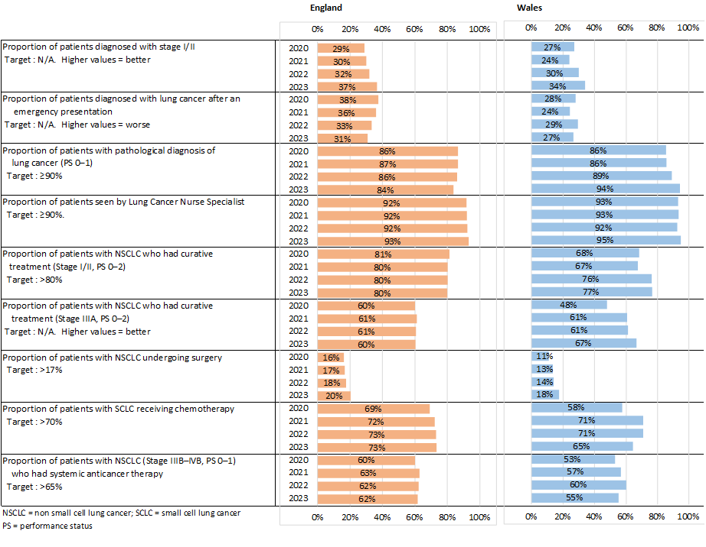
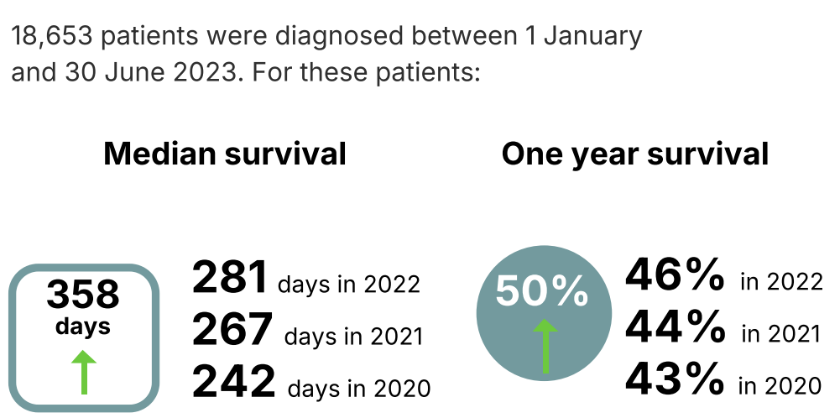
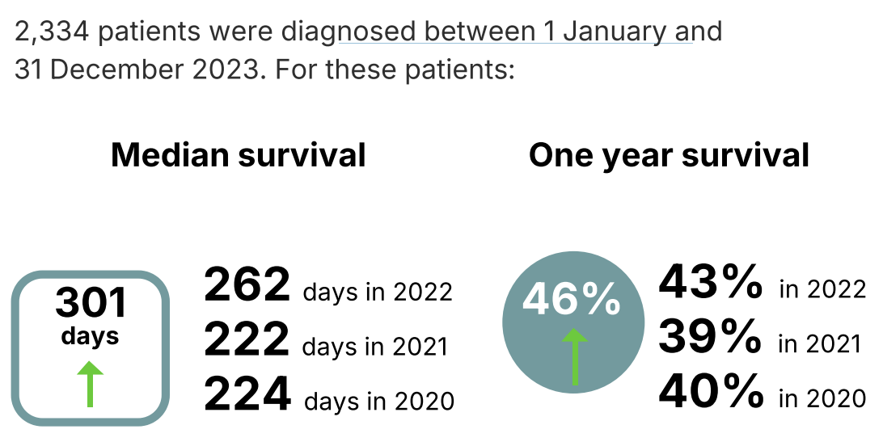
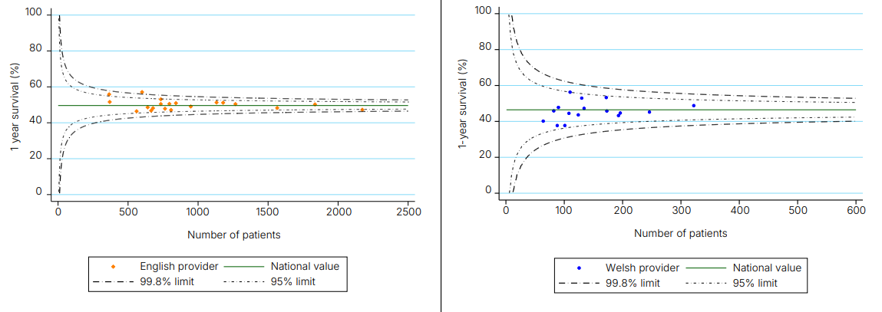
Impact of the NLCA 2024-2025
NLCA Quality Improvement goals:
Improve early diagnosis of lung cancer
Increase the proportion of patients who receive treatment with curative intent
Increase the proportion of people with lung cancer receiving Systemic Anti-Cancer Therapy (SACT) and reduce unwarranted variation in access to SACT
Improve the quality of the patient pathway
Improve and reduce variation in lung cancer outcomes
Improvement goal 1: proportion of patients diagnosed with Stage 1 or 2 (aiming to increase)
Improvement goal 2: proportion of patients with non-small cell lung cancer (stage 1 or 2, PS 0-1) who had curative-intent treatment (Target≥80%)
Improvement goal 2: proportion of patients with non-small cell lung cancer who had surgery (Target≥17%)
Improvement goal 3: proportion of patients with non-small cell lung cancer (stage 3B-4, PS 0-1) who had systemic anti-cancer therapy (Target≥65%)
Improvement goal 4: proportion of patients seen by a lung cancer nurse specialist (Target≥90%)
Improvement goal 4: proportion of patients diagnosed after emergency presentation (aiming to decrease)
Improvement goal 5: Median and one-year survival (aiming to increase)
No negative outliers for survival in England or Wales in 2023
50%
in 2023
46%
in 2023
in 2023
in 2023
NLCA referenced in the Quality and Innovation (CQUIN) for lung cancer
Annual NLCA – BTOG Webinar to share findings, over 500 downloads of 2024’s podcast of the webinar
Quality Improvement tools available on NLCA website
NICE guidelines and recommendation underpinned by NLCA findings
NLCA work closely with UK Lung Cancer Coalition and publish an annual blog post
NLCA Patient and Public Forum with Roy Castle Lung Cancer Foundation ensures patients are at the centre of the audit
Plenary presentations of NLCA key findings at BTS Winter Meeting 2024, BTOG Conference 2025 & SCTS Annual Meeting 2025
Patient resources, including a ‘questions to ask healthcare professionals’ leaflet on NLCA website
Patient and Public Version of the State of the Nation 2025 Report
NCLA results fed back to Care Quality Commission (CQC) and Welsh government
Presentation from NLCA at L-QI-CAN 2025 to show how NLCA can aid local QI

