Slide 1
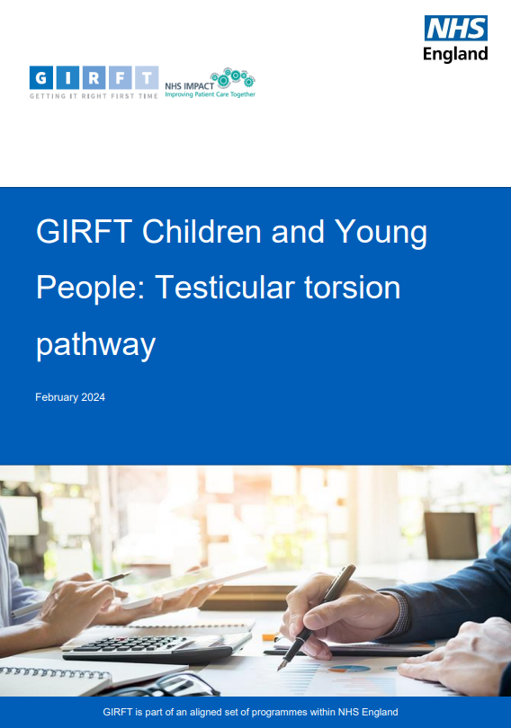

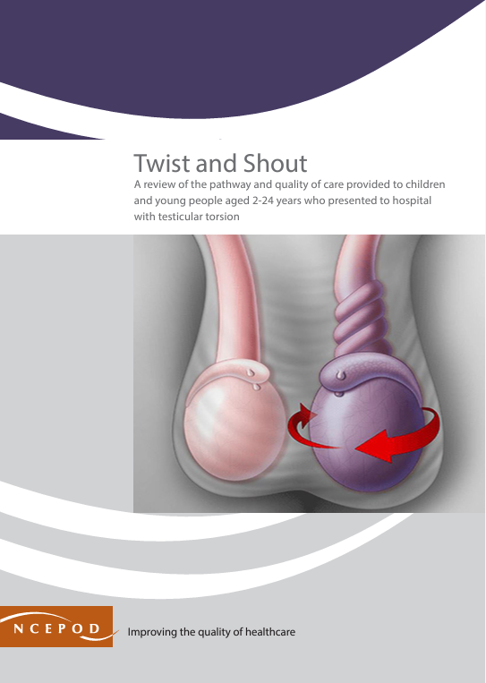


THE CHILD HEALTH CLINICAL OUTCOME REVIEW PROGRAMME
IMPACT – TESTICULAR TORSION – ‘TWIST AND SHOUT’
Published in February 2024 - this report explored the quality of the emergency surgery pathway for patients arriving at hospital with a suspected testicular torsion.
LOCAL IMPACT – SERVICE DELIVERY
One trust added links to their ‘your baby’ page on their website.
Another has used the report to aid engagement with school networks and headteachers via children and young people (CYP) transformation boards to promote collaboration and information sharing.
An operational delivery network has used the report to develop a regional best practice document for testicular torsion.
A local and regional pathway has been developed for the care of CYP with a painful acute scrotum.
The report contributed to the case for urology to take suspected torsion cases directly, rather than the general surgery team.
A nurse specialist has been recruited in one trust to do the follow-up appointments and ask if everything is alright with the testis. This was reported to be ‘really quick’ streamlining the discharge pathway.
KEY MESSAGES
Increase public awareness about the signs and symptoms of testicular torsion.
Ensure emergency pathways minimise the need for transfers by diverting patients to a hospital where surgery can take place.
Ensure there is urgent senior review at arrival, decision-making is prompt, and the patient received a timely operation.
Extended patient-initiated follow-up following surgery, allowing the patient to seek help when they feel ready.
LOCAL IMPACT – EXAMPLES OF QUALITY IMPROVEMENT
The report has been used to implement a local guideline for torsion
Patients having orchidectomy are being discussed as part of a mortality and morbidity meeting
Initiation of a regional trainee-led audit of the pathway of care to identify delays
NATIONAL IMPACT
GIRFT Children and Young People. 2024. Testicular torsion pathway
PUBLIC IMPACT
A blog post was updated
Don’t Forget the Bubbles
CONFERENCE PRESENTATIONS
Royal College of Paediatrics and Child Health annual conference
South West Surgery in Children ODN meeting
British Society of Urological Surgeons annual scientific meeting
Royal College of Emergency Medicine annual scientific conference
British Association of Paediatric Urologists annual congress
Royal Society of Medicine Section of Urology meeting
PUBLISHED ARTICLES
The Urology Foundation. 2024
Surgeons’ News. 2024. Quality of Care
BMJ Best Practice. Updated 2025. Testicular Torsion
Stuart-Delavaine C & Willis K. 2025. Management of suspected testicular torsion – audit of current practice. British Journal of Surgery, 112(Suppl. 1)
HISTORY OF THE CHILD HEALTH PROGRAMME
Uses patient/parent/carer focus groups and surveys, clinician and organisational questionnaires, and a deep dive into the case notes to review the quality of healthcare provided to children, young people and young adults aged 0-25 years.
Published reports on:
chronic neurodisability | mental health | long-term ventilation | transition to adult services | testicular torsion juvenile idiopathic arthritis
Improving the quality of healthcare
www.ncepod.org.uk

