Slide 1


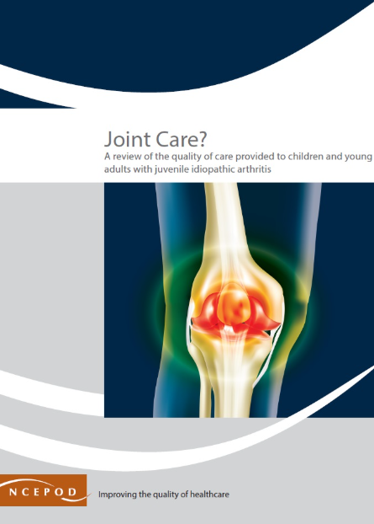

NATIONAL
Evidence of quality and outcomes of care nationally
LOCAL
How the project stimulates quality improvement
Impact of the Child Health Clinical Outcome Review Programme
In response to ‘Joint Care’, the British Society of Rheumatology said:
"This report comes at a great time for advancements in paediatric and adolescent rheumatology. There is exciting national work through the Getting it Right First Time Programme and a new treatment pathway in development for JIA. At BSR, we are delighted to have given the go ahead for the development of a JIA guideline that will address the needs of children, adolescents and adults with JIA".
The stakeholder meeting for ‘Twist and Shout’ highlighted the following improvements:
One trust added links to their ‘your baby’ page on their website.
Another has used the report to aid engagement with school networks and headteachers via children and young people (CYP) transformation boards to promote collaboration and information sharing.
A local and regional pathway has been developed for the care of CYP with a painful acute scrotum.
The report contributed to the case for urology to take suspected torsion cases directly, rather than the general surgery team.
A nurse specialist has been recruited in one trust to do the follow-up appointments and ask if everything is alright with the testis. This was reported to be ‘really quick’ streamlining the discharge pathway.
The report has been used to implement a local guideline for testicular torsion.
Patients having orchidectomy are now being discussed as part of a mortality and morbidity meeting in one hospital.
Initiation of a regional trainee-led audit of the pathway of care to identify delays has occurred in another trust.
‘The Inbetweeners’ continues to be presented at recent events:
Midlands transition meeting
Ready Steady Go study Day
Somerset NHS Foundation Trust
MP Sharon Hodgson asked the SoS for Health and Social Care to take steps to implement the‘Joint Care’ recommendations.
‘Joint Care’ has been presented at
British Society of Rheumatology annual conference
Royal College of Paediatrics and Child Health annual conference
British Society for Children's Orthopaedic Surgery
The Royal College of Ophthalmologists responded to ‘Joint Care’, as did the National Rheumatoid Arthritis Society.
“Without NCEPOD, patients would still be undergoing non-life threatening surgical procedures throughout the night with its inherent increased associated morbidity, mortality, surgeon burn out and second victim syndrome, all of which are detrimental to patient care and the surgical workforce. In addition to its significant pan-specialty impact, NCEPOD also delivers at a specialty level with the recent report into the pathway and quality of care of testicular torsion ‘Twist and Shout’ published in 2024 serving as the gold standard document across the profession and beyond.”
President, British Association of Urological Surgeons 2025
The Royal Free NHS Foundation Trust is recruiting a Mental Health Champion to work in an acute paediatric setting and mentions NCEPOD as a long-time advocate for such a role.
SYSTEM
Supporting policy development & system management
According to The Yorkshire Post, Sheffield Children's Hospital have mentioned NCEPOD in their quality accounts report stating they use our grading to identify and describe elements for improvement within their care of patients.
PUBLIC
How the project is used by the public and the demand for it
The findings of ‘Joint Care’ have been embedded into the paediatric rheumatology Getting It Right First Time programme.
The stakeholder meeting for ‘Twist and Shout’ highlighted that operational delivery networks and paediatric networks are using the report to develop regional best practice documents for testicular torsion.
South Thames Paediatric Network – Acute Scrotum Management
South Yorkshire – Healthier Together
East of England ODN Regional Guideline – Children Presenting with Acute Scrotum
A blog post relating to ‘Twist and Shout’ was created and updated information for patients on testicular torsion.
The recently published Patient Safety Healthcare Inequalities Reduction Framework has referenced the ‘The Inbetweeners’ as part of the implementation for enabling smoother transitions of care.
We held a public webinar for ‘Joint Care’.
Versus Arthritis responded to our ‘Joint Care’ report.
The paediatric critical care network held a session on ‘Balancing the Pressures’ at the national paediatric long-term ventilation collaborative conference.
We have an active social media presence on X, Bluesky, YouTube, Facebook and LinkedIn.
NCEPOD continues to recruit to a panel of lay representatives to support our entire work programme.
Impact examples from 09/2024 to 08/2025. Impact report produced 08/2025.

