Slide 1
Clinical Audit Awareness Week 2025 Webinar and Q&A: Clinical Audit Heroes Awards 2025 Commendations Winners presentation
In collaboration with
Friday 6 June 2025, 10.00am -11.00am
This event will start at 10.00am
Chris Gush CEO, HQIP
Rachael Sample Associate Director for Quality and Development National Clinical Audit and Patient Outcomes Programme (NCAPOP), HQIP
June 2025 (#CAAW25)
Notes:
Drew: Show slides before event begins so early joiners can see ‘event will start at 12.30’

Slide 2
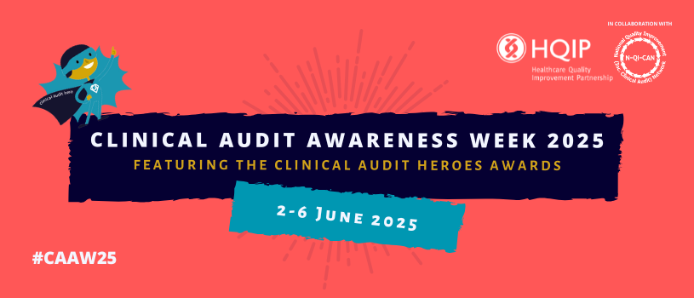
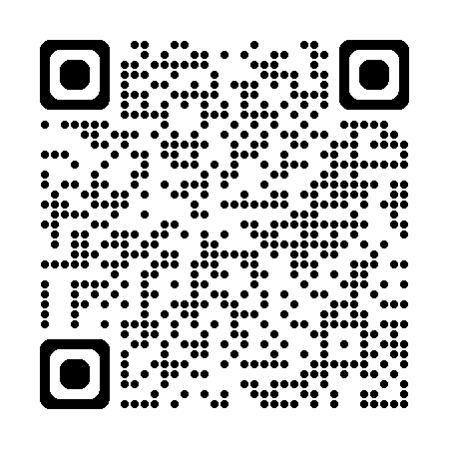
Welcome & introduction
Welcome to Clinical Audit Awareness Week 2025 (2-6 June 2025)
More info: www.hqip.org.uk/clinical-audit-awareness-week
Introduction to today’s topic
Clinical Audit Awareness Week 2025 (#CAAW25)
In collaboration with

Slide 3
Healthcare Quality Improvement Partnership (HQIP)
Rachael Sample
Associate Director, National Clinical Audit and Patient Outcomes Programme (NCAPOP)
HQIP
Name, Title
Clinical Audit Awareness Week 2025 (#CAAW25)
In collaboration with

Slide 4
Healthcare Quality Improvement Partnership (HQIP)
Chris Gush
CEO
HQIP
Name, Title
Clinical Audit Awareness Week 2025 (#CAAW25)
In collaboration with

Slide 5
IN COLLABORATION WITH
#CAAW25
Our Clinical Audit Heroes Awards 2025
NCAPOP Commendation
Runner-up & Winner…

Slide 6
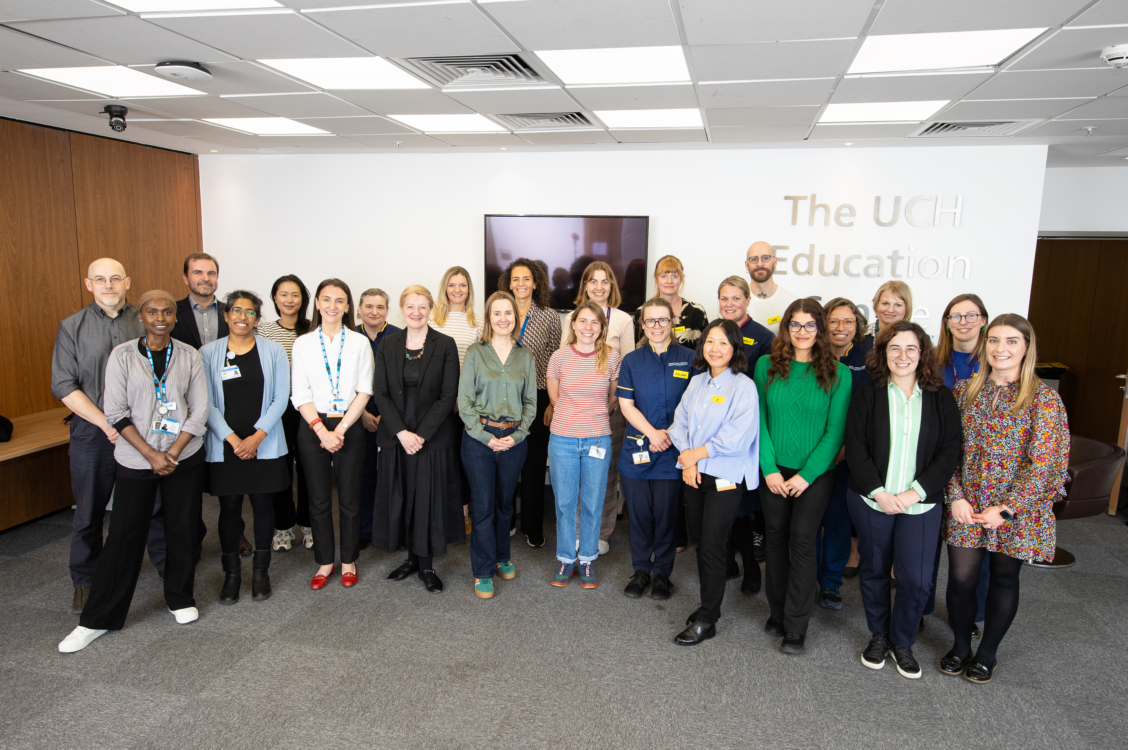
NCAPOP Commendation
Runner-up
Transforming End of Life Care Team
University College London Hospital
Project: University College London Hospital Transforming End of Life Care Quality Improvement Project
Notes:
Judges' comments:
This project was an important clinical area showing good improvement and we were glad to see the co-production. It is a very useful and simple tool. We liked the sharing of resources for vulnerable patients and the increase in coping strategies.

Slide 7
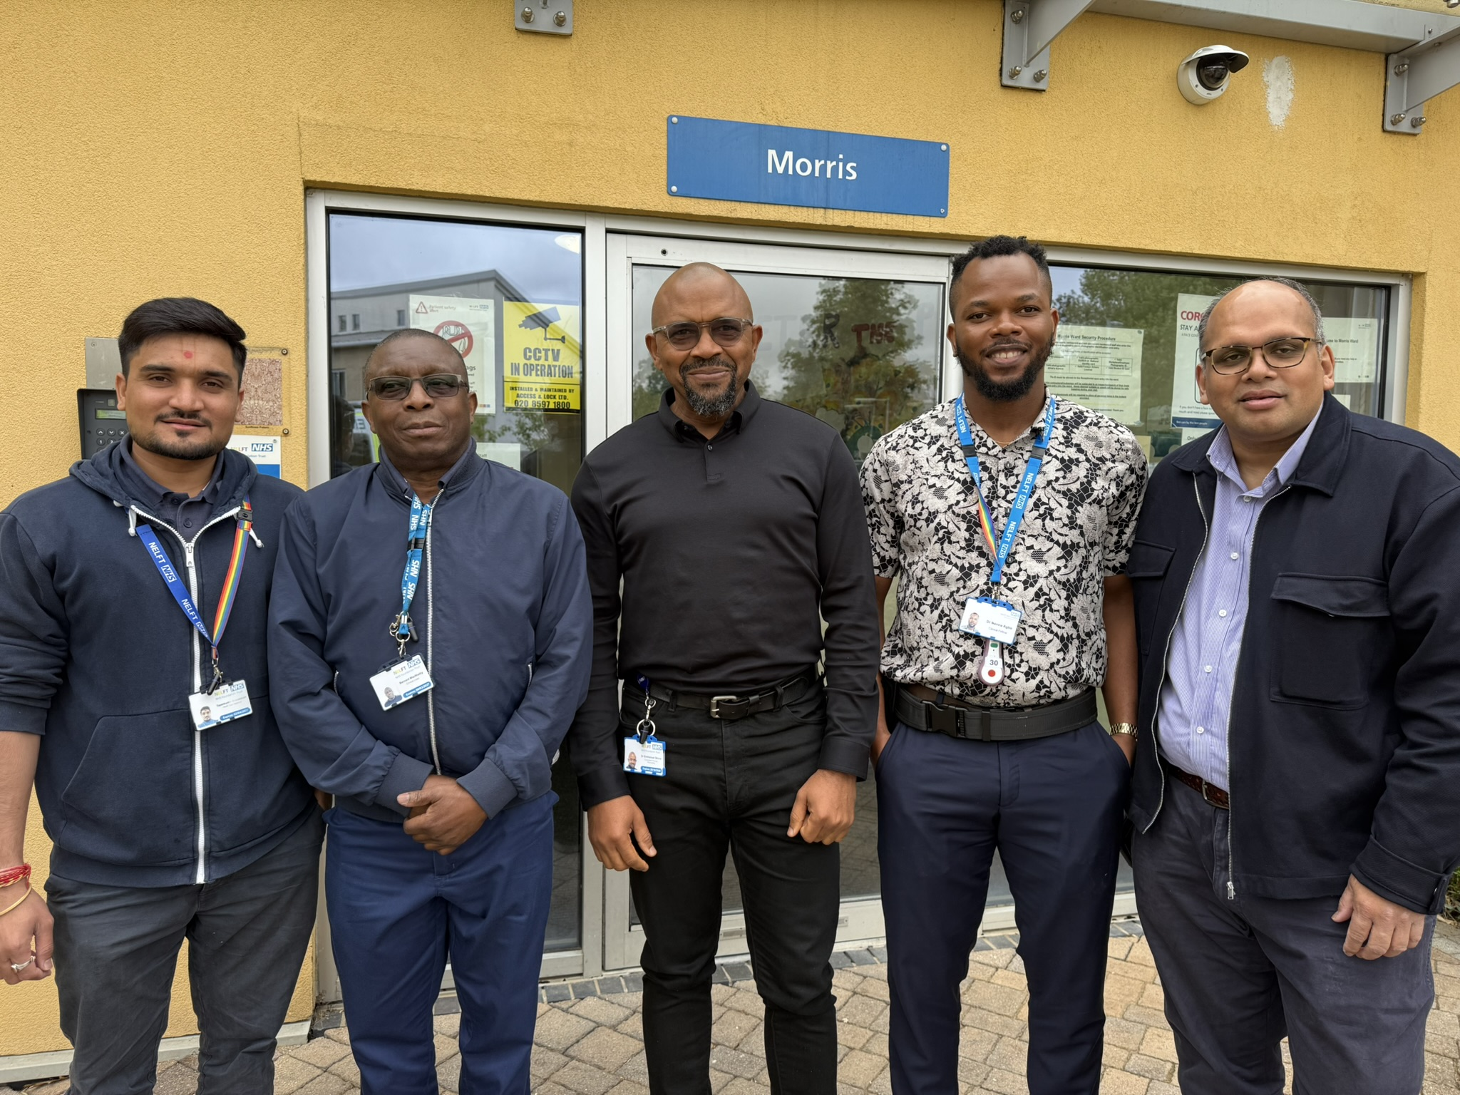
NCAPOP Commendation
Winner
Dr Emmanuel Okoro, Dr. Mamun Rahman, Dr Ikenna Agbo, Bernard MacMaddy & Tapankumar Brahmbhatt
Morris Ward, Goodmayse Hospital
North East London NHS Foundation Trust
Project: Improving Physical Healthcare Audit (Morris Ward Low Secure Forensic Unit, Improving Physical Health SDIP)
Over to Dr Emmanuel Okoro &
Dr Ikenna Agbo
Notes:
Judges' comments:
This project was an important clinical area showing good improvement and we were glad to see the co-production. It is a very useful and simple tool. We liked the sharing of resources for vulnerable patients and the increase in coping strategies.

Slide 8
Audit Title: Physical Health Care On Long-Stay MH Ward
(NELFT Low Secure Forensic Unit, Physical Health SDIP, June 2024)
Team Members
Project Lead : Dr. Emmanuel Okoro (Consultant Forensic Psychiatrist
Project Supervisor: Dr. Mamun Rahman (Specialty Doctor)
Data Analysis & Report Writing: Dr. Ikenna Agbo (Clinical Fellow)
Data Collection: Bernard MacMaddy (Nurse clinical lead)
& Tapankumar Brahmbhatt (Health Care Assistant)

Slide 9
Rationale & Background
Addressing Parity of Esteem in National Clinical Audit
“People with severe mental illness (SMI) are at increased risk of poor physical health, and their life-expectancy is reduced by an average of 15–20 years mainly due to preventable physical illness. Two thirds of these deaths are from avoidable physical illnesses including heart disease and cancer, mainly caused by smoking.
Less than a third of people with schizophrenia in hospital receive the recommended assessment of cardiovascular risk in the previous 12 months. People with SMI are three times more likely to attend A&E with an urgent physical health need and almost five times more likely to be admitted as an emergency”
- (HQIP, 2017)
Increased Health Risks in People with SMI:
🔻Reduced activity: due to medication side effects / low motivation / self-neglect
🚬 Smoking: Leading cause of preventable death
⚠️ chronic conditions:
2x risk – Obesity & Diabetes
3x risk – Hypertension & Metabolic Syndrome
5x risk – Dyslipidaemia

Slide 10
Introduction
Morris Ward: 15 bed, adult male forensic LSU, for people with SMI & significant risks.
LOS: 18 - 24 months. Recovery-based holistic Care & Rehabilitation Programme.
Membership:
North London Forensic Collaborative (NLFC)
Forensic Mental Health Quality Network (FMHQN)
🏆 Achievements:
Ranked 1st in FMHQN National Standards Met (2019)
🟡Outstanding in Caring & Responsive domains.
Challenges:
GP-led annual health checks & national health screening.
Lack of Podiatry / Dietician / Diabetic Nurse.
💡 Actions Taken:
✅ Business case for enhanced physical healthcare was approved by NLFC Central Hub.
📊 Baseline audit completed prior to the physical health SDIP.

Slide 11
Project Aim & Objectives
Aim:
To assess physical healthcare metrics of patients on Morris Ward (LSU) against NICE guidelines on physical health care for people with SMI.
Objectives:
Review NICE recommendations for physical healthcare in individuals with SMI.
Identify NICE physical health standards for audit: BMI, CVD Risk Assessment, Smoking , Substance Misuse, National Screening.
Data collection & analysis of patients’ physical health indicators from EPR.
Benchmark the data against identified NICE standards to highlight gaps.
Identify gaps in physical healthcare access, experience & outcomes.
Make recommendations for improvement and to inform future SDIPs.
Drive change using QI methodology

Slide 12
Standards/Data/Results
NICE guidelines | Target | Compliance Result | Comments (Sample size = 15)
Body Mass Index monitoring [NG181] 1.7.3 Recommends that initial assessments should include BMI. | 100% | Met | 40%, (6 pts) BMI = 18.5 – 24.9 kg/m² (normal) 26.7% (4 pts) BMI = > 25 kg/m² ( over wt.) 33.4% (5 pts) BMIs >30 kg/m² (obese)
[NG181] 1.10.15.services should offer annual physical health checks, including BMI . | 100% | Met
Cardiovascular Disease (CVD) risk assessments. [NG238] 1.1.7 Use the QRISK3 tool to calculate the estimated CVD risk within the next 10 years for people aged between 25 and 84 without CVD. | 100% | Met | CVD risk assessments completed for all patients
Smoking cessation [CG178] 1.1.3.3 Offer people with psychosis or schizophrenia who smoke help to stop smoking, even if previous attempts have been unsuccessful. | 100% | Met | No change in smoking status for most smokers, despite interventions.
[CG178] 1.1.3.5 For people in inpatient settings who do not want to stop smoking, offer nicotine replacement therapy to help them to reduce or temporarily stop smoking. | 100% | Met
Substance Misuse [NG58] 1.1.1 Identify and provide support to people with coexisting severe mental illness and substance misuse | 100% | Met | 46.5% completed, 46.5% actively participating, and 7% offered but yet to commence.
National Screening [NG181] 1.10.5 A nominated professional should work in collaboration with a healthcare professional to offer routine screening through the national screening programmes, if the person is eligible. | 100% | Met | All eligible patients were offered screenings . 100% of diabetics had retinal screening done 60% dental checks 73% optician screening

Slide 13
 | Recommendations /Actions | Status
1 | Employ an Activity Coordinator & extend physical health activities to weekends. | Done
2 | Establish a medical post with a focus on physical health: to improve early detection, liaison with GPs and referral to relevant acute hospital specialists for the management of complex physical health conditions. | Done
3 | Align BMI monitoring with co-produced individualised activity schedule (Activity Coordinator, OT & Nurses) & reflect in care plans. | Done
4 | Increase the uptake of national screening through collaboration with GPs & NHSE regional screening hubs | Done
5 | Ensure co-produced specific care plans for identified chronic physical health conditions - (e.g. dietary & physical activities) | Done
6 | Enhance smoking cessation interventions through collaboration with Trust’s Tobacco Cessation Lead, based on Service user's feedback. | On-going
7 | Re-Audit in 1 Year & include qualitative data collection to highlight service user experience | Pending

Slide 15
Early Indications Of Impact
Patients:
Improved weight & diabetic management
Extended physical activity programme to include weekends
Improved smoking cessation options / education (Visible lead)
Improved access to national health screenings.
Staff:
Clearer guidelines on physical health care planning & management
Improved support from specialist services.
Trust:
Strengthened adherence to NICE guidelines
Enhanced reputation for holistic care and improved patient outcomes
Demonstrates commitment to continual Quality Improvement.
Next Steps
Co-produced QI project on weight management & healthy lifestyle
Reaudit Aug. 2025 & include qualitative data on patient experience.

Slide 16
SO WHAT ? - Key Message
Improves long-term physical health outcomes for people with SMI.

Slide 17
Thanks!
Questions

Slide 18
IN COLLABORATION WITH
#CAAW25
Our Clinical Audit Heroes Awards 2025
Communicating for Impact Commendation
Runner-up…

Slide 19
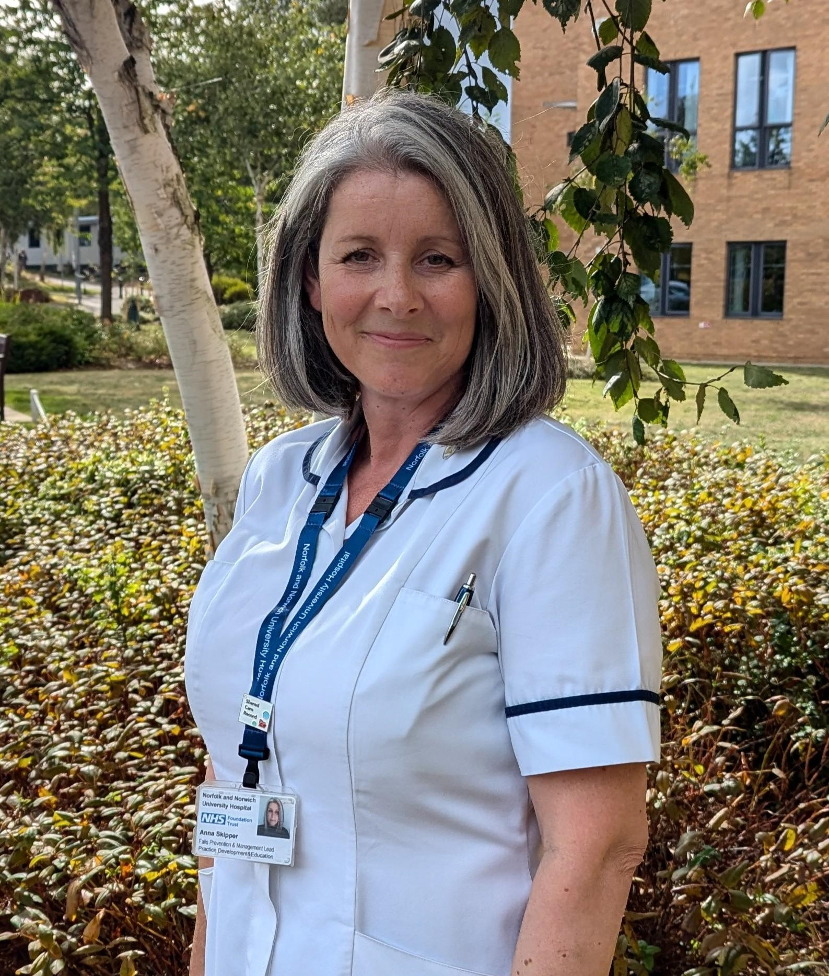
Communicating for Impact Commendation
Runner-up
Anna Skipper, Falls Prevention and Management Lead
Norfolk and Norwich University Hospitals
NHS Foundation Trust
Project: Falls Prevention Improvement Project
Notes:
Judges' comments:
This project was an important clinical area showing good improvement and we were glad to see the co-production. It is a very useful and simple tool. We liked the sharing of resources for vulnerable patients and the increase in coping strategies.

Slide 20
IN COLLABORATION WITH
#CAAW25
Our Clinical Audit Heroes Awards 2025
Communicating for Impact Commendation
Joint Winner #1…

Slide 21
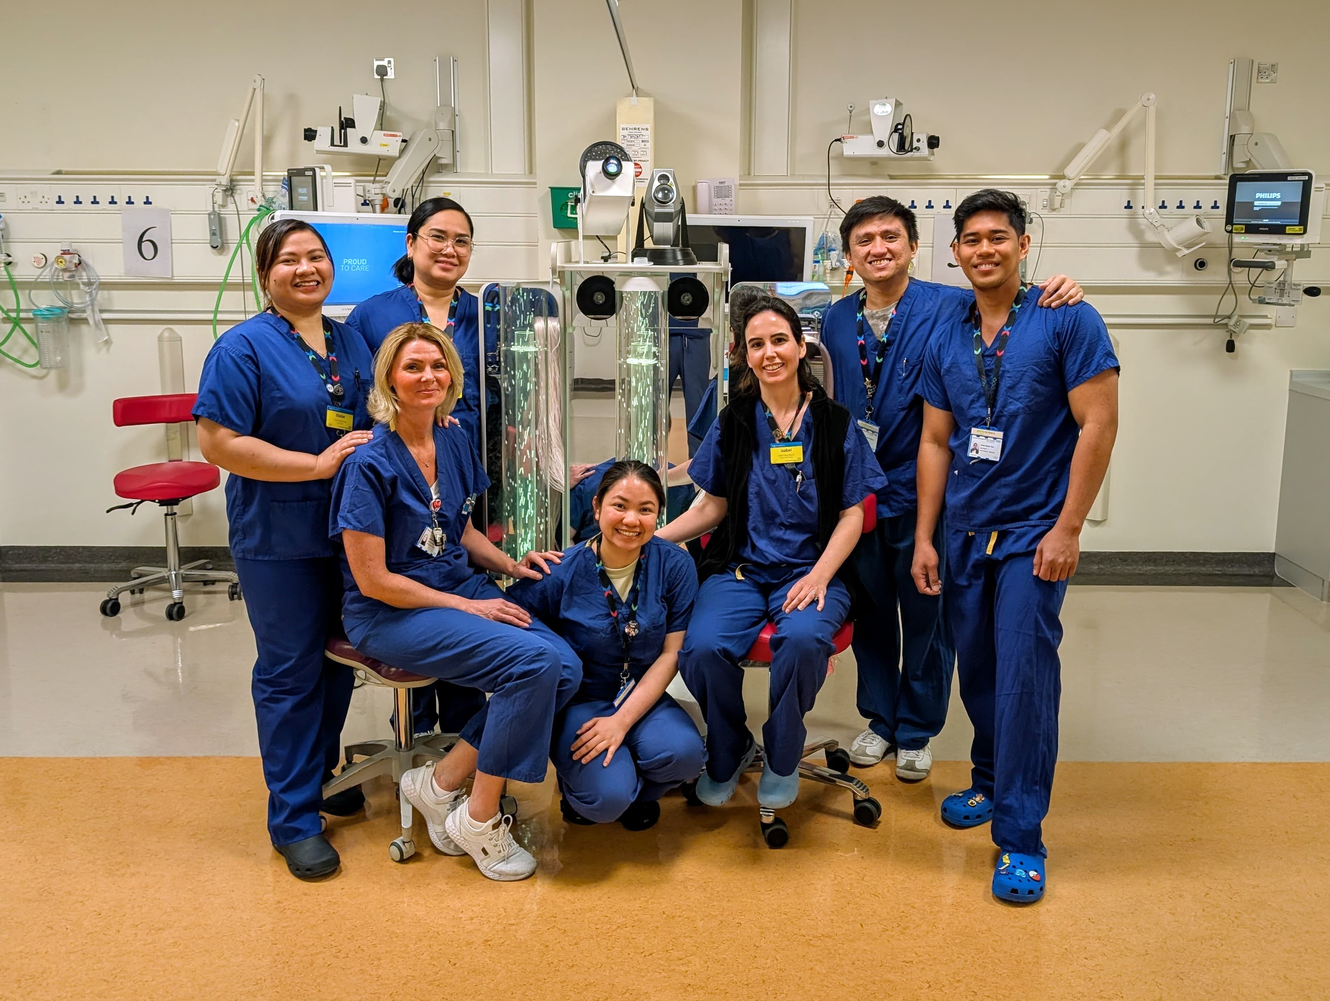
Communicating for Impact Commendation
Joint Winner #1
Isabel Diez-Martin, Peter Brooks, John Paul and Paediatric Recovery Team
Chelsea and Westminster Hospital NHS Foundation Trust NHS
Project: Implementation of the Cornell Assessment for Paediatric Delirium as a Vital Sign in the Paediatric Post-Anaesthetic Care Unit
Over to Isabel Diez-Martin
Notes:
Judges' comments:
This project was an important clinical area showing good improvement and we were glad to see the co-production. It is a very useful and simple tool. We liked the sharing of resources for vulnerable patients and the increase in coping strategies.

Slide 22
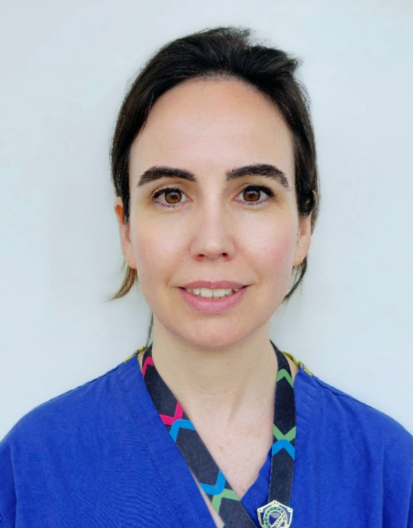
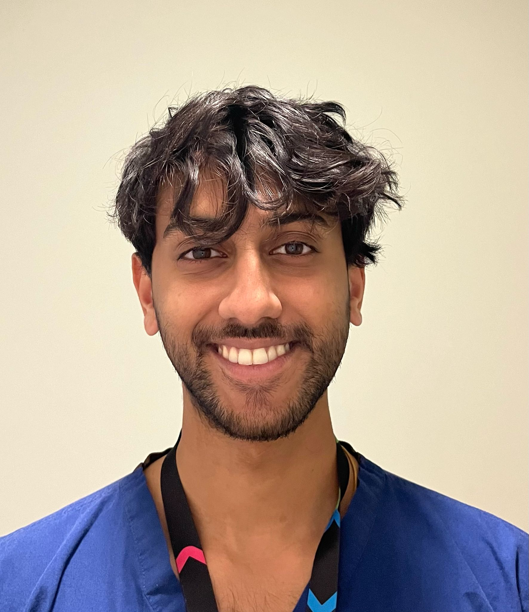
COMMUNICATING THE IMPACT
Implementation of the Cornell Assessment for Paediatric Delirium (CAPD) as a Vital Sign in the Paediatric Post-Anaesthetic Care Unit (PACU)
A Quality Improvement Initiative
6TH June 2025
Isabel Diez-Martin PACU/Recovery Nurse
Dr Peter Brooks
Paediatric Anaesthetist
John Paul
iBSc Medical Student
Anaesthesia & Critical Care

Slide 23
Background
10–30% of children experience Emergence Delirium (ED) post-anaesthesia.
Often underdiagnosed without routine screening.
Only 10% of nurses documented ED
No standardised screening tool was integrated into the electronic medical record (EMR)
Staff reported a moderate-to-high impact of ED on patients, families, and hospital resources
Problem
A March 2024 audit in PACU identified gaps in ED recognition and management
Notes:
What if I could tell you that a common complication that is often underdiagnosed,

Slide 24
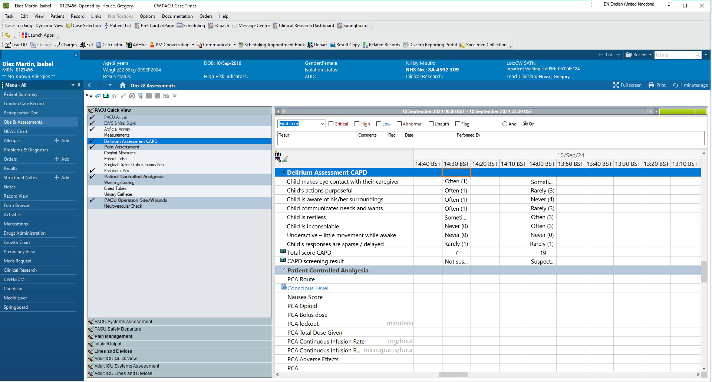
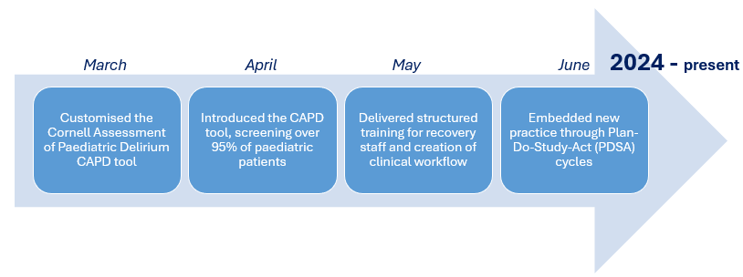
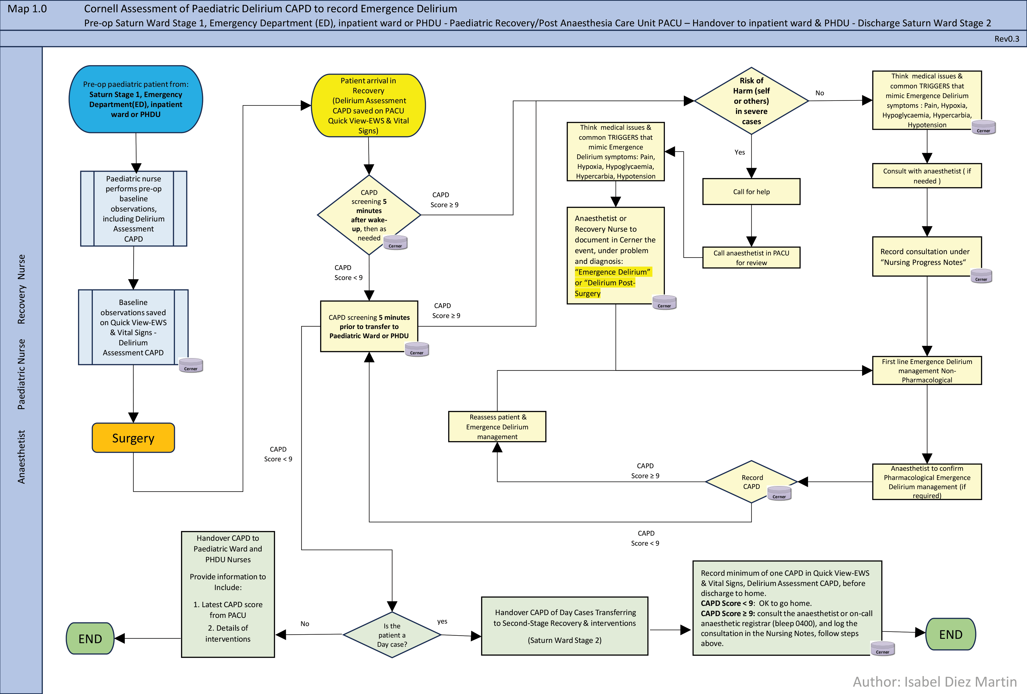
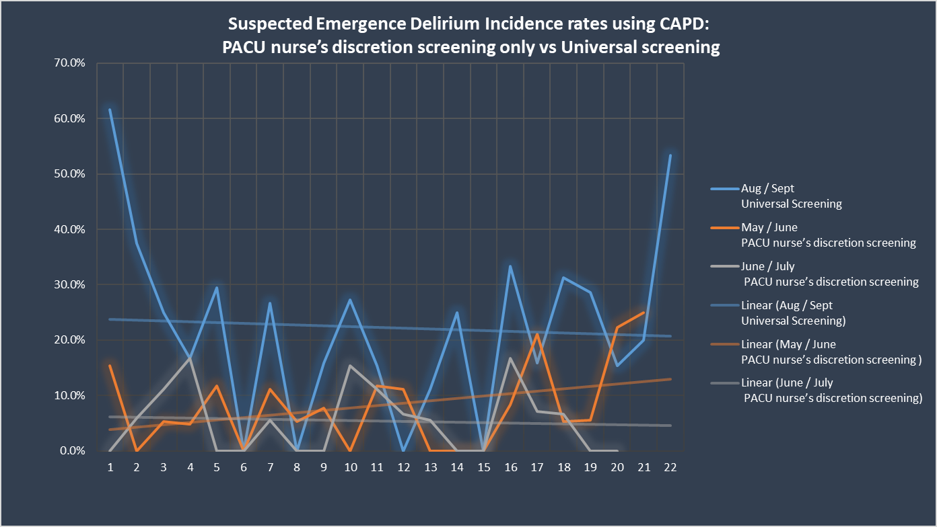
Strategy for Change: “Who we needed to reach” & “Clarity of purpose”
Plan Identify knowledge gaps and train staff on ED recognition and CAPD application.
Plan
Do
Study
Act
Act
Refine processes and
work towards full EMR integration.
Do
Integrate CAPD into PACU workflows.
Study Assess staff confidence and ED documentation rates.

Slide 25
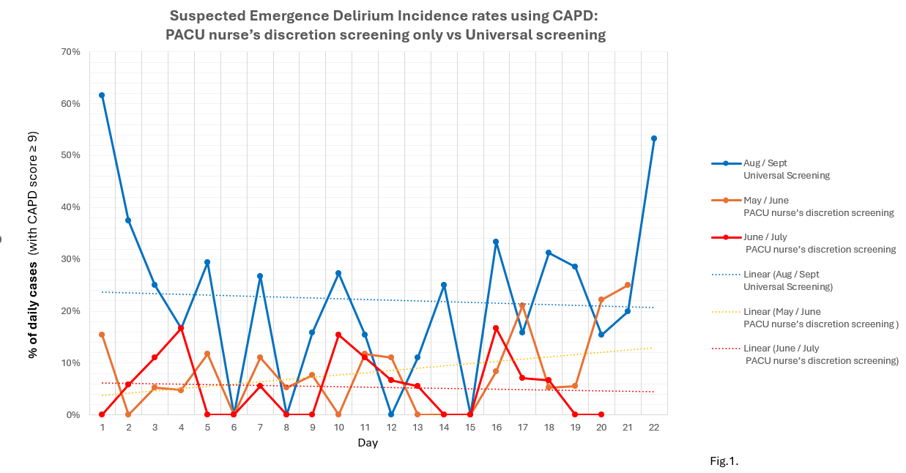
Measure of Improvement
RESULTS
Universal screening and documentation for paediatric ED integrated into workflows
Build infrastructure to collect clean, unbiased, fit-for-purpose data for further research and innovation.
Enable medical staff to identify patients that had ED before and improve follow-up care.
Improve patient safety and staff confidence, work more effectively, contribute to a better surgery pathway.

Slide 26
Lessons learned
Routine CAPD screening improved ED recognition and documentation.
Recognising ED as a “vital sign” and quality indicator, and using a screening tool, are important steps in developing management guidelines and risk prediction models for paediatric ED.
Improved Detection
Staff Confidence
Nurses became more skilled in ED recognition and documentation, though ongoing education is needed
Stakeholder Engagement
Higher ED rates in dental surgery patients suggest the need for targeted interventions
Digital Integration
Training Effectiveness
Data-Driven Insights
Universal screening reduced false negatives
Early staff involvement facilitated adoption
CAPD integration into EMRs will enhance data reliability
Focused education improved staff competence, but ongoing refinement is required

Slide 27
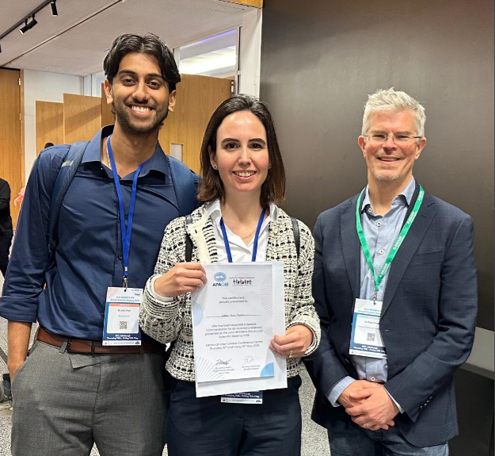
Choose the Right Channels
Beyond our hospital
APAGBI & SPA Annual International Scientific Meeting 2025 15 - 16 May
Award and publication 📄🧠🎖️
Staff training, documentation stations, staff huddles
Formal presentations stakeholders
Participation at Trust events
NIHR Nursing and Midwifery
May 8th Dragon’s Den Birmingham 🏆
35TH ANNUAL BARNA CONFERENCE
Friday April 25th, 2025 London
Speaker 🗣️🎤

Slide 28
Communication didn’t just support change, it enabled it.
Thank you!

Slide 29
IN COLLABORATION WITH
#CAAW25
Our Clinical Audit Heroes Awards 2025
Communicating for Impact Commendation
Joint Winner #2…

Slide 30
Communicating for Impact Commendation
Joint Winner #2
National Audit of Care at the End of Life
NACEL team
Project: Jessica Moss, NACEL team
Over to Joylin Brockett
Notes:
Judges' comments:
This project was an important clinical area showing good improvement and we were glad to see the co-production. It is a very useful and simple tool. We liked the sharing of resources for vulnerable patients and the increase in coping strategies.

Slide 31
National Audit of Care at the End of Life (NACEL) Communicating impact
Joylin Brockett,
Senior Project Manager, NHS Benchmarking Network
Notes:
Communicating for Impact Commendation – Recognising excellence in effectively communicating project impact.
How has NACEL effectively communicated its impact

Slide 32
About NACEL
NACEL is a national comparative audit of the quality and outcomes of care experienced by the dying person (18+) and those important to them.
Focuses on the last admission leading to death in a hospital setting only; acute, community and mental health hospitals in England, Wales, Jersey and Northern Ireland.
NHS Benchmarking Network have delivered the audit since 2017, now undertaking the sixth round of data collection (2025).
Commissioned by the Healthcare Quality Improvement Partnership (HQIP) on behalf of NHS England and the Government of Wales and Jersey.
The audit is separately commissioned for Northern Ireland by the Public Health Agency.
Notes:
99% of eligible NHS providers are registered to take part in NACEL 2024
By conducting a national data collection, the audit aims to evaluate care and support quality improvement.

Slide 33
Communicating impact
Communication
Reference Group meetings
Academic publications
Professional presentations
Political agenda
Portal /
Data Tool
Newsletter/ Social media
Community of practice
Notes:
NACEL communications strategy and plan used as a framework to guide activity
Promote audit
Share findings
Share impact
community of practice - in its infancy but semi-established and functiona
Disseminate information to key stakeholders
Steering Group meetings (2-5 times a year)
Advisory Group meetings (2 times a year)
Patient and Public Involvement Group (1-3 times a year)
Catch ups wit the NHSE PEoLC Team & NCD (7 times a year)
ICB Transformational Leader meetings (2 times a year)
Recently joined the Ambitions Partnership (2 times a year)
l

Slide 34
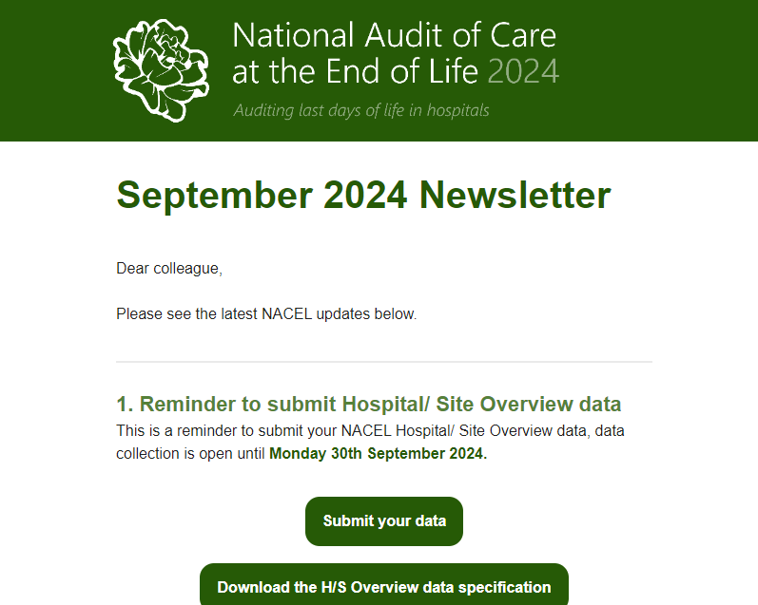
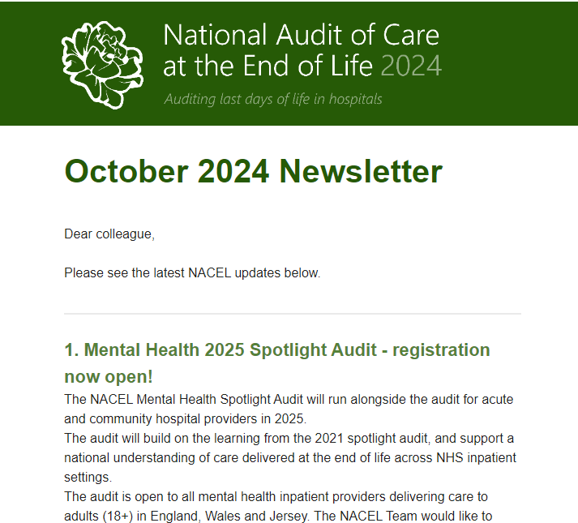
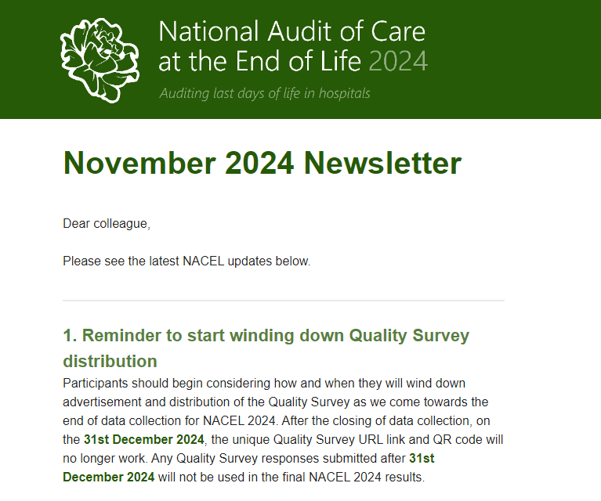
Communicating impact
Newsletter
A monthly newsletter is shared with 700+ health and social care professionals to inform them of the latest updates and news from the audit.
Monthly Mailchimp stats (21.05.25):
Open rates: 30%
Click rate: 8%
Interactive links to navigate to the NACEL portal (including QI and events page), data collection page, the Data and Improvement Tool and more.
Newsletter content is further shared via
Notes:
Sent to people responsible for inputting data to the audit / registered for our output tool

Slide 35
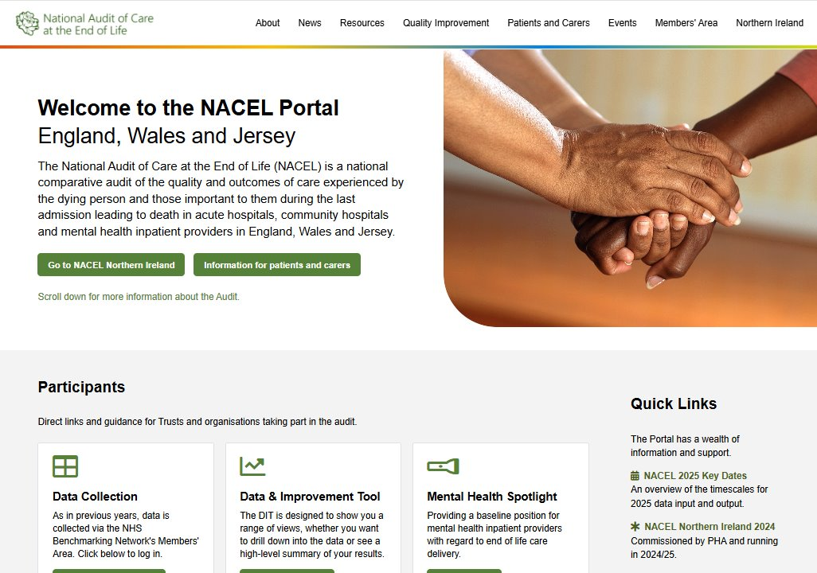
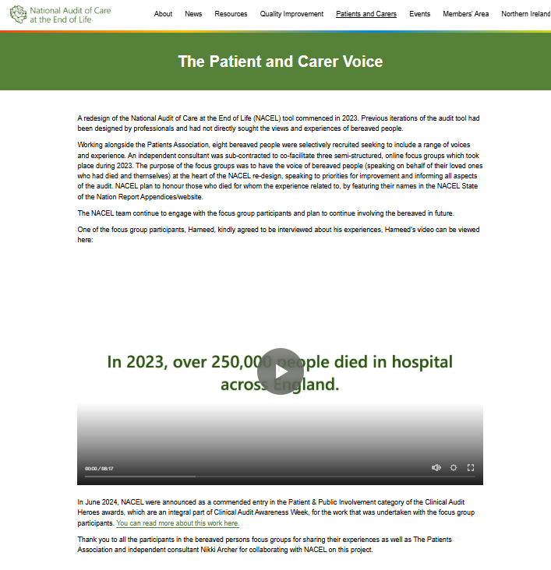
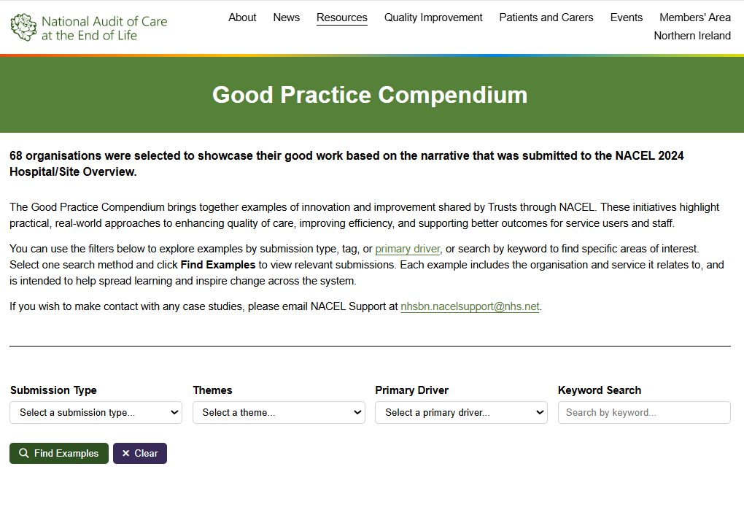
Communicating impact
Portal
The NACEL Portal hosts a dynamic, interactive space to share news, resources and good practice in quality improvement work.
Average of 4k visits a month.
Recently published..
A Good Practice Compendium showcasing 68 examples of good practice in quality improvement work.
Coming soon..
An Audit Impact page to share the 200+ local examples of how participation in NACEL has impacted local end of life care service model.
Notes:
patient and public section sharing the work we have done with them

Slide 36
Communicating impact
Impact of NACEL examples
Norfolk and Norwich University Hospitals NHS Foundation Trust
“NACEL's focus on coordination and communication within multidisciplinary teams has prompted us to enhance how we share information across care settings. Our work on shared care records and the new EPR system stems directly from these findings…”
Manchester University NHS Foundation Trust
“NACEL has given us the opportunity to capture the experience of families and carers more clearly leading to us to expand and develop workstreams to improve their experience.”
Essex Partnership University NHS Foundation Trust
“…Staff confidence increased, more accessible training opportunities.”
Bradford Teaching Hospitals NHS Foundation Trust
“…following 2022 NACEL results a CNS in palliative care with a special interest in South Asian populations and religious needs has been appointed…identifying and meeting the needs of this group, which make up a significant proportion of the demographic the team see.”
Leeds Teaching Hospitals NHS Trust
“Development of action plans in response to NACEL results has led to board level support of changes in service delivery and processes.”
Notes:
Valuable for us to collect data on this before we report it back.

Slide 37
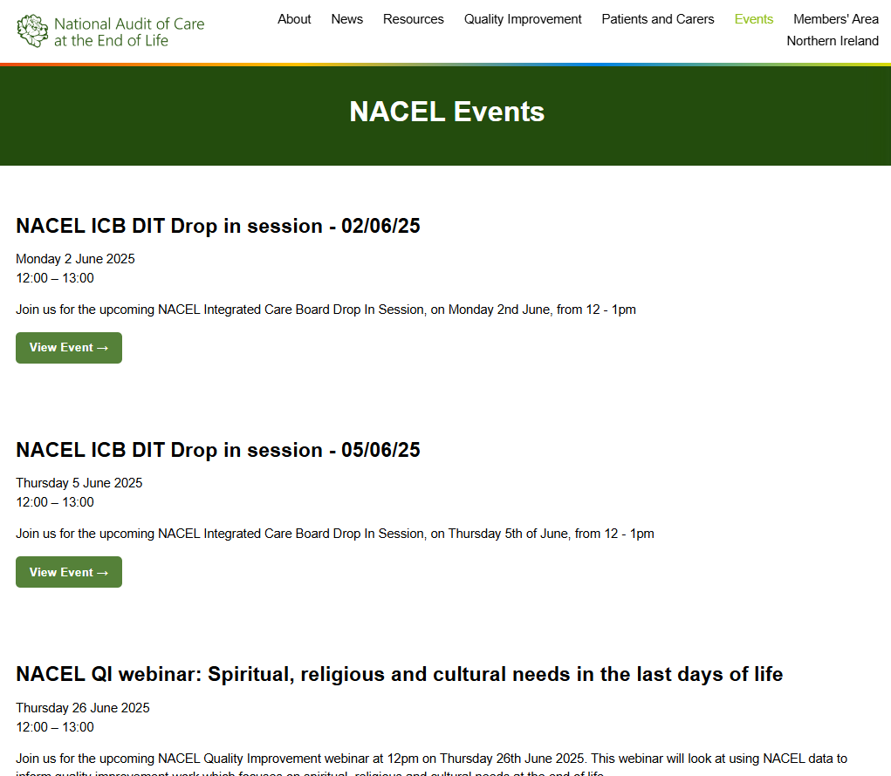
Communicating impact
NACEL presentations
Online events to showcase NACEL programme work and findings:
Drop in sessions (Adhoc)
Quality Improvement Huddles (Twice a year)
Quality Improvement webinars (3 a year)
Certificates issued to those that engage with the QI programme
Notes:
Drop in sessions
170 attendees over 6 sessions
Targeted at different audiences: ICB, audit & clinical colleagues
Demonstration of how to use NACEL outputs
Quality Improvement Huddles
113 attendees at the first session
An informal conversation about a co-designed topic. Co-facilitated.
Targeted at teams least experience with QI work
Quality Improvement webinars. Topics included:
471 attendees to date
An introduction to NACEL QI (89 attendees)
Turning data into improvement (98 attendees)
Recognition of dying (87 attendees)
Hydration (197 attendees)
Demonstrate how to use NACEL to support local QI.
A specific topic of care chosen & invited good practice speakers to share examples of how to incorporate NACEL data.

Slide 38
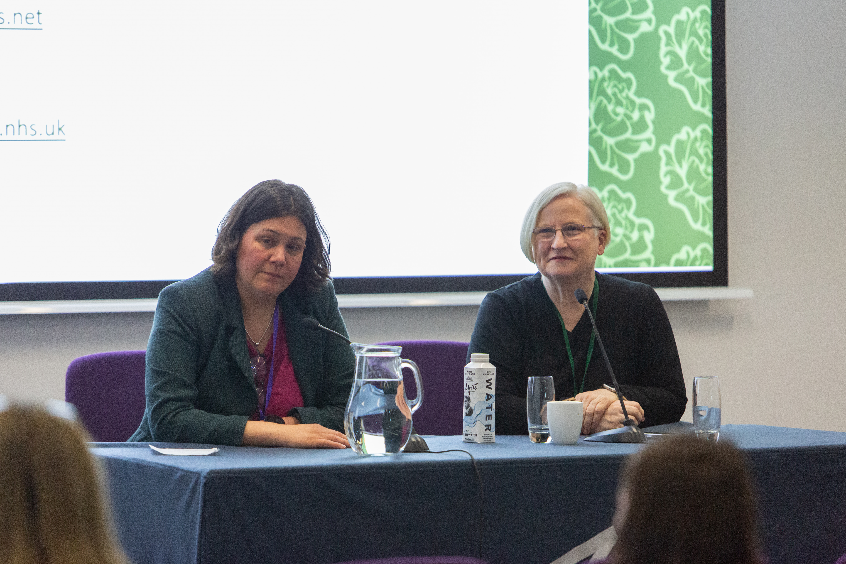
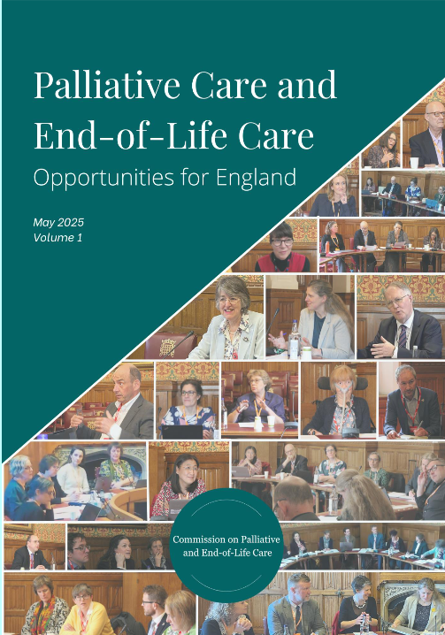
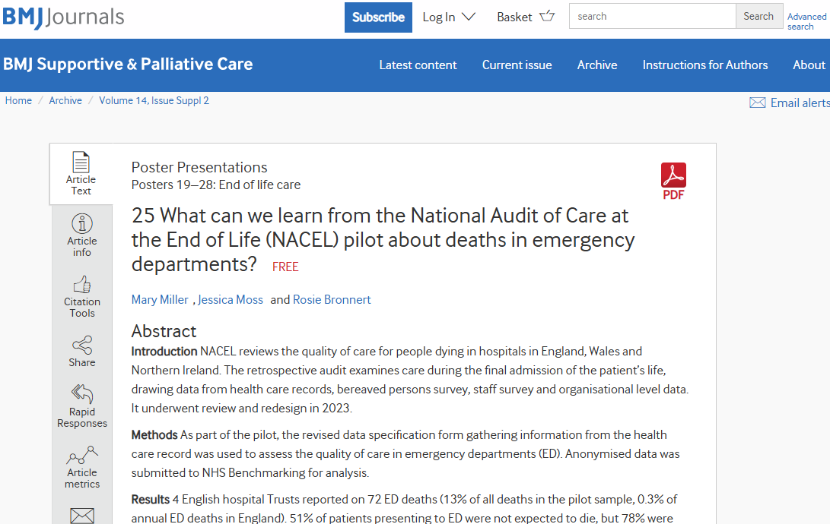
Communicating impact
Professional presentations/academic outputs
Presentations/workshops delivered at external conferences
Publish academic publications
Contribute to other external publications
Notes:
Presentations/workshops delivered at external conferences including:
Community Hospital Association
International collaborative for Best Care for the Dying Person
Ambitions Partnership
Palliative Care Congress
Hospice UK webinar
Submitting evidence to political agenda:
Contributed to the palliative care and end of life care roundtable submission of intent for the 10 Year Health Plan,
Provided data to the Health and Social Care Committee’s Independent Evaluation of Palliative Care in England.
Academic publications since April 2023 – March 2024:
Dying in Hospitals
Pilot of ED deaths
Learning from those at the bedside

Slide 39
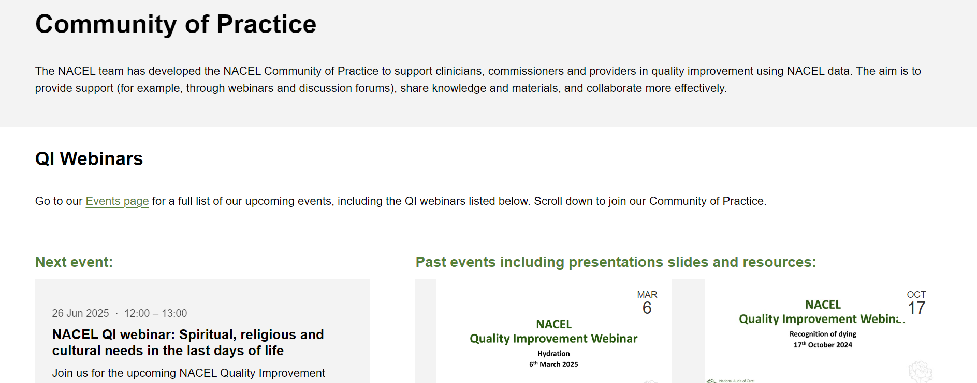
Communicating impact
Community of Practice
NACEL Community of Practice is currently hosted on NACEL Portal
The new platform in development will be with the ‘Q Community’ and will enable focused dynamic discussions, networking and sharing amongst other benefits
Notes:
The new platform is with the ‘Q Community’ and will enable focused dynamic discussions, networking and sharing amongst other benefits.
NACEL hope this innovative approach will help increase reach and impact for NACEL.

Slide 40
Conclusion
ENABLERS
CHALLENGES
Recording how the audit is being used for local purposes
Analysing comms engagement to tailor future communication methods
Using different mediums of communication
Collaboration
Engaged Steering Group/Advisory Group
Communicating to the right audience at the right time
Challenge of overusing emails
Reaching frontline clinicians
Establishing a broad inclusive community of practice
Ensuring NACEL ambassadors remain engaged
Notes:
Tried a range of different mediums, testing out what works best
We seek out opportunities to collaborate. Not always obvious connections – whole team has signed up to various newsletters to understand landscape
Fortunate to have engaged Governance Groups who signpost opportunities to broaden our reach
Dedicated Steering Group Chair has massively helped.
Recognised the power of benchmarking and sharing what others are doing amongst participants.
Highest rated webinars are those with good practice speakers
Share examples of how others are using the audit
Importance in explaining where “audit” sits within the national programme/agenda
Lots of other work going on. Valuable to position the audit

Slide 41
Thank you for listening
You can get in contact with the NACEL team at:
nhsbn.nacelsupport@nhs.net
0161 521 8274
Visit the website at www.nacel.nhs.uk

Slide 42
Q&A
Submit a written question via Q&A

Slide 43
Clinical Audit Awareness Week activities
READ a new Efficiencies case study – available on HQIP’s website now! Optimisation of resident doctor rotas in critical care Epsom and St Helier University Hospitals NHS Trust
Clinical Audit Heroes award winners: www.hqip.org.uk/clinical-audit-heroes-awards-2025
HQIP’s NCAPOP programme: www.hqip.org.uk/national-programmes
Find out more about all Clinical Audit Awareness Week (event recordings, resources, case studies, etc): www.hqip.org.uk/clinical-audit-awareness-week
For those on social media, please share your #CAAW25 updates!
More info from HQIP generally:
Visit the HQIP website: www.hqip.org.uk
Audit reports: www.hqip.org.uk/resources
Support with quality improvement from HQIP: www.hqip.org.uk/services
Sign up to HQIP’s mailing list: www.hqip.org.uk/subscribe-form
You can contact HQIP at communications@hqip.org.uk
Clinical Audit Awareness Week 2025 (#CAAW25)
In collaboration with

Slide 44
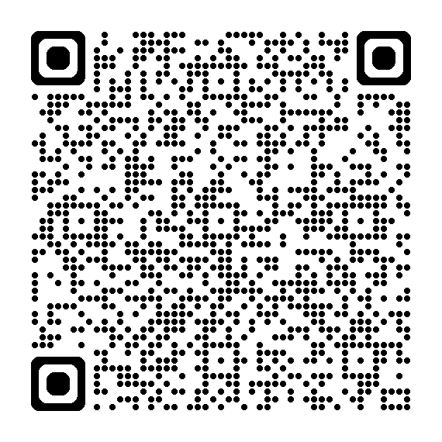
Tell us what you think…
Complete the short form to share your feedback about this #CAAW25 event
www.bit.ly/3S6D7LS

Slide 45
DISCOVER MORE #CAAW25 EVENTS & RESOURCES
In collaboration with
Clinical Audit Awareness Week 2025 (#CAAW25)
Go to www.hqip.org.uk/clinical-audit-awareness-week
Or scan the QR code
Stay in touch:
Sign up to HQIP mailing list: www.hqip.org.uk/subscribe-form/
Follow on X and LinkedIn: @HQIP (use the hashtag #CAAW25)
Share your feedback about CAAW25 www.bit.ly/3S6D7LS
Notes:
Please complete the poll to give your feedback on this event. Link is posted in the chat; it only takes 2 minutes to complete.
IF TIME ONLY – ask Drew for a question or two
We will review the chat for any key questions
If you have queries, email communications@hqip.org.uk
Happy planning and organising CAAW25!

