Slide 1



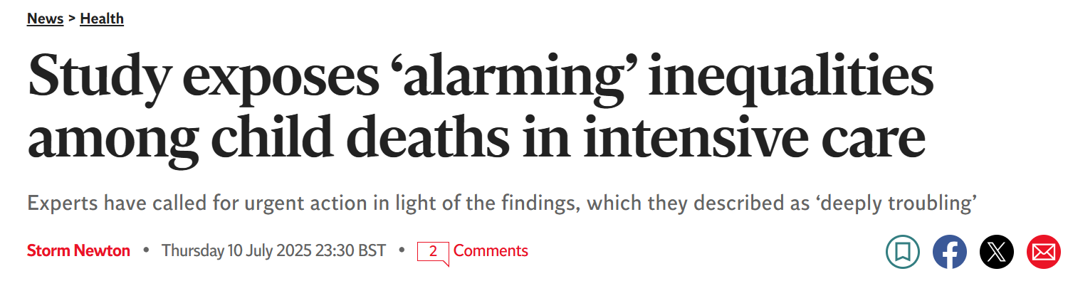









Impact of the Level 3 National Paediatric Critical Care Audit
State of the Nation Report 2024 National Recommendations in-focus
National recommendations made in our State of the Nations Reports support the big questions that many working in paediatric critical care have. Support for and developments related to those in our 2024 Report are described below.
Paediatric Intensive Care Audit Network picanet.org.uk • picanet@leeds.ac.uk
National recommendation 1: Investigate reasons for higher PICU admission rates in children from ethnic minority groups and the most deprived areas of England, Wales and Scotland.
A research study led by Imperial College London, in collaboration with the PICANet team at the Universities of Leeds and Leicester, and others analysed PICANet data for children aged 0–15 years who were admitted to UK PICUs between 01 Jan 2008 and 31 Dec 2021. The study highlights inequalities associated with ethnicity and child poverty for children admitted to intensive care in the UK.
The wider research community, national policy makers and healthcare leads across the UK are signposted to the need for research into the following barriers associated with ethnicity and deprivation to reduce disparities, “[...] access barriers tied to deprivation, marginalisation, immigration, and language, to clearly understand these mechanisms to enable targeted intervention”. Investment into high-quality, accessible early-years care is also noted as being particularly important.
The research was reported on in national news outlets.
Contribution of ethnicity and deprivation to paediatric critical care outcomes in the UK, 2008–21: a national retrospective cohort study
Mitchell, Hannah K et al. The Lancet Child & Adolescent Health, Volume 9, Issue 9, 646 - 654
National recommendation 2: Investigate reasons for the differences in mortality between males and females and how this has changed over time.
National recommendation 3: Monitor changes over time in reasons for admission to PICU and the impact on paediatric critical care services following the planned roll out of the respiratory syncytial virus (RSV) vaccination programme.
PICANet now provide the UK Health Security Agency (UKHSA) with data to support their monitoring of RSV in PICU.
This recommendation has been extended in the State of the Nations Report 2025. We recommend continued monitoring because the maternal RSV vaccination programme is expected to have its full impact on infant critical care admissions in the 2025-26 season. Additionally, NHS England announced that the nirsevimab immunisation will be rolled out to high-risk babies and very preterm infants, potentially impacting on respiratory admissions.
A journal article investigating mortality differences between male and female children admitted to UK PICUs is coming soon.

