Slide 1





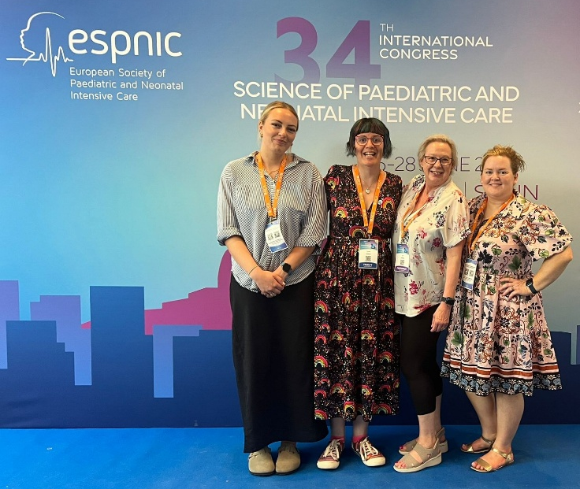







Impact of the Level 3 National Paediatric Critical Care Audit
Paediatric Intensive Care Audit Network picanet.org.uk • picanet@leeds.ac.uk
Impact examples from Dec 2024 to Nov 2025. Impact report produced 21 Nov 2025.
National impact: how the project provides evidence of quality and outcomes of care nationally
Local impact: how the project stimulates quality improvement
In January 2025 PICANet launched a new reporting feature called the Event Summary Viewer. All participating organisations can filter and plot their data by various characteristics and timelines and download data behind the charts to support local audit and quality improvement projects.
We now include a range of interactive charts with each State of the Nations Report which provide a clearer and more user-friendly way to interrogate the data.
PICANet Co-PI Sarah Seaton gave the “Rising Star” lecture at The Neonatal Society’s 2025 Spring Meeting entitled: "The use of national data to inform early life care".
The PICU team at the Royal Hospital for Children and Young People, Edinburgh have shared their successful QI Project example. You can read how they have improved their recording of pupil reaction from around 46% to on average 95%.
HQIP's Caroline Rogers, Associate Director, included PICANet data as an example when speaking at the Institute for Social Value's Annual Conference in October 2025. A panel explored social value in integrated care and tackling health inequalities.
PICANet and the Child Health Outcomes Research at Leeds (CHORAL) research programme are collaborating to link researchers and healthcare professionals and support world class research. CHORAL is a research programme with a vision of a whole system connected approach for better child health outcomes.
We have extended our global reach, with our Clinical Advisor sharing experience of the NPCCA with colleagues at the Indian Academy of Pediatrics during their Annual PICU conference in Hyderabad.
System impact: how the project supports policy development and management of the system
Public impact: how the project is used by the public and the demand for it
Our Clinical Advisor participates in the Modernising Services Framework Sepsis initiative which is co-led by the Chief Scientific Officer for England, working across the health and care system.
The national research programme on end-of-life care for infants, children and young people (ENHANCE), has published a PICANet affiliated paper, Parents’ experiences of the financial and employment impacts of their child receiving end-of-life care: a national qualitative study, which will hopefully raise awareness and lead to more support for these families.
The PICANet team continue to collaborate with NHS England’s Getting It Right First Time (GIRFT) team to address recommendations and develop metrics for future data dashboards which will be used by the paediatric critical care community.
We successfully advertised for more experts by experience, those who have cared for a child whilst they were in paediatric critical care, to join our Steering Group.
In June 2025, we attended the European Society of Paediatric and Neonatal Intensive Care (ESPNIC) conference. An excellent opportunity to hear about new work and build relationships with the wider community. Our Co-PI Sarah attended in her new role as ESPNIC’s Deputy Chair for Research, Ethics and Outcomes.
We have an increasingly active social media presence on Bluesky and LinkedIn where we signpost to recognised paediatric healthcare related awareness days/weeks.

