Slide 1





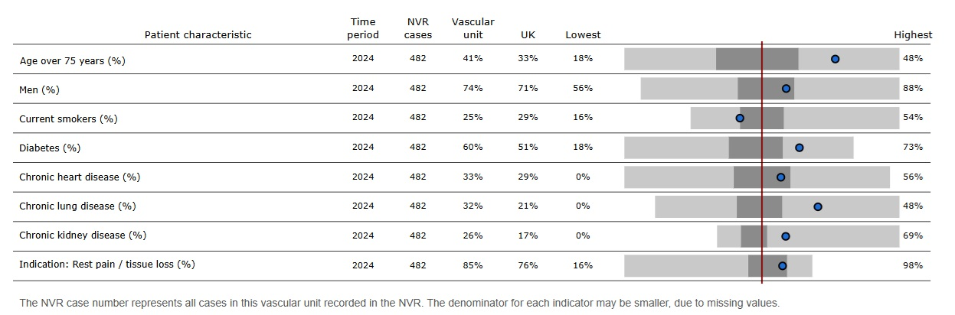
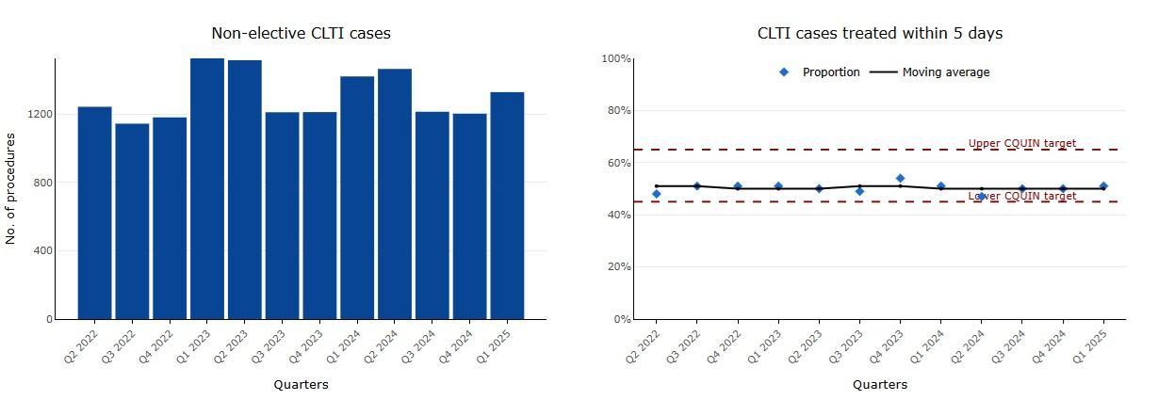
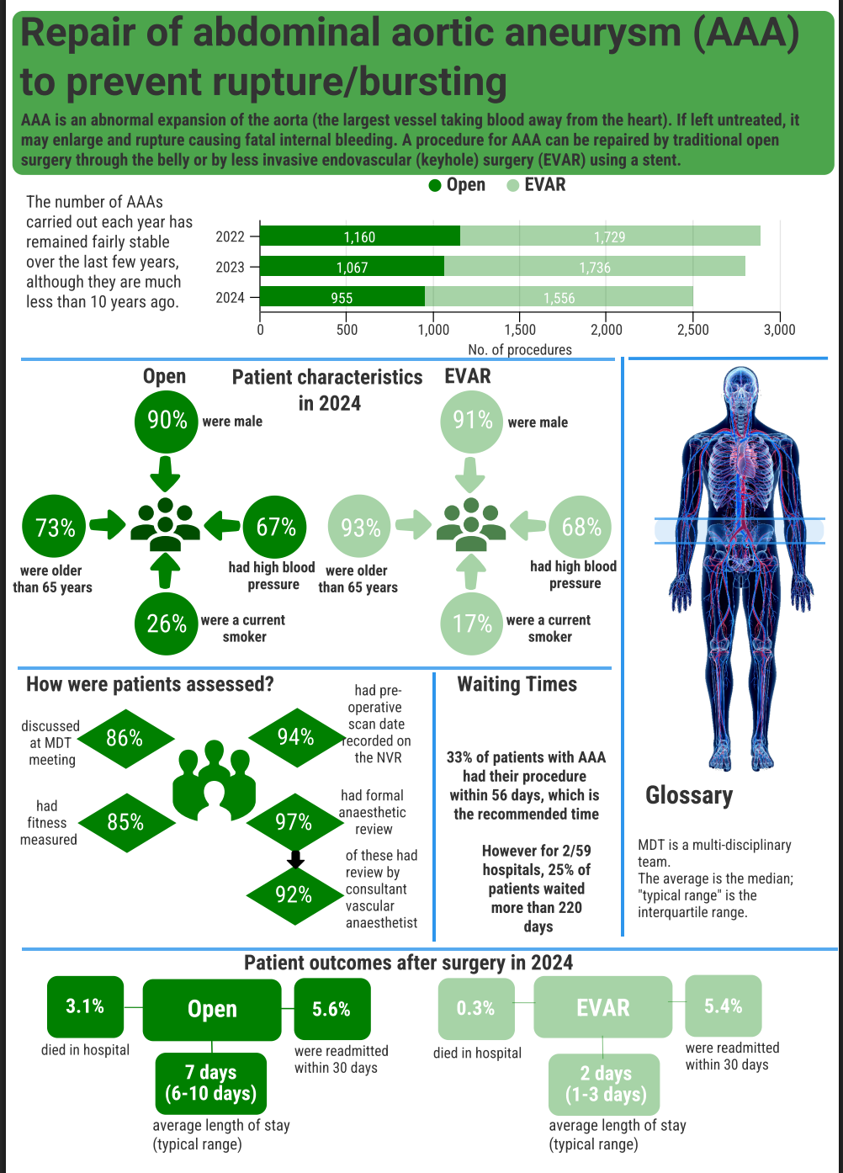
National Vascular Registry Impact Report
The National Vascular Registry (NVR) evaluates the quality and outcomes of care for adults who had major vascular procedures in NHS hospitals. Its overarching aim is to support vascular services provide high quality of care for these people, share examples of good practice, and highlight areas where care might be improved. The NVR team engaged with medical professionals and patient representatives to identify priority areas of care for evaluation. This led to the NVR adopting these Quality Improvement Goals:
Maintain low rates of death after all major arterial procedures.
Reduce time to treatment for patients with urgent vascular conditions.
Maintain low rates of complications after all major arterial procedures.
See the NVR’s Healthcare Improvement Strategy, alongside improvement methods and progress against the goals to date.
The NVR is commissioned by the Healthcare Quality Improvement Partnership (HQIP) and delivered by the Royal College of Surgeons of England (RCSEng). The NVR team work with three main partner organisations – the Vascular Society of Great Britain and Ireland, the British Society of Interventional Radiology, and the Vascular Anaesthesia Society of Great Britain and Ireland.
NATIONAL
How the NVR provides evidence of quality and
outcomes of care nationally
SYSTEM
How the NVR supports policy development
& system management
The risk of mortality or stroke/death following most major vascular procedures between 2022 and 2024 has remained low. Vascular units all produced comparable outcomes (there were no “negative” outliers).
Key results are published on the NVR’s interactive web-based dashboard. The State of the Nation results are refreshed annually; a selection of key process indicators are refreshed quarterly. The dashboard can be used by anyone – clinicians, public, policy makers and commissioners.
In 2024, 49% of patients with critical limb threatening ischaemia (CLTI) admitted in an emergency were revascularised within 5 days, the recommended time. 18 of 60 units had at least 25% of their patients wait more than 10 days.
The dashboard has been continually improved. During 2025, additional indicators were added, and the dashboard gives the user more options for customising reports.
Results from the NVR are used in data packs for both the vascular surgery and interventional radiology GIRFT visits.
The median time from symptom to carotid endarterectomy in 2024 was 14 days and 53% were treated within 14 days. This is slightly better than in 2023 when 49% of people were treated within 14 days.
The capture and reporting of medical devices on the NVR has enabled the monitoring of the long-term performance of implant medical devices. Information on device outcomes is a vital resource for clinicians, commissioners and the device industry.
LOCAL
How the NVR stimulates quality improvement
PUBLIC
How the NVR supports patients and the public
The NVR data collection system can generate summary tables and graphs that describe the user’s practice. Consultant surgeons, interventional radiologists and anaesthetists can produce a summary report that supports their revalidation.​
A Patient and Public Involvement (PPI) group advises the NVR on how it can better meet the needs of these groups. Its membership includes patients from all three vascular disease areas covered by the NVR, and representatives from established vascular patient charities.
All reports and publications by the NVR team are all available from the VSQIP website.
Any data entered onto the NVR IT system can be downloaded as a csv file to allow for local data analysis and monitoring.
The NVR’s online dashboard allows NHS trusts and health boards to compare their results to other vascular units, and national figures.
There were over 1,500 interactions with the NVR online dashboard between October and November 2025.
Each year, the NVR produces infographics for its procedures so that key results are available in an accessible format for the public and patients. Advice on the content and format of these infographics is provided each year by NVR’s PPI group.
The NVR has been the data source for many of the recent quality improvement initiatives from the Vascular Society of Great Britain & Ireland. These include reducing the post-op mortality following elective AAA repair, the time from emergency admission to revascularisation for patients with CLTI, and initiatives to improve the pre and peri-operative care for patients undergoing a major lower limb amputation.
Impact examples from January 2025 to December 2025. Impact report updated in December 2025.

