Slide 1
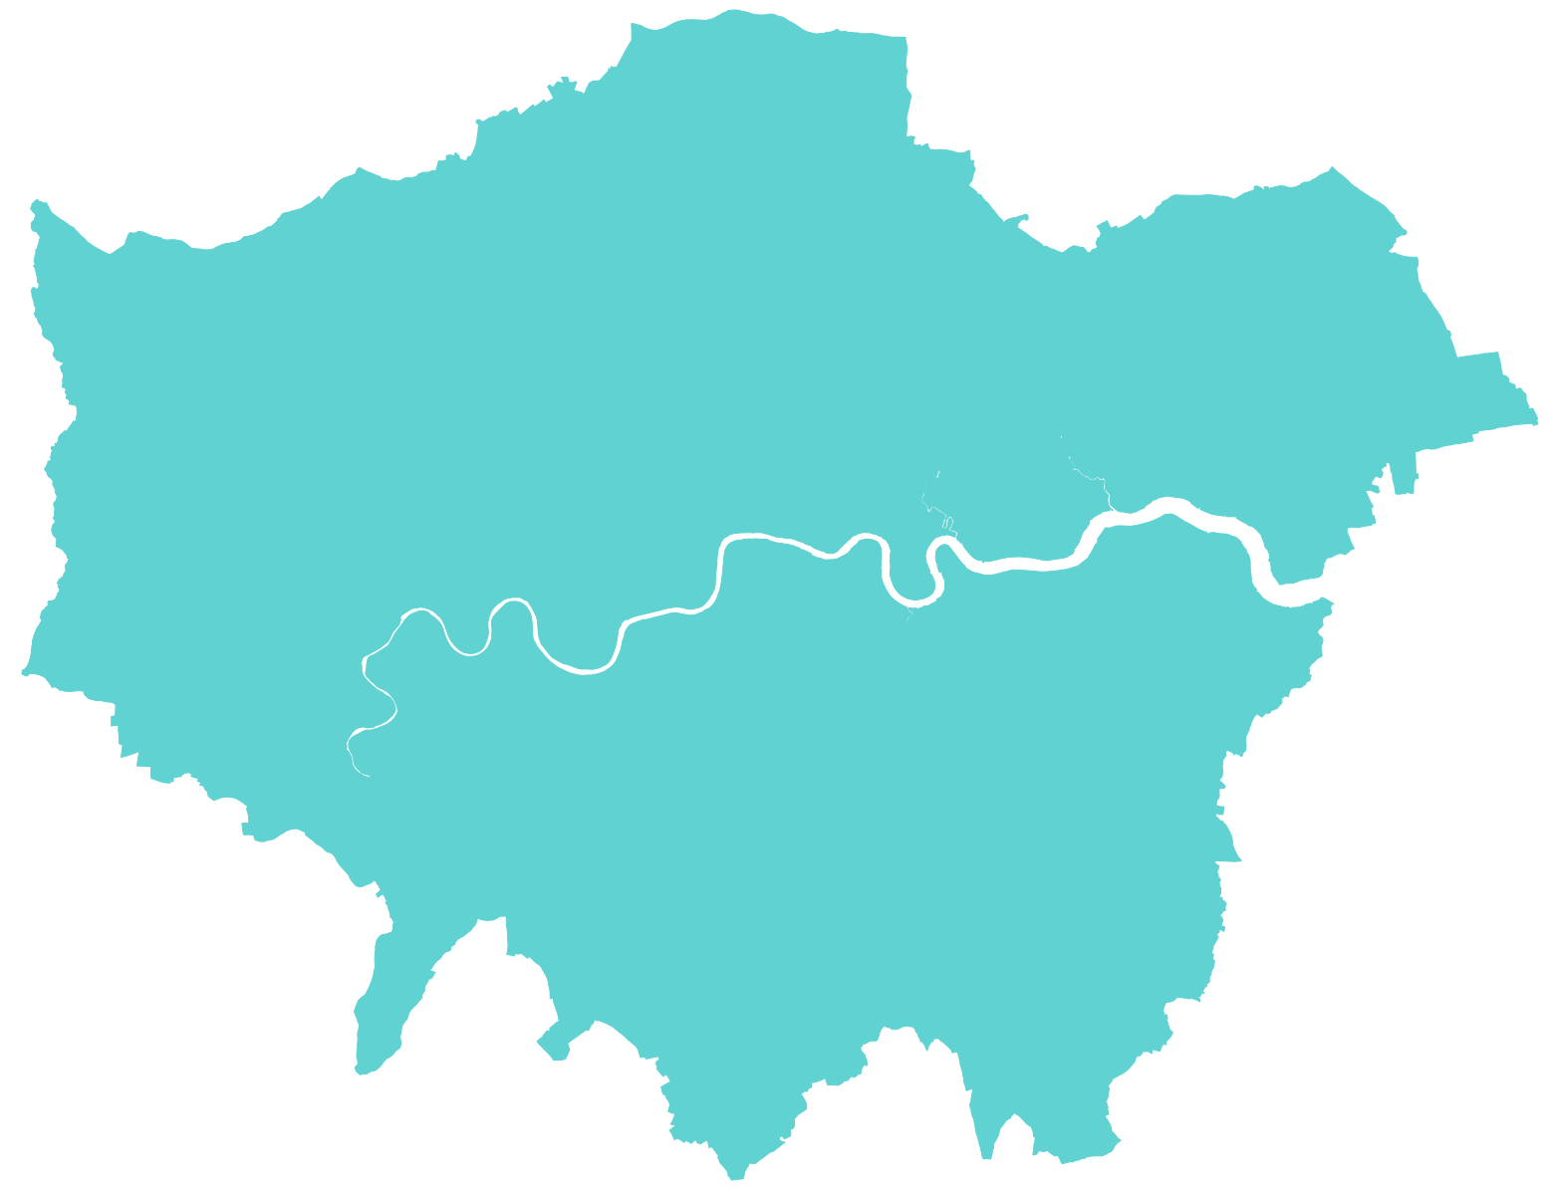
Identifying surgical hubs and spokes for ovarian cancer in England using routine cancer registration data
Background
The National Ovarian Cancer Audit (NOCA) has undertaken a service mapping exercise to examine relationships between NHS organisations in the delivery of care for ovarian cancer. In the UK, ovarian cancer care is delivered through a hub and spoke model. These hubs are surgical centres staffed by gynaecological oncologists, with specialist MDT and comprehensive teams. Chemotherapy is also provided at these centres. These hubs are distributed across the country to ensure equitable access to care and contribute to gynaecological oncology and medical oncology training.
Methods
Data were analysed for 5,735 women diagnosed with ovarian cancer between 1st January 2021 and 31st December 2021 at 124 NHS trusts.
Results
We identified 40 cancer centres and 84 cancer units.
40 cancer systems
1 cancer centre (hub) in each system
Percentage of care delivered within each system
84 cancer units (spokes)
Gateshead: Surgery 98.5% Chemotherapy 96.8%
Conclusions
Routine cancer registration data can be used to understand flows of patients from diagnosis to treatment. Our data contain every patient diagnosed with ovarian cancer in England in 2021, enabling us to evaluate the performance of each cancer centre.
South Tees: Surgery 73.8% Chemotherapy 97.9%
Lancashire: Surgery 98.4% Chemotherapy 97.0%
Leeds: Surgery 98.3% Chemotherapy 99.1%
Manchester: Surgery 99.6% Chemotherapy 99.7%
Cheshire and Merseyside: Surgery 97.0% Chemotherapy 100.0%
Hull: Surgery 97.9% Chemotherapy 99.0%
Sheffield: Surgery 98.9% Chemotherapy 99.4%
North Midlands: Surgery 90.9% Chemotherapy 100.0%
Nottingham: Surgery 96.0% Chemotherapy 96.4%
Derby: Surgery 100.0% Chemotherapy 98.7%
Norwich: Surgery 95.2% Chemotherapy 100.0%
Leicester: Surgery 98.4% Chemotherapy 93.8%
Cambridge: Surgery 94.2% Chemotherapy 100.0%
Wolverhampton: Surgery 96.5% Chemotherapy 90.5%
Ipswich: Surgery 96.2% Chemotherapy 97.6%
Birmingham: Surgery 99.4% Chemotherapy 98.2%
Mid & South Essex: Surgery 87.5% Chemotherapy 91.8%
Coventry: Surgery 100.0% Chemotherapy 93.7%
Northampton: Surgery 98.9% Chemotherapy 96.5%
Gloucester: Surgery 87.8% Chemotherapy 99.4%
Oxford: Surgery 59.3% Chemotherapy 95.7%
Bristol: Surgery 96.9% Chemotherapy 100.0%
West Herts: Surgery 87.7% Chemotherapy 89.4%
Bath: Surgery 100.0% Chemotherapy 100.0%
Somerset: Surgery 96.4% Chemotherapy 96.3%
Surrey: Surgery 97.1% Chemotherapy 91.3%
East Kent: Surgery 97.6% Chemotherapy 44.4%
UCLH: Surgery 96.0% Chemotherapy 93.6%
Barts: Surgery 96.4% Chemotherapy 94.6%
Exeter: Surgery 91.8% Chemotherapy 100.0%
Sussex: Surgery 94.4% Chemotherapy 97.4%
Maidstone: Surgery 96.2% Chemotherapy 97.4%
Royal Marsden: Surgery 98.5% Chemotherapy 95.7%
Southampton: Surgery 97.2% Chemotherapy 98.3%
Imperial: Surgery 92.9% Chemotherapy 76.5%
Guy’s: Surgery 100.0% Chemotherapy 96.3%
Dorset: Surgery 96.9% Chemotherapy 98.4%
Portsmouth: Surgery 91.9% Chemotherapy 92.7%
Cornwall: Surgery 100.0% Chemotherapy 100.0%
N.B. The percentages describe the proportion of patients that received surgery or chemotherapy within the defined system.
Numerator: Number of patients diagnosed at each system that received surgery or chemotherapy within the system.
Denominator: Number of patients diagnosed at each system that received surgery or chemotherapy.

