Slide 1


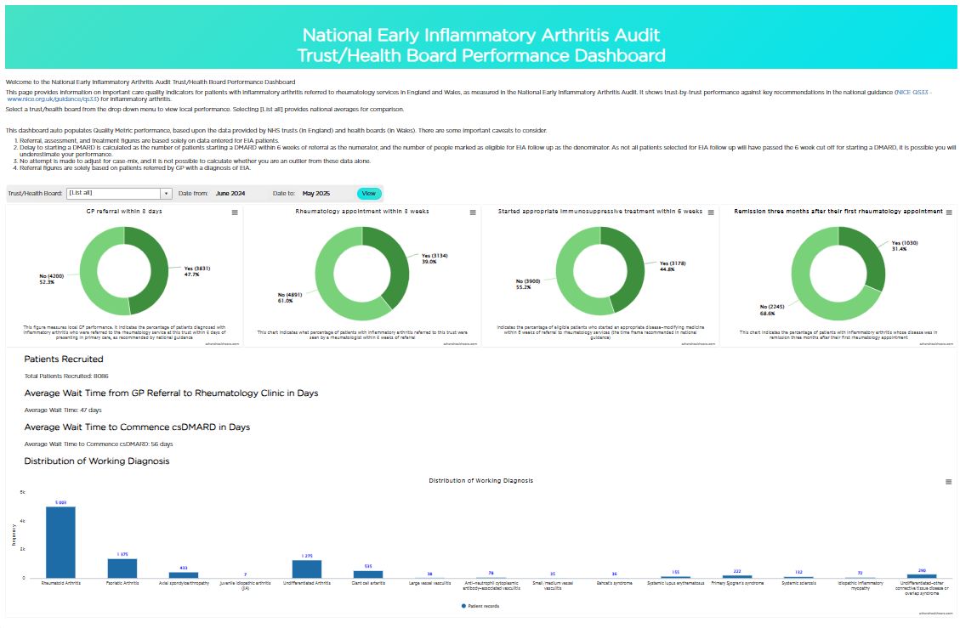
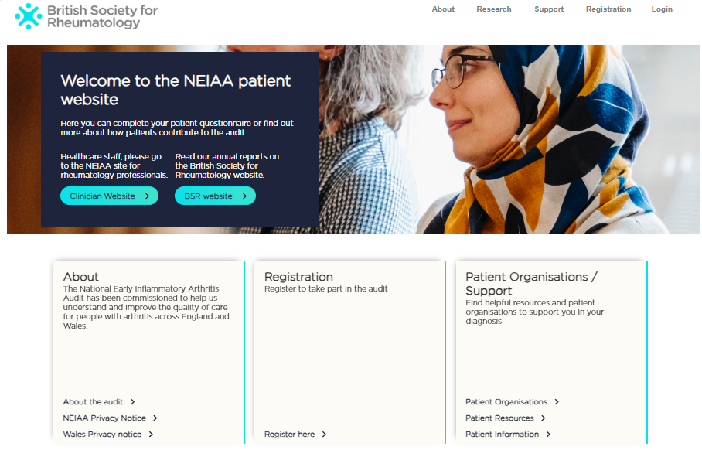
Impact of the NEIAA
IMPROVEMENT GOALS
1. Reduce by 10% each audit year the time in days from receipt of referral to first rheumatology appointment for patients eligible for follow-up.
2. Reduce by 7.5% each audit year the time in days from receipt of referral to starting treatment for patients eligible for follow-up.
3. Increase the number of patients being entered into the audit by 20% each audit year.
4. Increase by 15% each audit year the proportion of patients entering baseline PROM data to achieve 75% of patients by 2025.
NATIONAL
How the project provides evidence of quality and outcomes of care nationally
The NEIAA State of the Nation Report 2024 was published in October 2024. Highlights from the report include:
5,778 patients were recruited with confirmed EIA
(2023/24 = 5,440)
51% of patients were referred within 3 working days
(2023/24 = 56%)
60% of patients started treatment within 6 weeks
(2023/24 = 52%)
Patients are being seen and treated quicker therefore reducing the risk of more severe disease, ensuring they are able to continue work or education.
In early 2025, the rheumatology service in Jersey was onboarded. This will provide an opportunity to audit care quality and outcomes for patients on the island.
SYSTEM
How the project supports policy development & system management
NEIAA data was used in an article about variation in DMARD initiation for RA, showing that there are disparities that must be addressed if we are to deliver equitable access to b/tsDMARDs, regardless of geography, and 4 other full articles published in Rheumatology (LINK 1, LINK 2, LINK 3) and Rheumatology Advances in Practice (LINK 4).
Through joined up working with BSR guideline working groups, the audit was built into the 2024 BSR systemic sclerosis guideline as a tool to measure quality of care and in 5 other full articles in Rheumatology (LINK 1, LINK 2) and Rheumatology Advances in Practice (LINK 3, LINK 4, LINK 5).
Welsh Rheumatology Clinical Implementation Network gained access to live Health Board level data in mid-2024, enabling improved oversight of audit data and engagement.
NEIAA data was used in an article published in The Lancet Rheumatology showing that DMARD initiation for newly diagnosed RA patients varied markedly by ethnicity and age, as well as in 4 other full articles in Annals of the Rheumatic Diseases, RMD Open, and The Lancet Rheumatology (LINK 1, LINK 2, LINK 3, LINK 4).
NEIAA data was used in 1 conference abstract published in Rheumatology (LINK 1) and 2 conference abstracts published in Annals of the Rheumatic Diseases (EULAR conference) (LINK 2, LINK 3).
In response to feedback from funders we undertook further analysis of remission data. This paper showed that while national remission rates for early RA have remained stable in England and Wales since 2018, there is marked regional and hospital-level variation, highlighting ongoing inequities in service delivery
NEIAA data informed BSR’s external affairs and policy work through parliamentary briefings, inquiry evidence submissions, and consultation responses.
LOCAL
How the project stimulates quality improvement
Engagement work was undertaken year-round by the NEIAA Clinical Lead, Dr Liz Price. This included holding meetings with outlier providers and writing bespoke letters to support local engagement with senior healthcare managers. Various national, regional, and local meetings were also attended by the project team to promote the audit.
PUBLIC
How the project is used by the public and the demand for it
A publicly available performance dashboard (LINK) displaying key performance data by trust/health board went live in April 2025. This allows patients, carers, and members of the public, to see near real-time data on the performance of providers, including treatment timeliness. It is the project's ambition that this data will inform local decision making, particularly where there are significant delays, which we know have both a significant impact on outcomes as well as the UK economy (NASS 2022 Impact Report).
Regional and local datasets are published on an annual basis. These are complemented by continually improved dashboard and report features on the NEIAA data-entry platform, providing critical tools for local quality improvement.
Between 1 June 2024 and 29 May 2025 , the NEIAA page on the British Society for Rheumatology website was viewed 8,432 times (2023/24 = 8,694 views).
In partnership with the NEIAA patient panel, healthcare professionals, and patient organisations, the accessibility of the NEIAA patient website was improved. This included introducing translated patient information leaflets to enhance patient and public engagement with the audit programme.
Additional questions were introduced to the clinical dataset in September 2024 for cases of Giant Cell Arteritis with the aim to support services with measuring performance against quality standards for the disease.
At the recommendation of key clinical stakeholders, certificates recognising the participation of healthcare professionals were introduced in September 2024 to celebrate and encourage data-entry and improve recruitment rates.
A collection highlighting the latest articles published in Rheumatology and Rheumatology Advances in Practice was introduced in September 2024 (LINK), providing a readily accessible repository for key research outputs.
Impact examples from June 2024 to May 2025. Impact report produced May 2025.

