Slide 1


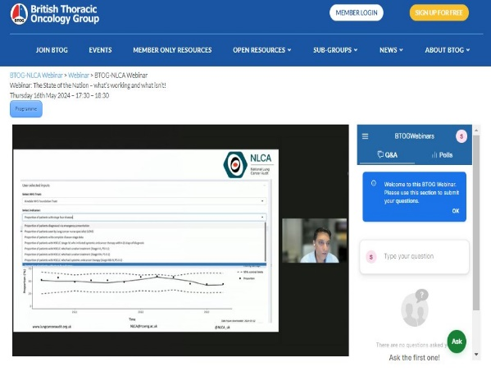
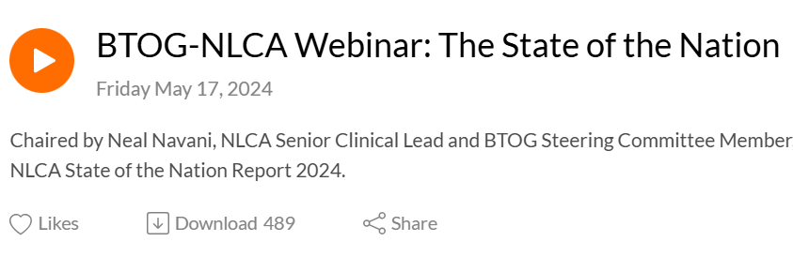
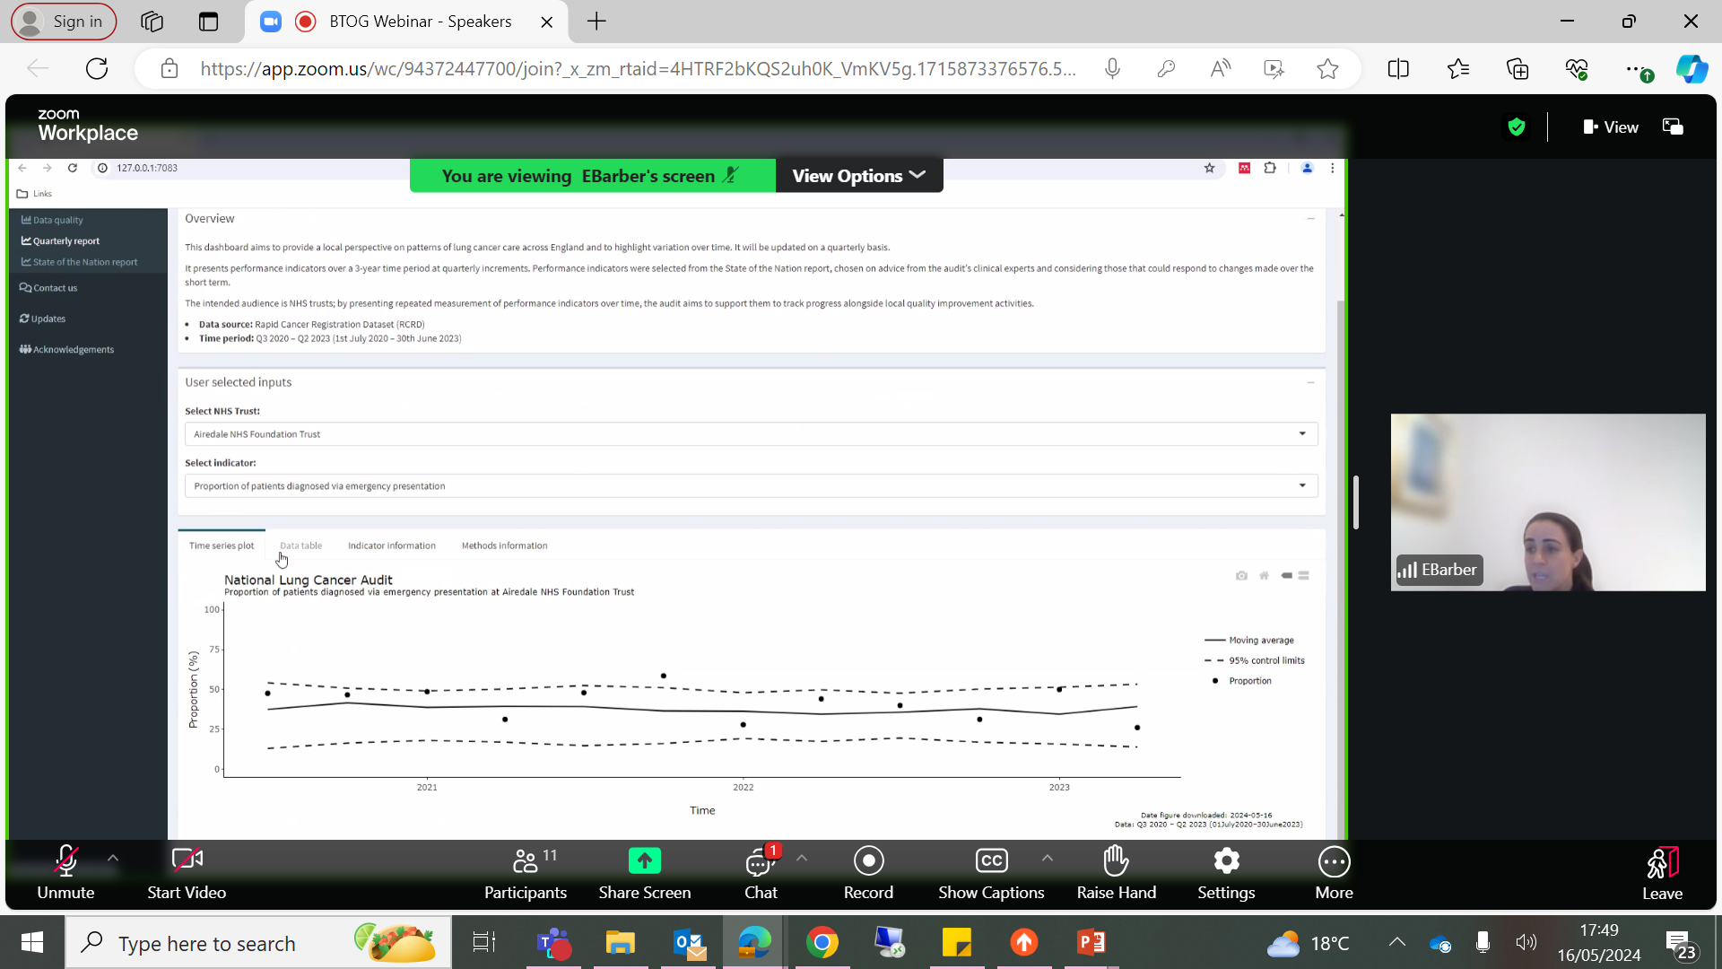


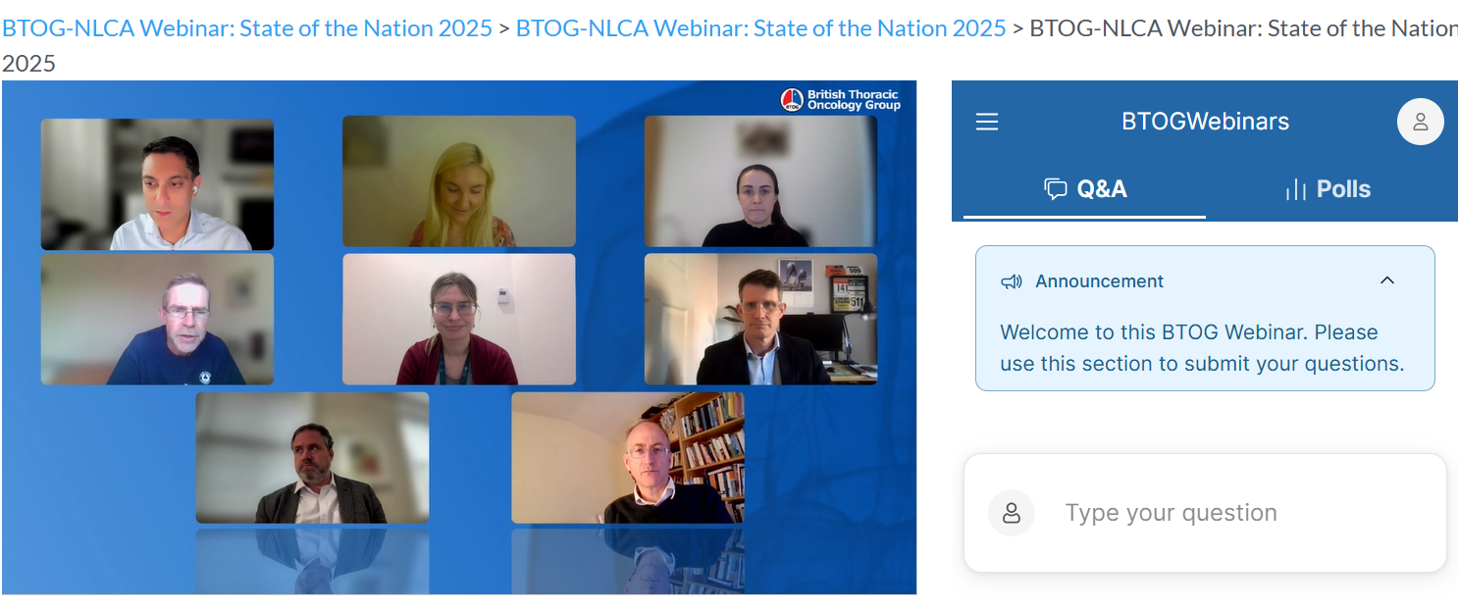
National Lung Cancer Audit webinars with British Thoracic Oncology Group
Impact Poster 2025
In May 2024 and May 2025, NLCA and BTOG held joint webinars to:
Promote the findings from the latest State of the Nation reports
Introduce new features of our dashboards for trust and cancer alliance level results
Discuss future directions of the audit
Answer questions live from the audience
CPD points awarded!
May 2024: BTOG NLCA Webinar: State of the Nation – what’s working and what isn’t?
Now available as a podcast on Podbeans – 489 downloads so far!
97% of attendees rated the State of the Nation talk as excellent
Ella Barber– NLCA Data Scientist presenting at the Webinar. Showing the functionalities & uses of the new interactive dashboards to support local QI.
65 live attendees
Amazing data and great to see the improvements and skill development… clear that all centres do not report to the same standard. Great/really important webinar - well done
- Anonymous feedback
May 2025: BTOG NLCA Webinar: State of the Nation – progress, old challenges and a data-driven road ahead
54 live
attendees
NLCA Project Team presenting at the webinar and answering questions live as they are submitted by the audience.

