Slide 1


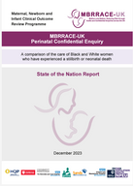

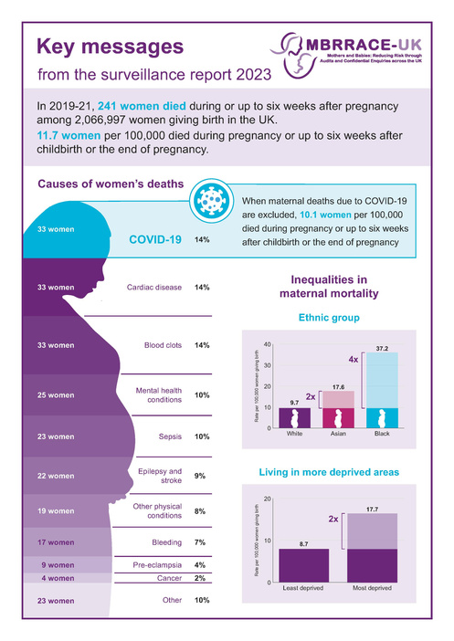
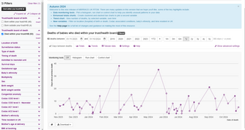
Impact of
MNI CORP
National
How the project provides evidence of quality and outcomes of care nationally
Reporting
Since 2022, MBRRACE-UK has generated:
Earlier data release
9
Reports plus associated State of the Nation reports, lay summaries and infographics
Key figures on perinatal and maternal mortality are being released earlier than in previous years:
51
Recommendations that have expanded in scope to include new areas of focus outside of maternity care and that have resulted in system changes and local quality improvement as detailed in this impact report
  Data brief on maternal mortality
  Trust and health board level reports of perinatal mortality
  Real-time data monitoring (RTDM) tool
System
How the project supports policy development & system management
Policy development
NHS Plans
National initiatives on inequality
MBRRACE-UK’s findings are frequently cited in NHS health initiatives:
MBRRACE-UK’s findings on inequalities in perinatal and maternal mortality rates have contributed to various planned national improvements:
  Suicide prevention strategy for England: 2023-2028
  NHS Mental Health Implementation Plan: 2019/20-2023/24
  NHS England’s three year delivery plan
  The Labour Party’s 2024 manifesto
  NIHR’s £50M ‘Challenge’ funding call
  NHS England Equity & Equality Steering Group
  Lord Darzi’s report on the state of the National Health Service in England
Data sharing
ONGOING: Maternal and perinatal data are shared with the Care Quality Commission, DHSC and NHS England
SPECIAL CIRCUMSTANCES: MBRRACE-UK data were shared with JCVI to ensure that pregnancy continues to be regarded as a clinical risk group for COVID-19. Data on perinatal deaths were shared with the Thirlwall Inquiry into the crimes of Lucy Letby.
How the project is used by the public and the demand for it
Public
Engagement
Third sector stakeholders
Website
Media
Social media
provide advice on the conduct of the programme and are involved in the dissemination of MBRRACE-UK findings.
280,000+
1,589
14,989
visits to the MBRRACE-UK website in 2024
mentions in UK and international media since 2022
followers of the MBRRACE-UK
X channel
COLLABORATORS: Representatives from Sands, the baby loss charity, and National Maternity Voices (NMV) are members of the MBRRACE-UK collaboration.
4,500+
14,474
36,000
LAY SUMMARIES: Produced in collaboration with numerous third sector stakeholders including mother and baby charities.
maternal report downloads since 10 October 2024
reads of an article published
14 February 2023
views of posts about the most recent maternal report
Local
How the project stimulates quality improvement
Report launch meetings
Real-time Data Monitoring (RTDM) Tool
Two report launch meetings are held annually to present findings to healthcare professionals, policy makers, key stakeholders and members of the general public.
Recent re-specification of the RTDM tool allows
users to use interactive ‘run charts’ to identify increased frequency of deaths. Local quality improvement initiatives have embedded the RTDM tool into reporting processes and rapid review systems.
960
attendees at the most recent launch meeting for the maternal report on 10th October 2024
6 November 2024

