Slide 1


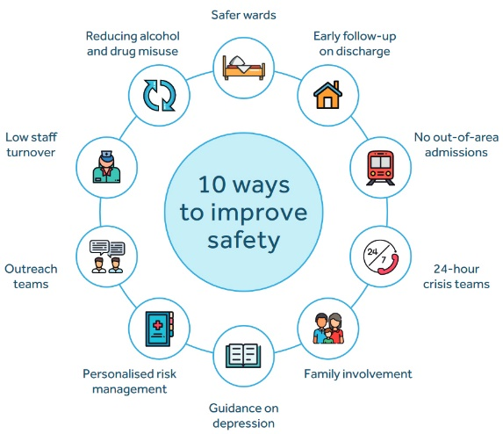


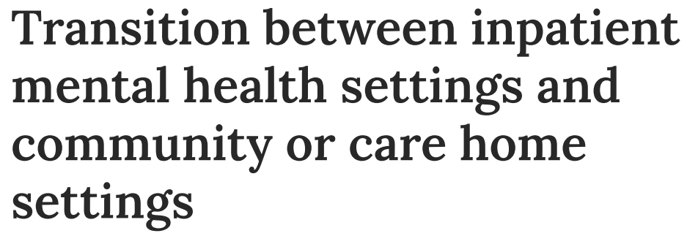

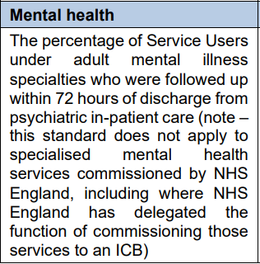


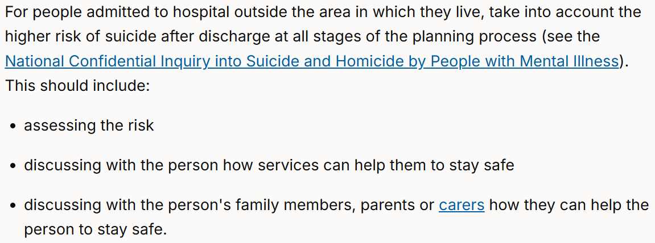

Impact of NCISH:
system level
NCISH has collected in-depth information on all suicides in the UK since 1996.
NCISH recommendations have been shown to reduce suicide rates in mental health settings that implement them (1997-2006). Implementing NCISH recommendations is linked with 200-300 fewer patient deaths annually, equating to a potential societal cost saving of £450 million.
We developed “10 ways to improve safety” based on recommendations associated with lower suicide rates.
These “10 ways” form the basis of a self-audit toolkit for specialist mental health services, quality standards against which trusts can assess their suicide prevention.
The toolkit has been downloaded >45,650 times and is updated continually with new evidence.
Our evidence is cited in the latest national strategies, policies,
clinical guidance and regulation in all UK countries.
Suicide Prevention Strategy, England
Suicide Prevention Strategy, NI
Self-Harm Prevention Strategy, Scotland
“Mental health trusts should continue to review and implement evidence-informed recommendations from the NCISH Annual Report and 10 ways to improve safety”
“NCISH recommends comprehensive care planning…routine follow-up…in response to missed appointments and addressing adverse life and social circumstances…prior to discharge”
“…training for staff working in specific settings, safety planning, implementing NCISH recommendations…will help provide the right support at the earliest opportunity…”
NCISH recommendations underpin NICE guidelines
NCISH recommendation for follow-up within 72 hours of discharge from in-patient care now in the NHS Standard contract
Impact examples from 2004 to August 2025. Impact report updated September 2025.

