Slide 1



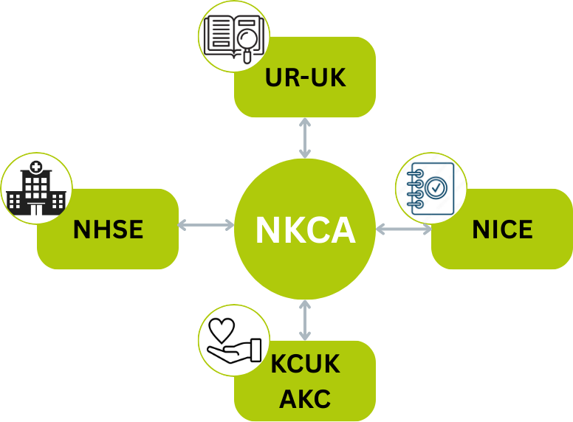
National Kidney Cancer Audit: In focus impact report 2025
Embedding the audit in the kidney cancer community
The NKCA Clinical Fellow, Raghav Varma, was invited to attend the Uro-oncology UK research meeting in November 2025 and there was huge interest from the kidney cancer research community in the outputs and future work from the audit
Feedback on the existing performance indicators was shared and will be used by the team to refine and develop them for future State of the Nation Reports
Increased awareness of the audit across the community will lead to greater engagement with our outputs and providers checking their data for accuracy and completeness leading to quality improvement
The NKCA team was approached by the NICE Quality Standards (QS) team during the development phase of the statements for our expert input
The NKCA provided feedback to the NICE QS team about what metrics could be measured using routinely collected data from the audit
The NICE QS team used the NKCA State of the Nation Report to develop draft QS statements
The NKCA Clinical Lead for Urology, Grant Stewart, was on the NICE Guideline committee, ensuring cross fertilisation of ideas and suggestions which will ultimately improve patient care
The NKCA has liaised with the Operational Performance team at NHSE to discuss ways to minimise duplication of efforts to improve Cancer Waiting Times for people diagnosed with kidney cancer
The NKCA has met with the Faster Diagnosis Team at NHSE to understand priorities, share learning and discuss opportunities for alignment of recommendations
Both NHSE teams explored ways for the audit to output data which would be beneficial to the community and minimise bespoke data collection by Cancer Alliances
The NKCA meets regularly with representatives from Kidney Cancer UK (KCUK) and Action Kidney Cancer (AKC) and both organisations have representation on the NKCA Clinical Reference Group
KCUK recommended that the NHSE Faster Diagnosis Team contact the NKCA to review opportunities for alignment
KCUK and AKC provided essential feedback to the NKCA on its Quality Improvement Intervention and supported the Patient and Public Involvement Forum
© 2025 Healthcare Quality Improvement Partnership (HQIP)
December 2025

