Slide 1
Clinical Audit Awareness Week 2024 featuring the Clinical Audit Heroes Awards 24-28 June 2024 This event will start at 12:30pm
Chris Gush CEO, HQIP
Professor Danny Keenan Medical Director, HQIP
27th March 2024; 12:30-1pm
Notes:
Tom: Show slides before event begins so early joiners can see ‘event will start at 12.30’

Slide 2
Welcome & introduction
24-28 June 2024, in collaboration with N-QI-CAN
Clinical Audit Heroes Awards
#CAAW24 – www.hqip.org.uk/clinical-audit-awareness-week
Chris Gush, HQIP CEO
Notes:
5 mins max - Welcome; thank you for coming.
1. House-keeping:
- Event will be recorded and subsequently shared on our website
- Mics automatically set to mute
- Due to the brevity of event, chat function has been switched off; please do email communications@hqip.org.uk after this event if you have any questions
2. Introduction
- Delighted to launch this important event as new CEO (bit about you, Chris?)
- 24-28 June 2024 this year
- Includes Clinical Audit Heroes Awards – more later…
- Thanks to our collaborator, NQICAN – but also to all of you, the clinical audit community – and the wider quality improvement and healthcare sector – that makes this event such a success
- Importance of campaign – raise awareness / share value of clinical audit and evidence-informed improvement
More on activities and practicalities later; first I’ll pass over to Danny to share more about the value of this/all of your important work…

Slide 3
Clinical audit
Strength to strength eg new approach with NATCAN (National Cancer Centre)
Creating insights
Enabling improvements in quality
Learning & sustaining impact
Improvements to support implementation of recommendations
State of the Nation summaries
Reduced number of metrics
National Clinical Audit Benchmarking (NCAB) tool
Outliers – guidance published 2024
Future of clinical audit
Quality improvement can - and must - follow on from clinical audit…
Prof Danny Keenan, HQIP Medical Director
Notes:
10 mins max in total for the next 4 slides:
National audit continuing to enable significant improvements in care for our patients….
+
Some of the changes HQIP has been making….
Emphasise a bright future for clinical audit…

Slide 4
START
Repeat the data collection to measure if improvement has occurred
Identify a topic that is important to audit
Implement the improvements
Establish the authoritative standards against which to audit
Audit cycle
Agree an improvement plan with stakeholders
Develop clear criteria that will measure performance against the agreed standard
Collect data and report results
Tip: Make sure everyone is signed up to how you collect the data
http://www.hqip.org.uk/assets/Guidance/HQIP-Clinical-Audit-Simple-Guide-online1.pdf
Notes:
Quality improvement can - and must - follow on from clinical audit

Slide 5
Quality improvement
What can HQIP do to help you:
Tighter sets of metrics in the national audit
Getting the results out to you
Timely
Visual (infographics and NCAB)
Direct (Newsletter with signposting)
Social media
Less and more direct recommendations which are doable
What more could we do to help?
Prof Danny Keenan, HQIP Medical Director
Notes:
National audit continuing to enable significant improvements in care for our patients….
+
Some of the changes HQIP has been making….
Emphasise a bright future for clinical audit…

Slide 6
Key questions to ask…
Do we know how good we are?
Do we know where we stand relative to the best?
Do we know/understand where variation exists in our organisation?
In our efforts to improve, what’s working?
Why are we measuring all this, and what difference is this actually making to the quality of services?
Prof Danny Keenan, HQIP Medical Director
Notes:
Hand back to Chris at the end of this slide…

Slide 7
Clinical Audit Hero Awards
Patient Safety Hero (clinical audits supporting improved patient safety)
Patient and Public Involvement Hero (effective involvement in clinical audit by patients, carers and/or the public)
Healthcare Inequalities Hero (clinical audits that have utilised findings to reduce health inequalities)
Influencing Change Hero (clinical audits that are supporting change in healthcare practice, planning or process)
Sustainability Hero (clinical audits that will have a sustainable impact, environmentally, organisationally or otherwise – future-proofing)
Closing date: Sunday 5 May 2024
www.hqip.org.uk/clinical-audit-heroes-awards-2024
Chris Gush, HQIP CEO
Notes:
5 mins max - So, what’s happening this year?
I’ll start with the Clinical Audit Hero Awards…
We have five awards – covering these important topics. They are designed to enhance the way that the audit programme is evolving – emphasis on lasting change, and bringing about change, whether local or system level.
Patient safety remains critical. PPI crucial. And Health inequalities is a focus for all of us, only enhanced by the revealing nature of the pandemic.
Your chance to share your amazing work; but also best practice and innovation (and make a difference beyond your organisation with the work you are doing)
Awards open nominations NOW. Closing date Sunday 5 May 2024. Criteria (which are minimal, designed to encourage entries) and online nomination forms available online now.
Looking for projects that demonstrate excellence in clinical audit and/or quality improvement. Awards are open to projects, individuals or teams involved in any type of healthcare setting in the UK, whether at a local, system or national level.
Making a nomination is quick and easy – four short questions only to complete, and reliably informed it could take as a little as 20 minutes!
Make a note of the deadline, share with colleagues. Get your thinking caps on about your entries – you can enter as many projects as you like – and encourage others to enter.

Slide 8
Online lunch & learn events
Daily online Lunch & Learn events (12.30-1.30pm):
Mon 24 June: Winner of the Patient Safety
Tues 25 June: Winner of the Patient and Public Involvement
Wed 26 June: Winner of the Healthcare Inequalities
Thurs 27 June: Winner of the Influencing Change
Fri 28 June: Winner of the Sustainability
www.hqip.org.uk/clinical-audit-awareness-week
Chris Gush, HQIP CEO
Notes:
3 mins max - Award winner(s) announced at daily online Lunch & Learn events
Organised by collaborator NQICAN and co-hosted with HQIP
Make a note of dates / times in diary. Links to join are available on our website. Share with colleagues. Subscribe to HQIP monthly ebulletins and see website for more details in due course…

Slide 9
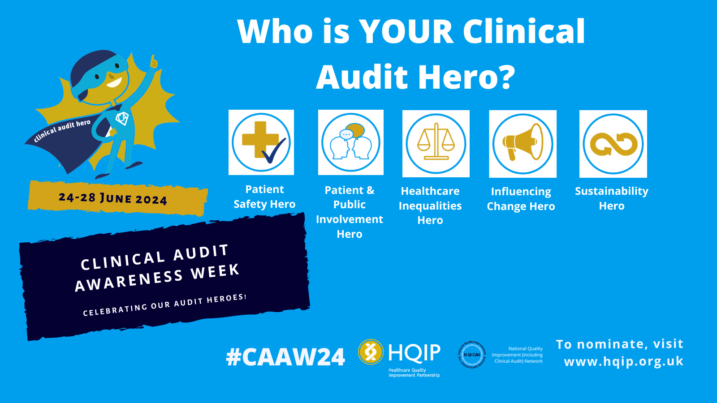
What will you do?
Toolkit for sharing: www.hqip.org.uk/clinical-audit-awareness-week-2024-promotional-toolkit
Social media & digital content
Hero awards resources
Promotional text
Say thank you
Get involved! #CAAW24
Chris Gush, HQIP CEO
Notes:
5 mins max - In addition to the awards, there are many other ways you can get involved…
This year, we are keen to max. impact of CAAW by getting everyone involved – from local and national audit and Quality Improvement Specialists to Trusts/clinicians and others in healthcare provision as well as policy makers, regulators, royal colleges and, of course, patients etc etc
Quality improvement is everyone’s business! Effective quality improvement is to everyone’s benefit – we are all patients too, after all!
Get on board and organise your own local events, awards, activities etc – and encourage others to do so too
Share information across your teams and beyond; ask Comms teams to help by sharing content in newsletters etc
Use our free online toolkit to help – from event posters and social media images to text for newsletters and resources to promote nominations and saying thank you – it’s all there!
And don’t forget to share on plans – and activities when they happen – online and, in particular, social media using #CAAW24

Slide 10
And there’s more…
Host of other activities / resources planned during Clinical Audit Awareness Week – watch this space…
Stay up-to-date:
Sign up to HQIP mailing list (monthly updates): www.hqip.org.uk/subscribe-form
Share on social media (#CAAW24)
www.hqip.org.uk/clinical-audit-awareness-week
Chris Gush, HQIP CEO
Notes:
2 mins max – And there’s much more planned…
-Keep in touch to find out more abut our activities
Many other events planned
Many resources / tools and guidance will be launched and reshared
Many ways to stay up-to-date – ebulletins, social media and website

Slide 11
Thank you
www.hqip.org.uk/clinical-audit-awareness-week
Stay in touch:
Sign up to HQIP mailing list
Follow on X: @HQIP
communications@hqip.org.uk
Notes:
Any questions after this event, send to comms@...

