Slide 1
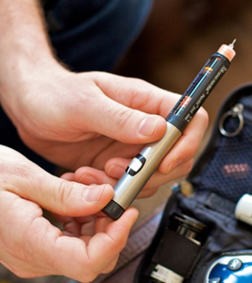


National Pregnancy in Diabetes Audit Report, 2016
England, Wales and the Isle of Man
12th October 2017

Slide 2




Prepared in collaboration with:
 | The National Pregnancy in Diabetes (NPID) audit is part of the National Clinical Audit and Patient Outcomes Programme (NCAPOP) which is commissioned by the Healthcare Quality Improvement Partnership (HQIP) and funded by NHS England. HQIP is led by a consortium of the Academy of Medical Royal Colleges, the Royal College of Nursing and National Voices. Its aim is to promote quality improvement, and in particular to increase the impact that clinical audit has on healthcare quality in England and Wales. HQIP holds the contract to manage and develop the NCAPOP Programme, comprising more than 30 clinical audits that cover care provided to people with a wide range of medical, surgical and mental health conditions. The programme is funded by NHS England, the Welsh Government and, with some individual audits, also funded by the Health Department of the Scottish Government, DHSSPS Northern Ireland and the Channel Islands.
 | NHS Digital is the trading name for the Health and Social Care Information Centre (HSCIC). NHS Digital managed the publication of the 2016 annual report.
 | Diabetes UK is the charity leading the fight against the most devastating and fastest growing health crisis of our time, creating a world where diabetes can do no harm.
Supported by:
 | The national cardiovascular intelligence network (NCVIN) is a partnership of leading national cardiovascular organisations which analyses information and data and turns it into meaningful timely health intelligence for commissioners, policy makers, clinicians and health professionals to improve services and outcomes.

Slide 3
Introduction
Pre-gestational diabetes increases adverse pregnancy outcomes for women and babies, including congenital malformation, miscarriage, preterm delivery, pre-eclampsia, macrosomia, and perinatal mortality. These risks can be reduced.
The National Pregnancy in Diabetes (NPID) audit measures the quality of antenatal care and pregnancy outcomes for women with pre-gestational diabetes.
It is intended to support local, regional and national quality improvement.
Data is collected and submitted by antenatal diabetes services in England, Wales and the Isle of Man.
Women consent for their data to be included in the audit.
The NPID audit is part of the National Diabetes Audit (NDA) portfolio within the National Clinical Audit and Patient Outcomes Programme (NCAPOP), commissioned by the Healthcare Quality Improvement Partnership (HQIP).
To reduce the burden of data collection for services, NHS Digital link the NPID data to NDA data and Hospital Episode Statistics (HES) / Patient Episode Database for Wales (PEDW) information.

Slide 4
Introduction
NPID addresses three high level audit questions:
Were women with diabetes adequately prepared for pregnancy?
Were appropriate steps taken during pregnancy to minimise adverse outcomes to the mother?
Were adverse neonatal outcomes minimised?
The 2016 audit report:
Measures against updated NICE guideline NG3¹
Publishes service level data
Compares NPID data over time
  ¹See References section.

Slide 5
The NPID audit shows us the importance of planning before you get pregnant as well as keeping your eye on the ball whilst actually pregnant. Most women are having healthy pregnancies and babies, but some aren’t. There is a lot more that could be done to encourage women to get pregnancy-ready and to help with a happy and healthy pregnancy
Patient representative, NPID Audit Advisory Group
The NPID audit continues to demonstrate excellent collaboration between professional and patient groups to provide important but concerning information about mothers and babies, demonstrating how policy and practice should be targeted to bring about improvement
Dr J M Hawdon, Consultant Neonatologist, Royal Free London NHS Foundation Trust
It’s time for diabetes and maternity networks to work together and get a grip on finding solutions to improve obstetric and neonatal outcomes of women with diabetes
Professor Helen Murphy, Professor of Medicine (Diabetes and Antenatal Care), University of East Anglia
Professor of Women's Health, Department of Women & Children’s Health, Kings College London
Honorary Consultant Physician, Cambridge University NHS Foundation Trust

Slide 6
Measuring against the NICE guideline NG3¹
NICE guideline (NG3¹) criteria used in NPID:
Prior to pregnancy
Use of folic acid supplement
Keeping HbA_{1c} below 48 mmol/mol where achievable without causing problematic hypoglycaemia
Stopping / substituting of oral glucose-lowering medications apart from metformin
Suspending statins and ACE inhibitors/ARBs
During pregnancy
Early first contact with joint diabetes and antenatal clinic
Monitoring HbA_{1c} to assess level of risk to pregnancy
More frequent retinal screening
Birth and neonatal care
Elective birth and timing of birth
Transfer of infants to intensive, high dependency or special care only if there are clear clinical indications
¹See References section.

Slide 7
Key messages
Overall recommendations:
The NPID audit demonstrates that there is a concerning lack of progress with delivering the NICE recommendations over the last 3 years. There is now therefore an urgent need for:
These outcomes to be owned across Local Maternity Systems (LMS), Public Health, primary care, diabetes and maternity networks and specialist antenatal services, with the authority and resources to join up an intentional and effective programme to improve outcomes.
Work is needed within each service area to identify the models, local pathways, roles, actions, and responsibilities needed to deliver this. Initially this can be informed by local quality improvement initiatives using NPID data against which to measure progress.

Slide 8
Key findings
In 2016, 3,304 pregnancies in 3,297 women with diabetes were recorded in 172 antenatal diabetes services.
1,608 women had Type 2 diabetes. Nearly half of women with Type 2 diabetes were Black, Asian or of mixed ethnicity.
Initiatives around supporting women to use safe and effective contraception and to prepare successfully for pregnancy will need to take account of ethnicity, age and deprivation, and how these may influence the way women access support from health services.
Women with Type 2 diabetes tended to be older, have shorter diabetes duration, be more overweight and be more likely to live in areas of social deprivation.

Slide 9
Key findings
Few women were well prepared for pregnancy
Only one in twelve women (8 per cent) had achieved HbA_{1c} < 48mmol/mol, use of 5mg folic acid and avoidance of potentially harmful medications before conception.
Despite the fact that women with Type 2 diabetes have better glucose control, other measures, including use of folic acid, suggest that they were not getting the pre-pregnancy care they needed.

Slide 10
Key findings
Presentation before 10⁺⁰ weeks of pregnancy:
24.0 per cent of women with Type 1 diabetes and 41.9 per cent of women with Type 2 diabetes did not present to the joint diabetes antenatal team before 10⁺⁰ weeks gestation.
This suggests reduced awareness of pregnancy risks and/or failure of diabetes antenatal care and referral pathways.
Maternal hypoglycaemia and ketoacidosis:
Almost one in 10 women with Type 1 diabetes had at least one hospital admission for severe hypoglycaemia.
Ketoacidosis, a high risk for mother and fetus, occurred in 2.7 per cent of women with Type 1 diabetes.

Slide 11
Key findings
Almost one in two babies had complications related to maternal diabetes:
47.6 per cent of babies born to women with Type 1 diabetes were large for gestational age (LGA), as were 22.9 per cent of babies born to women with Type 2.
Preterm delivery was common especially in women with Type 1 diabetes (43.3 per cent of singleton live births).
Delivery by caesarean section was common (64.7 per cent of Type 1 and 56.9 per cent of Type 2).
HbA_{1c} levels at or above 48 mmol/mol after 24 weeks were associated with preterm delivery, LGA babies, and neonatal unit admission.
Even after 37⁺⁰ weeks, rates of infant admission to neonatal care units was higher in women with diabetes than in the general population.

Slide 12
Key findings
Adverse neonatal outcomes are more common than in the general population:
99.0 per cent of registered births were live births.
Stillbirth rates were more than twice, and neonatal death rates nearly four times the general population rate.
Congenital anomaly rates were high (47.6 per 1,000 for Type 1 diabetes and 44.8 per 1,000 for Type 2 diabetes).
Higher first trimester HbA_{1c} was related to congenital anomaly rates and in women with Type 1 diabetes to stillbirth and neonatal death.

Slide 13
Key findings
Progress since 2014 and future opportunities :
There has been little overall change since 2014. However there is very considerable inter-service variation in measures relating to:
First trimester glucose control and 5mg folic acid supplementation.
First contact with the antenatal diabetes team.
Admission rates of term infants to a neonatal unit.

Slide 14
Recommendations:
Local diabetes and maternity services
Implement Locality Wide collaborative Systems and Pathways:
Take ownership of the challenges of improved care:
  Joint diabetes and maternity services, who alone have sufficient focus on pregnancy in diabetes must lead change, reduce social and cultural barriers to pregnancy preparation and provide improved support in pregnancy.
  This will involve identifying key stakeholders (page 7, 16) and, working with service users to redesign local services.
Pregnancy preparation:
  Increase awareness among all women with diabetes of risks and actions that they can take to reduce these, especially women with Type 2 diabetes, including safe and effective contraception
  Publish clear information about how these women can access specialist support
  Ensure that specialist and generalist teams are able to individualise support
Improved access to specialist support in early pregnancy
  Create clear pathways and publishing these in every locally appropriate setting
Specialist Support during pregnancy
  Ensure optimal personalised glucose control and fetal monitoring during pregnancy

Slide 15
Recommendations:
Wider diabetes care services
Primary care, family planning and community teams:
Planned, proactive awareness raising
  General Practices should identify all women with diabetes who may become pregnant as a part of their annual review / care and support planning, and support them to develop a plan for either safe, effective contraception or for pregnancy preparation as part of routine review / care (link to info prescription)
Clear pathways of referral (names / contact numbers) to specialist support
Specialist diabetes services:
Planned proactive awareness raising
  Ensure that all women with diabetes who may become pregnant have a plan for either safe, effective contraception or for pregnancy preparation as part of their routine review / care and support planning (link to info prescription)
Ensure access, where indicated, to new technologies to support optimal glucose management before and during pregnancy
Identify leadership for local quality improvement

Slide 16
Recommendations: Commissioners and Networks
 | Recommendation
STPs via Local Maternity Systems (LMS), CCGs and LHBs | Commit to monitoring and improving local performance against NICE guideline (NG3) and NICE Quality Standard (QS109).
Public Health Programmes | Work with local networks and services to raise awareness of the risks of pregnancy in diabetes, giving options for mitigation, and address ethnic and social barriers to the uptake of care.
Patient education programmes | Include teaching about pregnancy in diabetes in education sessions.
Diabetes and Maternity Networks | Provide infrastructure support and coordination for pregnancy in diabetes across local services, Acute Trusts, CCGs, LHBs, STPs and local communities.
Diabetes support groups and charities | Raise awareness of the benefits of pregnancy preparation and work with local services and networks. Help to develop support material.

Slide 17
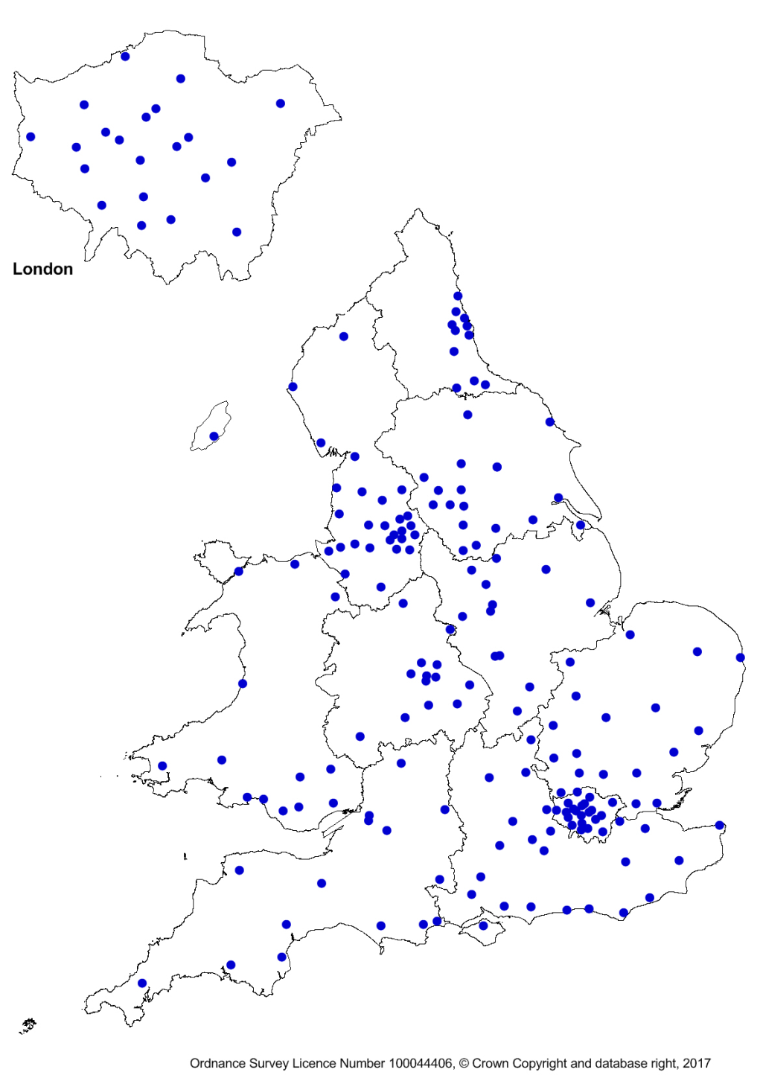
Audit Participation
Figure 1: Services that participated in the audit, 2016
172 services submitted data on pregnancies with a recorded outcome in 2016.
9 units submitted data to the audit for the first time in 2016.
3 units which had submitted ten or more records in 2014 and 2015, and which have not closed, did not participate in 2016.

Slide 18
Records used in this report
Table 1: Numbers of women, pregnancies and babies, 2016
ª Diabetes type not specified (28), maturity onset diabetes of the young (MODY) (33) or ‘Other’ diabetes type (10)
^{b} 7 women had two pregnancies recorded.
^{c} 49 twin and 1 triplet pregnancies were recorded

Slide 19
National Pregnancy in Diabetes Audit 2016
Characteristics of women
Diabetes type
Age
Duration of diabetes
BMI
Region
Ethnicity
Deprivation

Slide 20
Diabetes type by region
There remains considerable regional variation in the percentage of women who have Type 1 and Type 2 diabetes.
Since 2014 the proportion of women with type 2 diabetes in England has risen from 44 to 50 per cent.
Figure 2: Mother’s diabetes type for pregnancies by Government Office Regionª, 2016
ª Based on location of booking unit (may differ from delivery unit and woman’s residence).

Slide 21
Characteristics 1 – age, duration, BMI
Women with Type 2 diabetes were older, had a higher BMI, and had a shorter duration of diabetes than women with Type 1 diabetes.
Table 2: Median maternal age, duration of diabetes and Body Mass Index for pregnancies, 2016
ª Age at completion of pregnancy.
^{b} Duration of diabetes at start of pregnancy.

Slide 22
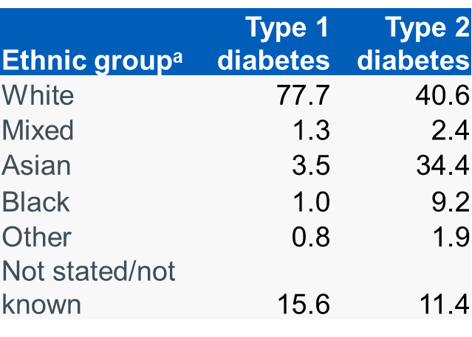
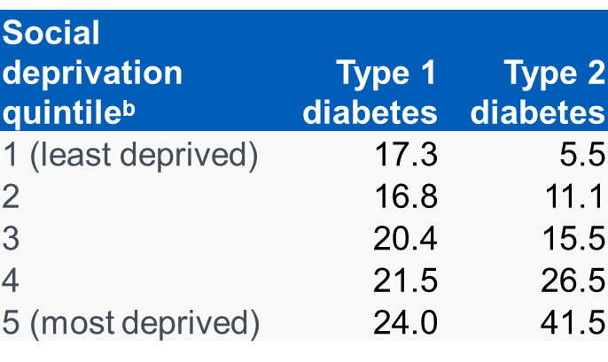
Characteristics 2 – ethnicity and deprivation
Ethnicity
Type 1 diabetes: Over three quarters of women were white.
Type 2 diabetes: Half of the women came from non-white ethnic groups.
Social deprivation scores
Type 1 diabetes: there was a fairly even spread across the deprivation groups.
Type 2 diabetes: over 40 per cent of women were from the most deprived group with a clear gradient towards greater deprivation scores.
Table 3: Percentage of pregnancies in each ethnic group, 2016
Table 4: Percentage of pregnancies in each social deprivation group, 2016
ªEthnic group only available for England
^{b} Social deprivation quintile only available for England.

Slide 23
Characteristics of women – comment
The proportion of women with Type 2 diabetes continues to rise and, for the first time, almost exactly half of women whose diabetes type was identified in the audit have Type 2 diabetes.
There is considerable regional variation in the proportions of women with Type 1 and Type 2 diabetes. In London, 70 per cent of women in the audit had Type 2 diabetes.
Women with Type 2 diabetes are older, have a much shorter duration of diabetes and higher BMI than women with Type 1 diabetes.
Nearly half of women with Type 2 diabetes were Asian, Black or Mixed Race.
Over 40 per cent of women with Type 2 diabetes were from the most deprived socio-economic group.
Initiatives around supporting women to use safe and effective contraception and to prepare successfully for pregnancy will need to take account of ethnicity, age and deprivation, and how these may influence the way women access health service support.

Slide 24
National Pregnancy in Diabetes Audit 2016
Were women adequately prepared for pregnancy?
HbA_{1c} management
Folic acid supplement
Non-recommended Diabetes treatments
Statins and ACE inhibitors

Slide 25
NICE guideline – HbA_{1c}
NICE recommendation (NG3¹): Explain to women with diabetes who are planning to become pregnant that establishing good glucose control before conception and continuing this throughout pregnancy will reduce the risk of miscarriage, congenital malformation, stillbirth and neonatal death. It is important to explain that risks can be reduced but not eliminated.
The guideline recommends:
Advising women with diabetes who are planning to become pregnant to aim to keep their HbA_{1c} level below 48 mmol/mol if this is achievable without causing problematic hypoglycaemia.
Strongly advising women with diabetes whose HbA_{1c} level is above 86 mmol/mol not to get pregnant because of the associated risks.
The NPID audit records the first HbA_{1c} measurement in pregnancy and uses the readings that are in the first trimester as an indication of HbA_{1c} prior to pregnancy.
¹See References section.

Slide 26
First trimester HbA_{1c}
During the three years 2014 to 2016 there has been no significant change in the percentages of pregnancies where the current NICE guideline targets were achieved.
Women with Type 2 diabetes were much more likely than women with Type 1 diabetes to have HbA_{1c} < 48 mmol/mol and less likely to have HbA_{1c} > 86 mmol/mol.
Table 5: First trimester HbA_{1c} levels, 2016

Slide 27
Which women had first trimester HbA_{1c} <48 mmol/mol?
Type 2 diabetes: There are no differences in age, duration of diabetes or BMI between women with first trimester HbA_{1c} < 48 mmol/mol and those with HbA_{1c} > 48 mmol/mol.
Type 1 diabetes: Those with first trimester HbA_{1c} < 48 mmol/mol were older and had been diagnosed more recently than those with HbA_{1c} > 48 mmol/mol.
Table 6: Average maternal age, duration of diabetes and BMI for women with first trimester HbA_{1c} <48 mmol/mol or > 48 mmol/mol, 2016
ª Age at completion of pregnancy.
^{b} Duration of diabetes at start of pregnancy.

Slide 28
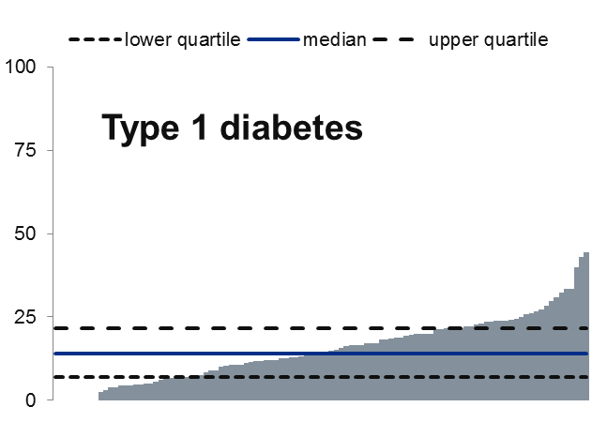
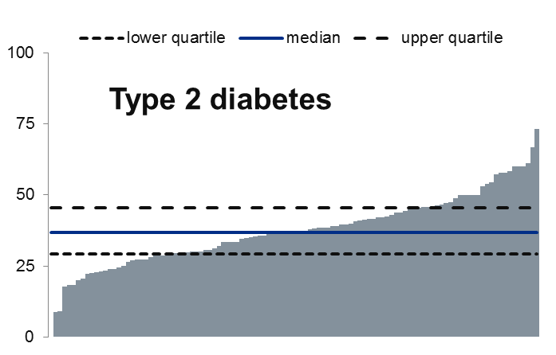
Local variation in first trimester HbA_{1c}
The percentage of women achieving first trimester HbA_{1c} <48 mmol/mol varied greatly between services.
For women with Type 1 diabetes the range was 0 to 44 per cent and for women with Type 2 diabetes 0 to 73 per cent.
Figure 3: percentage of pregnancies where mother had first trimester HbA_{1c} <48 mmol/mol, by serviceª, 2014 – 2016, with interquartile ranges^{b}
Direction of better performance
ª Includes services with at least 10 valid first trimester HbA_{1c} records: Type 1 diabetes – 107 services, Type 2 diabetes – 108 services
^{b} see slide Use of statistics in analysing NPID data 2016 for more explanation of median and interquartile range

Slide 29
NICE guideline – folic acid
Women with diabetes have an increased risk of having a pregnancy affected by a neural tube defect.
NICE recommendation (NG3¹): Advise women with diabetes who are planning to become pregnant to take 5mg/day folic acid until 12 weeks of gestation to reduce this risk.
The 5mg dose is available on prescription.
¹See References section.

Slide 30
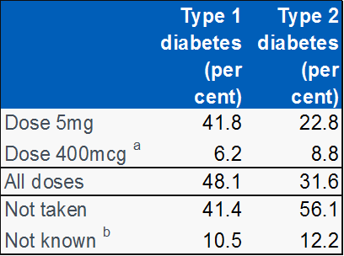
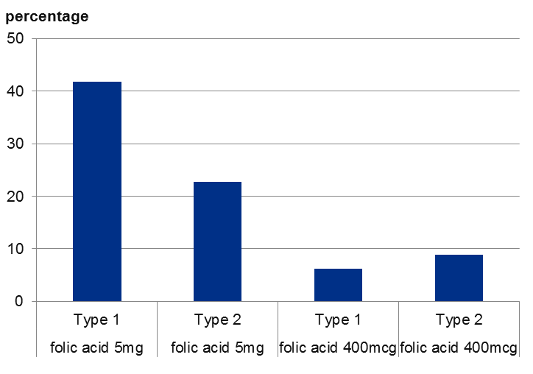
Use of folic acid supplement
Almost twice as many women with Type 1 diabetes were taking 5mg of folic acid prior to pregnancy as women with Type 2 diabetes
There has been no significant increase in the percentage of women taking folic acid at the recommended dose in the years since 2014.
Figure 4:Use of folic acid supplement prior to pregnancy, 2016
ª 400mcg is the folic acid recommended in pregnancy for non-diabetic women
^{b} ‘Not known’ includes women recorded as taking folic acid but with unknown dose.

Slide 31
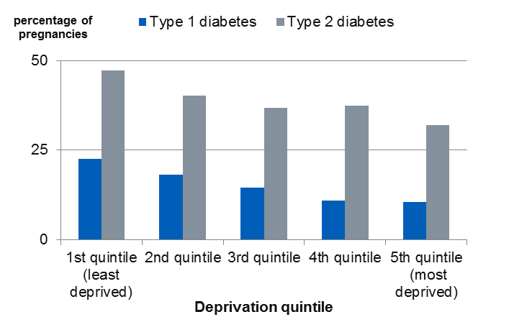
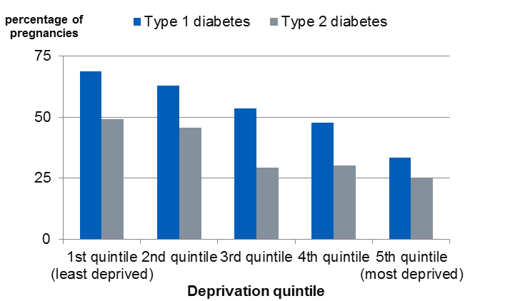
Deprivation and preparation for pregnancy
For both Type 1 and Type 2 diabetes, a significantly higher proportion of women in the least deprived group had HbA_{1c} < 48 mmol/mol in the first trimester of pregnancy and had taken folic acid prior to Last Menstrual Period (LMP) than in the most deprived group.
These results indicate that women in the most deprived groups are the least well prepared for pregnancy
Figure 5: percentage of pregnancies with first trimester HbA_{1c} < 48 mmol/ mol, by deprivation quintile, 2016
Figure 6: percentage of pregnancies taking 5mg folic acid at last LMP, by deprivation quintile, 2016

Slide 32
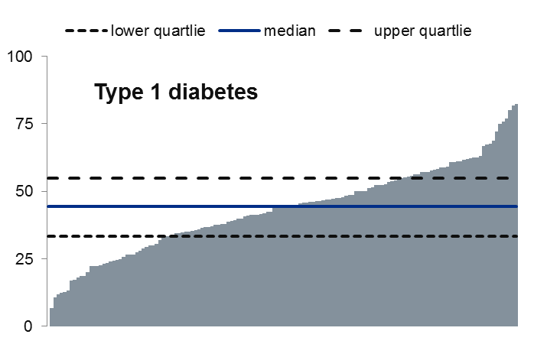
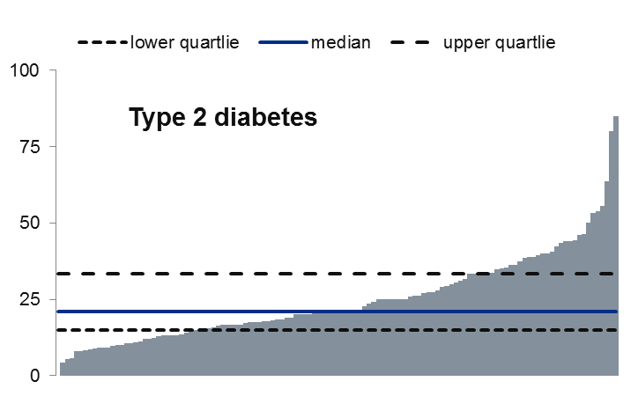
Local variation in use of 5mg folic acid
The percentage of women taking 5mg folic acid varied greatly between services – from none to more than 4 in 5 for mothers with Type 1 or Type 2 diabetes.
In 75 per cent of services, only a third of women with Type 2 diabetes had taken 5mg folic acid prior to pregnancy.
Figure 7: percentage of pregnancies where 5mg folic acid was taken prior to pregnancy, by serviceª, 2014 – 2016, with interquartile range^{b}
Direction of better performance
ª Includes services with at least 10 valid folic acid dose records: Type 1 diabetes – 144 services, Type 2 diabetes – 123 services
^{b} See slide Use of statistics in analysing NPID data 2016 for more explanation of median and interquartile range

Slide 33
NICE guideline – medications
NICE recommendations (NG3¹):
Women may be advised to use metformin as an adjunct or alternative to insulin before conception and during pregnancy, when the likely benefits from improved blood glucose control outweigh the potential for harm.
All other oral blood glucose-lowering agents should be discontinued before pregnancy and insulin substituted.
ACE inhibitors/ARBs and statins should be discontinued before pregnancy or as soon as pregnancy is confirmed.
¹See References section.

Slide 34
Treatment regimen prior to pregnancy
6.5 per cent of women with Type 2 diabetes were taking potentially hazardous glucose lowering medication at LMP.
Around one in eight women with Type 2 diabetes were taking statins or ACE inhibitors/ARBs or were on adverse diabetes medication prior to pregnancy compared to less than one in fifty women with Type 1 diabetes.
21.2 per cent of women with Type 1 diabetes (344) were using an insulin pump. A significantly higher proportion of these women had first trimester HbA_{1c} < 48 mmol/mol – 20 per cent for those on pump and 13 per cent for those not on pump.
Table 7: percentage of women on selected diabetes treatment regimens and adverse medications at LMP, 2016
 | Type 1 diabetes^{d} | Type 2 diabetes
On insulin ^{b} only | 93.4 | 7.7
On insulin ^{b} and metformin only | 5.2 | 12.0
On metformin only | 0.3 | 52.6
On at least one of statins/ ACE inhibitor/ ARB/adverse diabetes medications ^{c} | 1.8 | 13.0
^{b} ‘On insulin’ includes basal bolus insulin regimen, mixed insulin or basal insulin only and insulin pump therapy.
^{c} ‘Other diabetes medications’ are sulphonylurea or glitinide, gliptin, GLP-1 analogue and pioglitazone, irrespective of whether the woman was also taking metformin and/or insulin.
^{d} Data quality warning – some women with Type 1 diabetes were recorded as being on metformin only, and some on other unspecified medication or diet only. All women with Type 1 diabetes would be taking insulin.

Slide 35
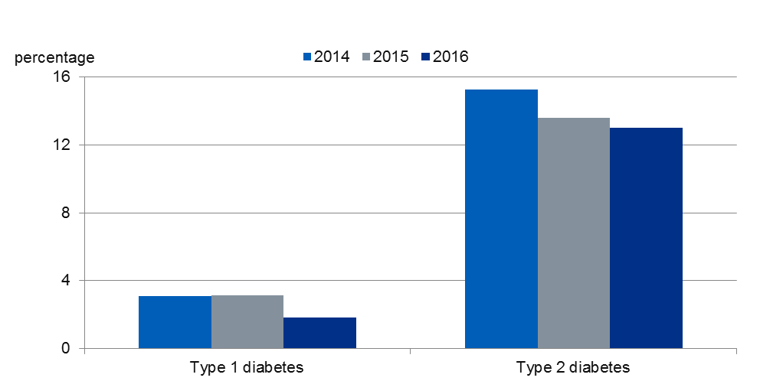
Trends in the use of statins, ACE inhibitors and adverse diabetes medication prior to pregnancy
The percentage of women with Type 1 diabetes who were taking statins, ACE inhibitors/ARBs or were on adverse diabetes medication prior to pregnancy has fallen significantly from 3.1 per cent in 2014 to 1.8 per cent in 2016.
Over the same period the percentage of women with Type 2 diabetes who were on any of these adverse medications fell from 15.2 per cent to 13.0 per cent, which is not a significant change.
Figure 8: Percentage of women who were taking statins or ACE inhibitors/ARBs, or who were on adverse diabetes medication at LMP, 2014 to 2016

Slide 36
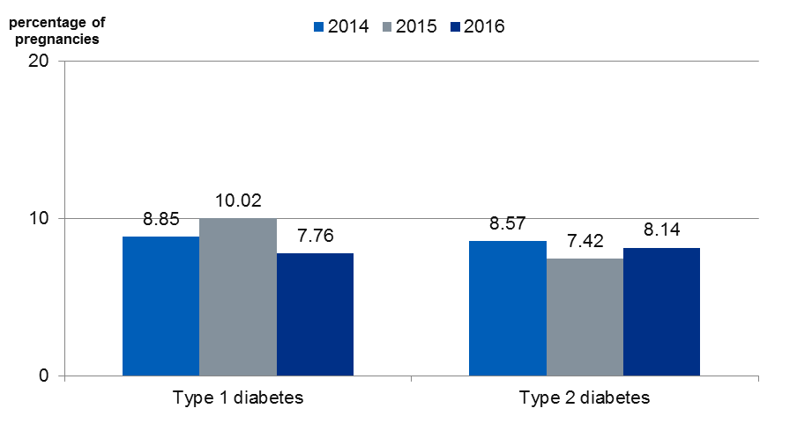
Were women well prepared for pregnancy?
The definition of “well prepared for pregnancy” includes a first trimester HbA_{1c} below 48 mmol/mol, taking 5mg folic acid and coming off all adverse medication prior to pregnancy.
Under this definition only around one in twelve women were well prepared for pregnancy – this is not significantly different for women with Type 1 and Type 2 diabetes and has not changed since 2014.
Figure 9: Percentage of pregnancies where HbA_{1c} was less than 48mmol/mol, 5mg of folic acid had been taken prior to pregnancy and not on any adverse medication – 2014 to 2016

Slide 37
Preparation for pregnancy - comment
Only one in twelve women (8 per cent) had achieved HbA_{1c} < 48mmol/mol, the use of 5mg folic acid and avoidance of potentially harmful medications before conception.
Women in the most deprived groups are the least well prepared for pregnancy.
Women with Type 2 diabetes are more likely to have HbA_{1c} < 48mmol/mol but were less likely to be taking 5mg folic acid, and more likely to be taking potentially harmful medications and this has not changed since 2014.
Women with Type 1 diabetes using insulin pumps were more likely to have HbA_{1c} < 48mmol/mol in the first trimester.
For women with Type 2 diabetes the lower uptake of folic acid and considerable numbers taking potentially harmful medications suggests persisting lower levels of awareness of / support around the benefits of pregnancy preparation.
Variation between services suggests that there are almost certainly to be opportunities to improve pregnancy preparation.

Slide 38
National Pregnancy in Diabetes Audit 2016
Maternal care in pregnancy
Timing of first contact with antenatal diabetes team
HbA_{1c} values in pregnancy

Slide 39
NICE guideline - antenatal care and monitoring HbA_{1c}
NICE recommendations (NG3¹):
Offer immediate contact with a joint diabetes and antenatal clinic to women with diabetes who become pregnant
Measure HbA_{1c} levels at the booking appointment to determine the level of risk to the pregnancy
Consider measuring HbA_{1c} levels in the second and third trimesters of pregnancy to assess the level of risk to the pregnancy
Be aware that level of risk to the pregnancy increases with a HbA_{1c} level above 48mmol/mol.
¹See References section.

Slide 40
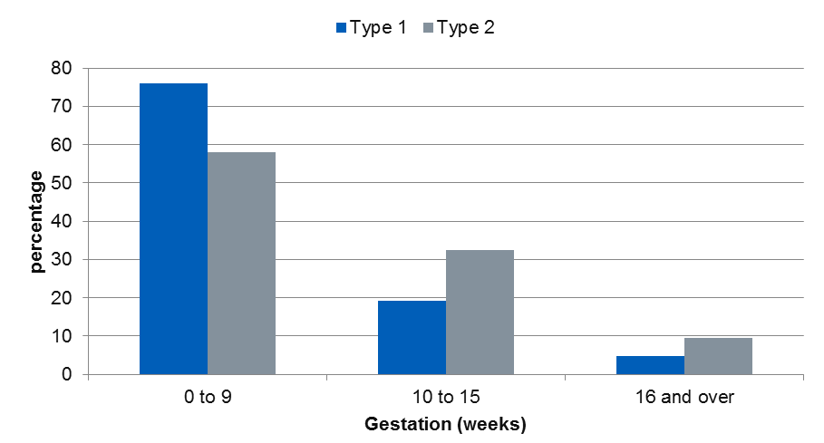
First contact with antenatal diabetes team
24.0 per cent of women with Type 1 diabetes and 41.9 per cent of women with Type 2 diabetes did not present to the joint diabetes antenatal team before 10⁺⁰ weeks gestation, a significant difference.
This did not change between 2014 and 2016.
Figure 10: Gestation (weeks) at first contact^{a,b} with specialist antenatal diabetes team, 2016
ª NICE recommends to offer immediate contact with the antenatal diabetes team – the NPID audit records the date of first contact with the team during pregnancy.
^{b} Very early appointments are likely to be preconception care appointments already in place.

Slide 41
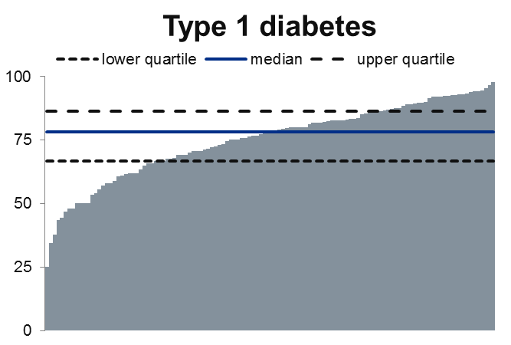
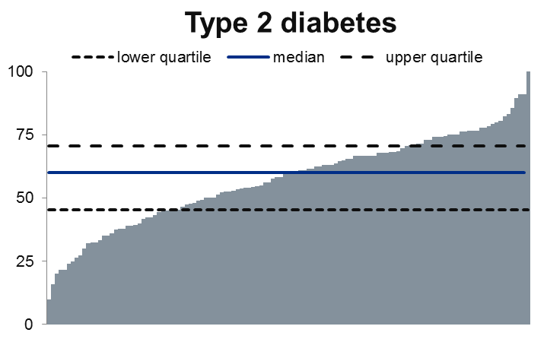
Local variation in timing of first contact with antenatal diabetes team
The percentage of women having contact in the first 10 weeks of pregnancy varied greatly between services.
The range was from 25 to almost 100 per cent for women with Type 1 diabetes and from 10 to 100 per cent for women with Type 2 diabetes.
Figure 11: percentage of pregnancies where first contact with antenatal diabetes team at less than 10 weeks gestation by serviceª, with interquartile range^{b}
Direction of better performance
ª Includes services with at least 10 valid first contact records: Type 1 diabetes – 120 services, Type 2 diabetes – 123 services
^{b} see slide Use of statistics in analysing NPID data 2016 for more explanation of median and interquartile range

Slide 42
HbA_{1c} values in late pregnancyª
Around 40 per cent of women with Type 1 diabetes and 75 per cent of women with Type 2 diabetes had HbA_{1c} <48 mmol/mol in late pregnancy^{b}.
The median HbA_{1c} for women with Type 1 diabetes in late pregnancy was 50 mmol/mol, and for women with Type 2 diabetes was 41 mmol/mol.
Neither the proportion of women with HbA_{1c} < 48mmol/mol nor the median HbA_{1c} in the last trimester changed significantly between 2014 and 2016.
Table 8: HbA_{1c} measurements in first trimester and at 24 weeks+, 2016
ª NICE recommends measuring HbA_{1c} at booking, and consider measuring in the second and third trimesters - the NPID audit records the first and last measurements in pregnancy.
^{b} HbA_{1c} falls physiologically in pregnancy because of changes in iron transport and red cell turnover³.
³ See References section.

Slide 43
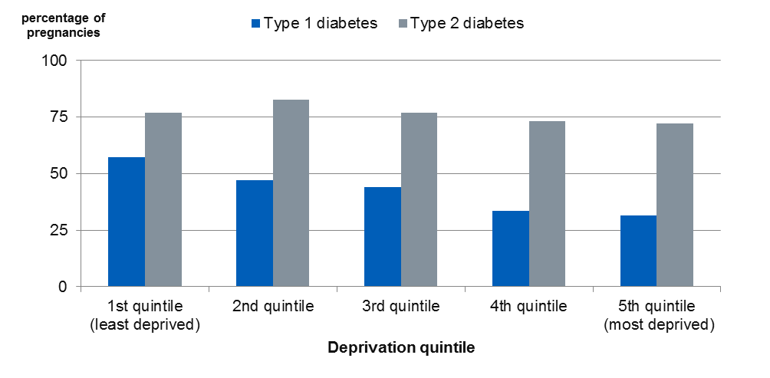
Deprivation and HbA_{1c} in late pregnancy
For women with Type 1 diabetes, a significantly higher percentage of women in the least deprived group had HbA_{1c} < 48 mmol/mol than in the most deprived group.
For women with Type 2 diabetes, there was no difference in the percentage of women who had HbA_{1c} < 48 mmol/mol in the third trimester of pregnancy across the deprivation groups.
Figure 12: percentage of pregnancies with third trimester HbA_{1c} < 48 mmol/mol, by deprivation quintile, 2016

Slide 44
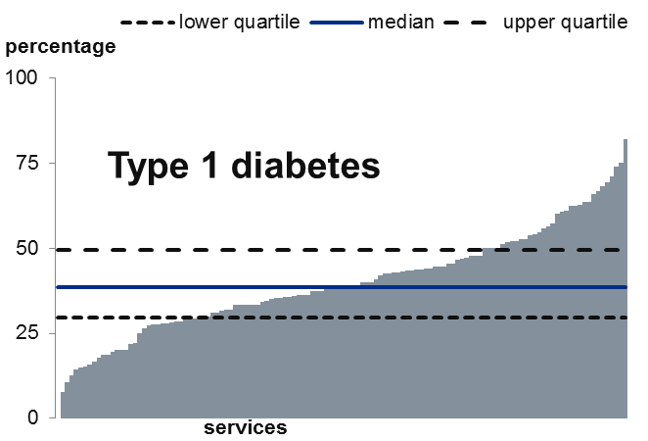
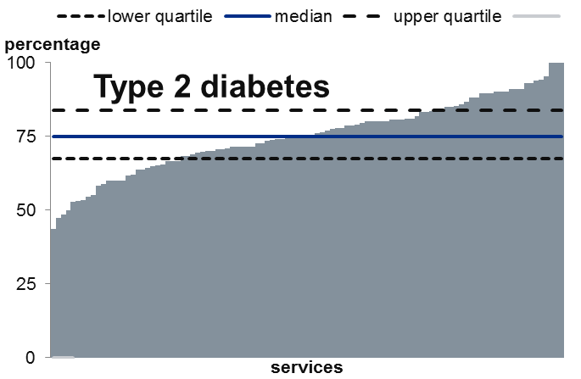
Local variation in third trimester HbA_{1c}
The percentage of women achieving third trimester HbA_{1c} < 48 mmol/mol varied greatly between services.
For women with Type 1 diabetes, the range was 0 to 82 per cent for women with Type 2 diabetes 43 to 100 per cent.
Figure 13: percentage of pregnancies where mother had third trimester HbA_{1c} <48 mmol/mol, by serviceª, 2014 to 2016, with interquartile ranges^{b}
Direction of better performance
ª Includes services with at least 10 valid 3rd trimester HbA_{1c} records: Type 1 diabetes – 126 services, Type 2 diabetes – 103 services
^{b} see slide Use of statistics in analysing NPID data 2016 for more explanation of median and interquartile range

Slide 45
Maternal care in pregnancy - comment
More women with Type 1 diabetes present early in pregnancy. This reinforces the evidence that women with Type 2 diabetes are less well informed/supported and less prepared.
Variation in the timing of first visit, with some localities achieving very high rates of early presentation, suggests that there is opportunity for improvement.
HbA_{1c} < 48mmol/mol is harder to achieve in women with Type 1 diabetes. Substantial proportions of both women with Type 1 (59 per cent) and Type 2 (25 per cent) diabetes have HbA_{1c} > 48mmol/mol in later pregnancy. Variation between services again suggests opportunities for improvement.
Strategies are urgently needed to better support achievement of target glucose control throughout pregnancy for all women with diabetes.

Slide 46
National Pregnancy in Diabetes Audit 2016
Were adverse maternal outcomes minimised during pregnancy?
Hospital admissions with hypoglycaemia
Hospital admissions with DKA (diabetic ketoacidosis)

Slide 47
Hypoglycaemia and DKA
Table 9: Hospital episodes with diagnosed hypoglycaemiaª during pregnancy, England and Wales, 2015
 | Type 1 diabetes |  | Type 2 diabetes
 | Number | percentage | Number | percentage
At least one admission | 159 | 9.7 | 48 | 3.2
No admissions recorded | 1477 | 90.3 | 1447 | 96.8
Table 10: Hospital episodes with diagnosed DKAª during pregnancy, England and Wales, 2015
 | Type 1 diabetes |  | Type 2 diabetes
 | Number | percentage | Number | percentage
At least one admission | 44 | 2.7 | 4 | 0.3
No admissions recorded | 1592 | 97.3 | 1491 | 99.7
ªSee Data Quality statement.

Slide 48
Maternal outcomes during pregnancy - comment
Hypoglycaemia carries significant risks for pregnant women, and pregnancies complicated by diabetic ketoacidosis are associated with increased rates of perinatal morbidity and mortality⁴.
Among women with Type 1 diabetes:
  Almost one in ten had at least one hospital admission with hypoglycaemia
  Around one in forty women were admitted to hospital with DKA
  These proportions have not changed between 2014 and 2015
Both hypoglycaemia and ketoacidosis should be preventable risks to women with diabetes and their babies.
⁴ See References section.

Slide 49
National Pregnancy in Diabetes Audit 2016
Timing and mode of birth
Gestation length
Onset of labour
Mode of delivery

Slide 50
NICE guideline – timing and mode of birth
NICE recommendations (NG3¹):
Advise women with no other complications to have an elective birth by induction of labour, or elective caesarean section if indicated, between 37⁺⁰ and 38⁺⁶ weeks of pregnancyª
Consider elective birth before 37⁺⁰ weeks if there are metabolic or any other maternal or fetal complications.
ª37⁺⁰ = 37 weeks and 0 days, 38⁺⁶ = 38 weeks and 6 days
¹ See References section.

Slide 51
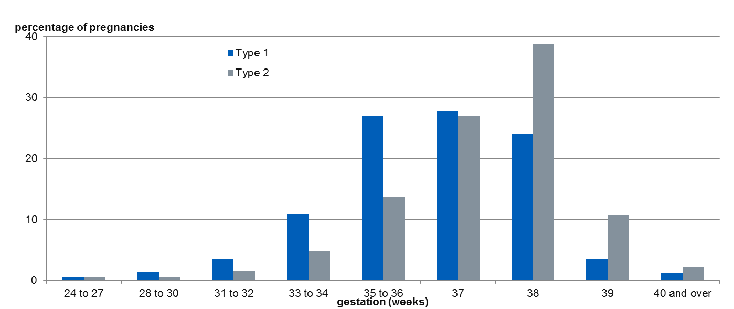
Gestation for singleton births
More than half of births were between 37⁺⁰ and 38⁺⁶ weeks. One in twenty births to mothers with Type 1 diabetes and one in eight births to mothers with Type 2 diabetes took place after 38⁺⁶ weeks.
43.3 per cent of women with Type 1 diabetes and 21.3 per cent of women with Type 2 diabetes delivered before 37⁺⁰ weeks.
There was a significant reduction in the proportion of births at more than 38 weeks’ gestation to Type 1 mothers between 2014 and 2016 (from 5.9 per cent to 4.8 per cent).
Figure 14: Gestation at delivery for singleton live births, 2016

Slide 52
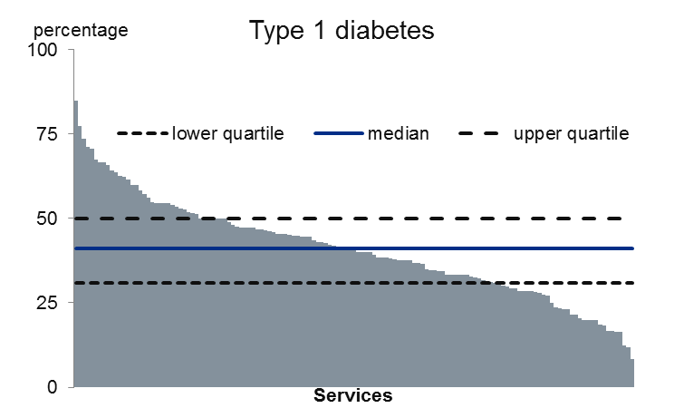
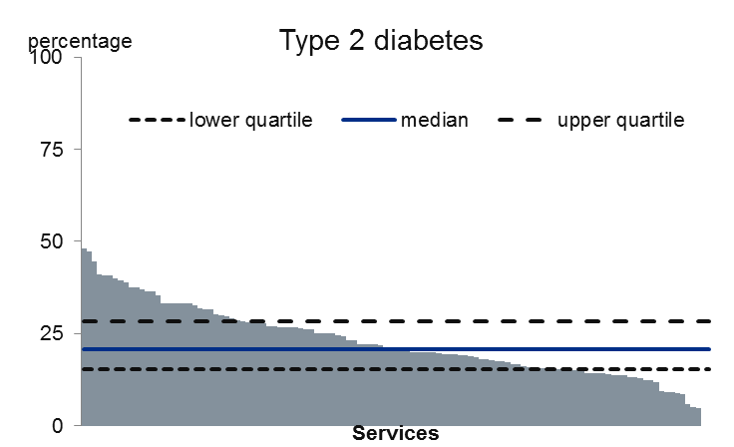
Local variation in proportion of babies born prematurely
The proportion of singleton live babies born before 37 weeks’ gestation varied greatly between services.
The range was from over 80 per cent of babies born to mothers with Type 1 diabetes down to less than 10 per cent, and from 48 per cent of babies born to mothers with Type 2 diabetes to none.
Figure 15: The percentage of singleton live babies born before 37 weeks’ gestation by serviceª, 2014 to 2016, with interquartile range^{b}
Direction of better performance
ª Includes services with at least 10 valid records for singleton live births: Type 1 diabetes – 139 services, Type 2 diabetes – 119 services.
^{b} see slide Use of statistics in analysing NPID data 2016 for more explanation of median and interquartile range

Slide 53
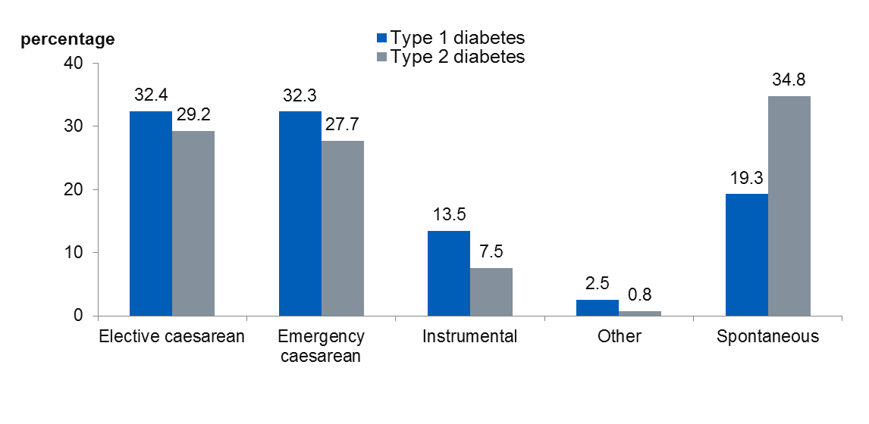
Labour and delivery
Less than one in six women had a spontaneous onset of labour.
Spontaneous delivery was almost twice as common among women with Type 2 diabetes compared to women with Type 1 diabetes.
Caesarean section was the most common mode of delivery.
A higher percentage of women with Type 1 diabetes had an emergency Caesarean or instrumental delivery than women with Type 2 diabetes.
Figure 16: Mode of delivery for births at or after 24 weeks gestation, England and Wales, 2015

Slide 54
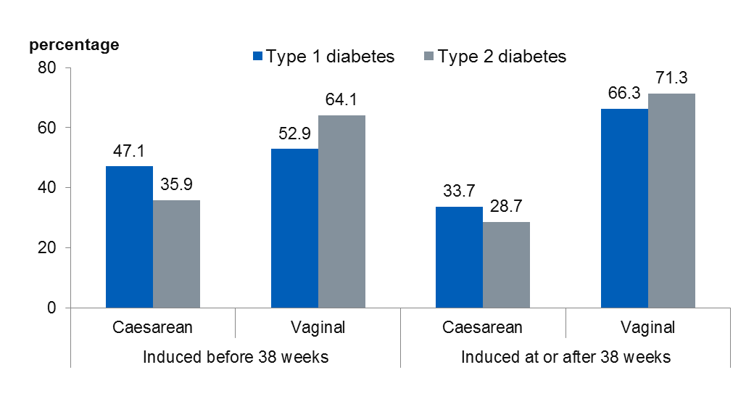
Method of delivery where labour induced
A significantly higher proportion of women with Type 1 diabetes who have induction of labour before 37⁺⁶ weeks go on to deliver by Caesarean section compared with women with Type 2 diabetes (47 per cent compared with almost 36 per cent).
Where labour is induced at or after 38 weeks, there is no significant difference in Caesarean section rates.
There has been no significant change in these rates since 2014.
Figure 17: Mode of delivery for singleton births where labour induced, England and Wales, 2015

Slide 55
Timing and mode of birth - comment
A significant proportion of births, especially for women with Type 1 diabetes were before 37⁺⁰ weeks suggesting that there were concerns about the foetus and/or the mother.
A high proportion of women were delivered by caesarean section (64.7 per cent of women with Type 1 diabetes and 56.9 per cent of women with Type 2 diabetes).
Induction of labour before 37⁺⁰ weeks commonly results in caesarean section especially in women with Type 1 diabetes.
The low rate of spontaneous onset of labour may be the result of NICE guidance which recommends delivery in women with diabetes before 38⁺⁶ weeks of pregnancy.

Slide 56
National Pregnancy in Diabetes Audit 2016
Were adverse fetal and neonatal outcomes minimised?
Pregnancy outcomes
Stillbirths and neonatal deaths
Congenital anomalies
Preterm births
Birthweights and large for gestational age
Neonatal unit admissions

Slide 57
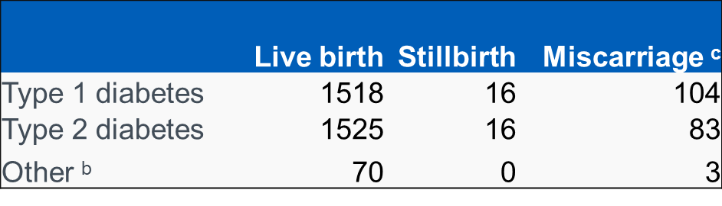
Pregnancy outcomes
99.0 per cent of registered births (live and stillbirths) in the 2016 NPID audit were live births, compared with 99.6 per cent of all registered births in 2016 in the general England and Wales maternity population⁵.
Table 11: Pregnancy outcomesª, 2016
ª A small number of terminations of pregnancy are not shown here
^{b} Diabetes type not specified, maturity onset diabetes of the young (MODY) or ‘Other’ diabetes type.
^{c} Early miscarriages (prior to booking) are likely to be under-reported.
⁵ See References section.

Slide 58
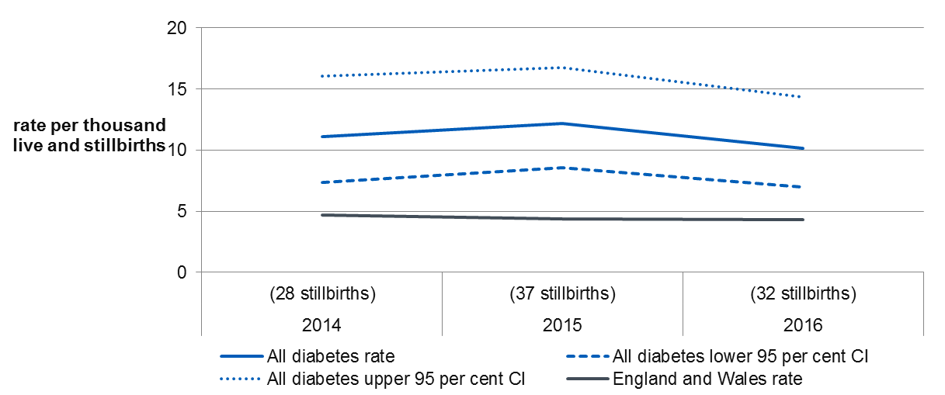
Adverse outcomes – stillbirth
Stillbirth rates in the NPID audit were 10.2 per 1,000 live and stillbirths in 2016, compared with 4.3 per 1,000 live and stillbirths in 2016 in the general population of England and Wales⁵.
There was no change in the stillbirth rate in the NPID population between 2014 and 2016.
Figure 18: Stillbirth rate (per 1,000 live and stillbirths) with 95 per cent confidence interval, 2014 to 2016 – all diabetes Types
⁵ See References section.

Slide 59
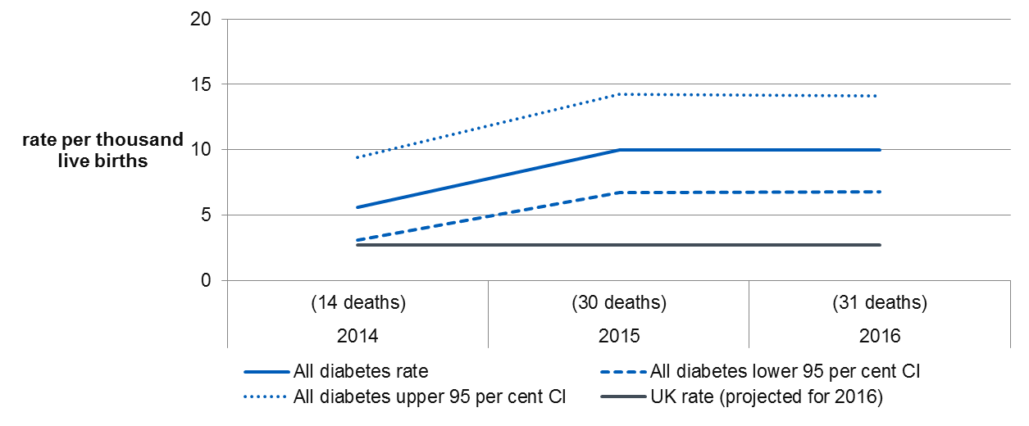
Adverse outcomes – neonatal death
Neonatal death rates in the NPID audit were 10.0 per 1,000 live births in 2016. These are much higher than the neonatal death rate for the UK in 2015⁶ of 2.7 deaths per 1,000 live births.
There was no change in the neonatal death rate in the NPID population between 2014 and 2016.
Figure 19: Neonatal death rate (per 1,000 live births) with 95 per cent confidence interval, 2014 to 2016 – all diabetes Types
⁶ See References section.

Slide 60
Adverse outcomes – congenital anomalies
Table 12: Congenital anomaly rate per 1,000 live and stillbirths, 2016
 | Type 1 diabetes | Type 2 diabetes
Rate per 1,000 ª | 47.6 | 44.8
95 per cent confidence interval | (37.3, 59.8) | (34.8, 56.7)
ª Includes live births and terminations at any gestation, stillbirths and miscarriages after 20 weeks.
Comparisons with other published rates should be made with caution because:
Some anomaly registers exclude certain ‘minor’ anomalies, while the NPID rate includes any reported anomaly.
The NPID audit is likely only to include anomalies identified prior to discharge from hospital, while other sources may include anomaly notifications some time after birth.

Slide 61
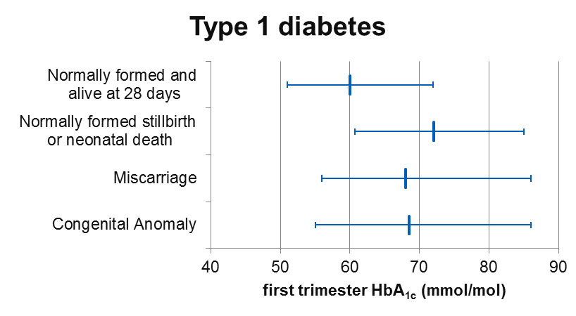
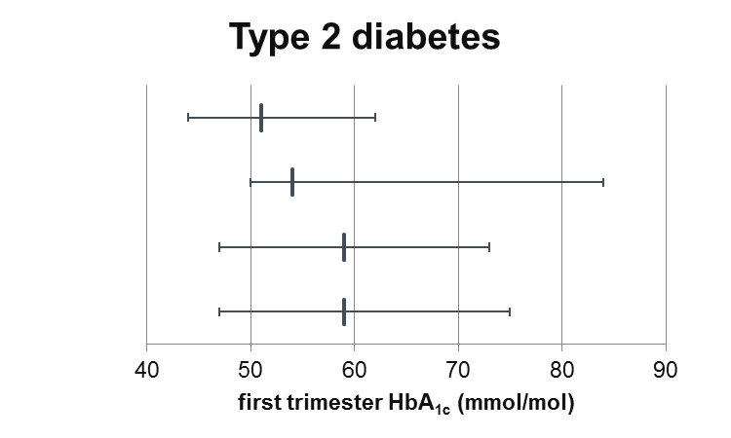
First trimester HbA_{1c} and outcomes
First trimester HbA_{1c} was significantly higher for women with both Type 1 and Type 2 diabetes where:
The pregnancy ended in a miscarriage, or;
There was a congenital anomaly.
First trimester HbA_{1c} was also significantly higher in women with Type 1 diabetes where the pregnancy resulted in a stillbirth or a neonatal death.
Figure 20: Median values and interquartile ranges for first trimester HbA_{1c} for selected pregnancy outcomes, 2016

Slide 62
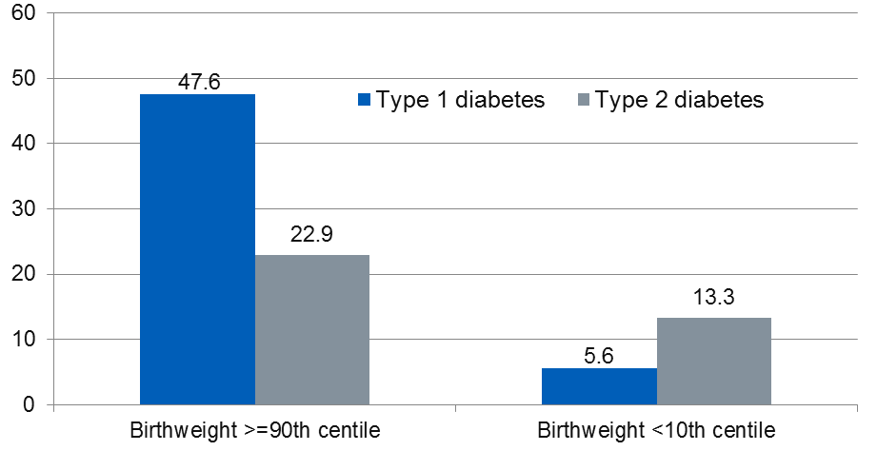
Birthweight centiles
The proportions of babies born above the 90th centile (large for gestational age - LGA) was much higher than in the general population for women with both types of diabetes.
Nearly a half of women with Type 1 diabetes delivered babies above 90th centile for the general population.
These levels have not changed since 2014.
Figure 21: Birthweight centilesª for singleton babies, 2016 – percentage of babies falling in each range, compared to expected
Expected level
ª Centiles adjust the actual birthweight for maternal ethnicity, height, weight and gestational age at delivery⁸.
⁸ See References section.

Slide 63
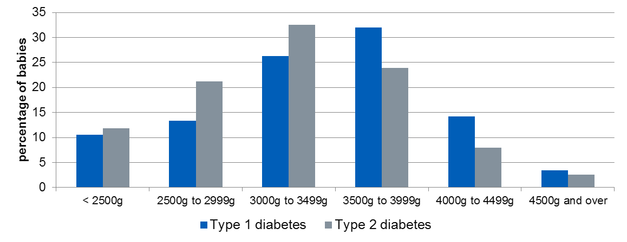
Birthweights
Macrosomia (birthweight 4 kg or more) is a recognised complication for babies of women with diabetes.
In 2015, in England and Wales, 11.1 per cent of live births weighed 4kg or more⁷.
17.7 per cent of babies of women with Type 1 diabetes and 10.5 per cent of babies of women with Type 2 diabetes had a birthweight of 4 kg or more. There was no change in these proportions between 2014 and 2016.
Figure 22: Birthweight distribution for singleton babies, 2016
⁷ See References section.

Slide 64
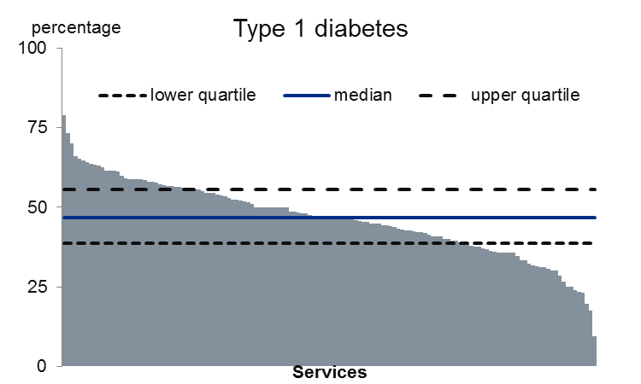
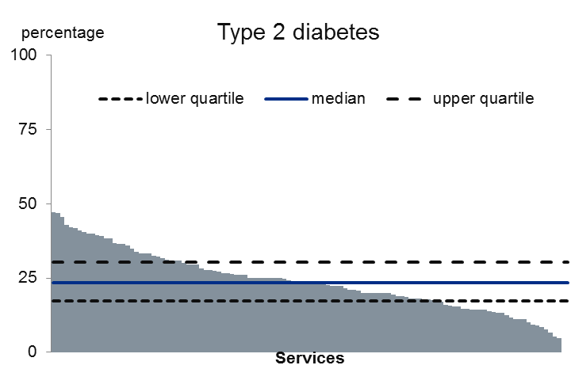
Local variation in babies born LGA
The proportion of LGA babies varied greatly between services.
The range was from over 70 per cent of babies born to mothers with Type 1 diabetes down to 10 per cent, and from 47 per cent of babies born to mothers with Type 2 diabetes to none.
Figure 23: The percentage of LGA babies by serviceª, 2014 – 2016, with interquartile range^{b}
Direction of better performance
ª Includes services with at least 10 valid gestation records: Type 1 diabetes – 139 services, Type 2 diabetes – 119 services.
^{b} See slide ‘Use of statistics in analysing NPID data 2016’ for more explanation of median and interquartile range

Slide 65
NICE guideline – neonatal care
NICE recommendation (NG3¹): Babies of women with diabetes should stay with their mothers unless there is a clinical complication or there are abnormal clinical signs that warrant admission for intensive or special care.
The guideline lists specific criteria for admission to the neonatal unit, including if babies have been born:
Before 34 weeks
Between 34 and 36 weeks if dictated clinically
¹ See References section.

Slide 66
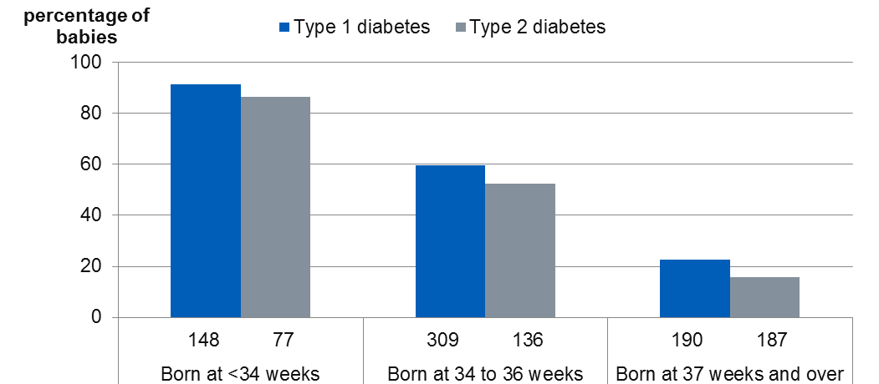
Neonatal unit admissions
Rates of admission among women with diabetes were higher than the general maternity population.
Most babies born before 34 weeks gestation were admitted to a neonatal unitª.
A significantly higher proportion of babies born after 37⁺⁰ weeks’ gestation to women with Type 1 diabetes were admitted to a neonatal unit than babies born to women with Type 2 diabetes.
There has been no change in neonatal unit admission rates among women with diabetes since 2014.
Figure 24: The percentage of babies admitted to a neonatal unitª, 2016
ª Neonatal unit includes special care and intensive care.

Slide 67
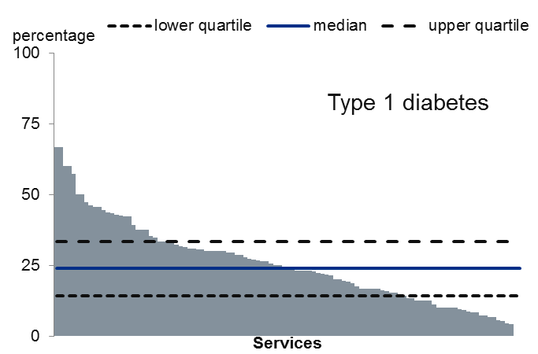
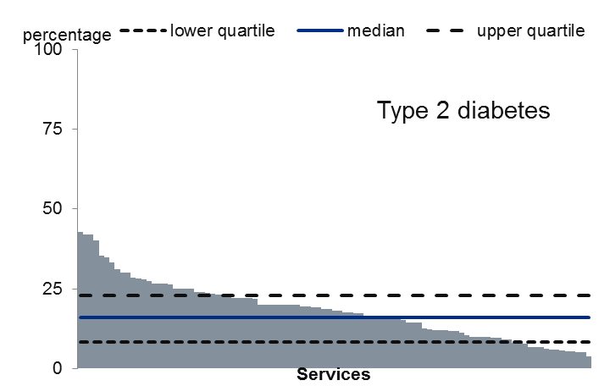
Local variation in babies born at or after 37 weeks admitted to neonatal unit
The proportion of full term babies admitted to a neonatal unit varied greatly between services.
The range was from two-thirds of babies born to mothers with Type 1 diabetes down to none, and from 43 per cent of babies born to mothers with Type 2 diabetes to none.
Figure 25: The percentage of babies born at/after 37 weeks admitted to a neonatal unit by serviceª, 2014 – 2016, with interquartile range^{b}
Direction of better performance
ª Includes services with at least 10 valid special care or intensive care admission records: Type 1 diabetes – 109 services, Type 2 diabetes – 110 services.
^{b} See slide Use of statistics in analysing NPID data 2016 for more explanation of median and interquartile range

Slide 68
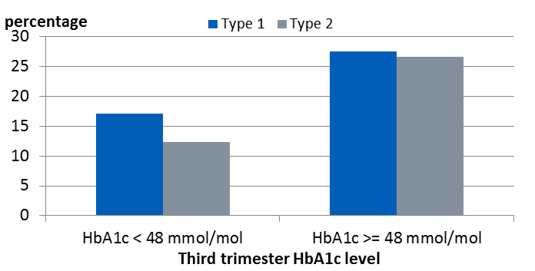
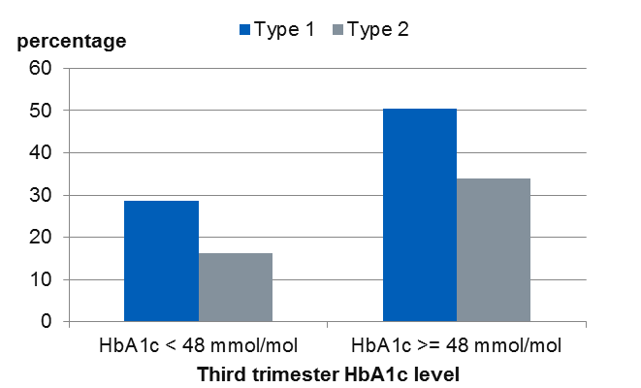
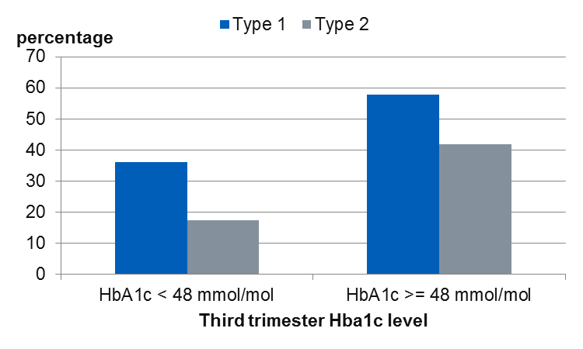
Third trimester HbA_{1c} and outcomes
For women with third trimester HbA_{1c} levels at or above 48 mmol/mol, rates of preterm births, LGA and neonatal care admissions were significantly higher than for women with lower glucose levels
Figure 26: percentage of babies born at 37 weeks or later admitted to neonatal care
Figure 27: percentage singleton live births before 37 weeks' gestation
Figure 28: percentage of babies born large for gestational age

Slide 69
Neonatal outcomes - comment
Women with diabetes have high rates of adverse neonatal outcomes (stillbirth, neonatal death, congenital anomaly, and large for gestational age infants) compared with the general population.
Women with Type 1 diabetes and higher early pregnancy HbA_{1c} have higher risk of stillbirth and neonatal death.
Women with Type 1 diabetes have much higher rates of macrosomia and babies with birth weight above 90th centile.
These findings have not changed since 2014.

Slide 70
Neonatal care – comment
Even after 37⁺⁰ weeks gestation the babies of women with diabetes are more likely to be transferred to a neonatal unit than the general maternity population. The babies of women with Type 1 diabetes are significantly more likely to be transferred than babies of women with Type 2 diabetes.
This is undesirable and should be largely avoidable.
There was no change in the rate of admission to neonatal units between 2014 and 2016.
Levels of third trimester HbA_{1c} at or above 48 mmol/mol are associated with higher rates of preterm birth, LGA babies and neonatal unit admission.
The very high rates of variation between centres suggests that there may be modifiable differences in neonatal unit admission policies.

Slide 71
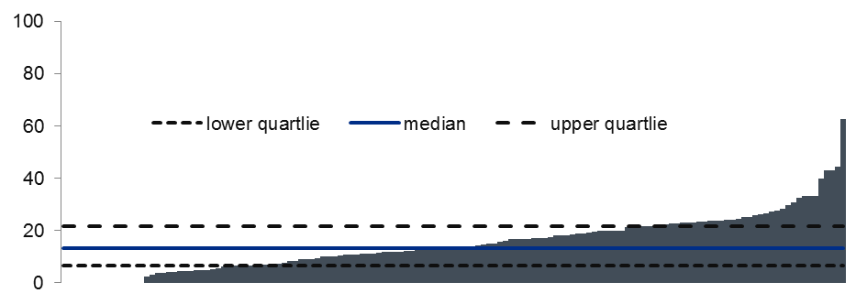
Use of statistics in NPID 2016
For NPID 2016 the mid-point used with most data items is the median rather than the mean since many of the variables are not normally distributed
The median is the middle value when the data is in ranked order, whereas the mean will be influenced by values in the tail of the distribution especially where the distribution is skewed
The measures of spread of the data which are used with the median describe the values at either end of the middle of the data – for example the interquartile range describes the values taken by the middle 50 per cent. If a distribution has median 65 and an interquartile range from 52 to 85, this indicates that the lowest 25 per cent of values are below 52, the next 25 per cent are between 52 and 65, the next 25 per cent between 65 and 85, and the highest 25 per cent will be above 85.
Unlike the mean and standard deviations, the interquartile range will not be symmetrical around the median.
Bar charts of the range of values across services are used through this report, and can be interpreted as indicated here
Lowest 25% of services
Highest 25% of services
Middle 50% of services
Direction of better performance

Slide 72
National Pregnancy in Diabetes Audit 2016
Additional information and references

Slide 73
Additional information
The following documents are available from:
http://digital.nhs.uk/pubs/npdaudit17
Supporting data in Excel
Powerpoint version of this report
Summary of Key Findings and Recommendations
Service level 2014-2016 data
Data Quality Statement
Methodology
Glossary

Slide 74
References
1. | NICE Diabetes in Pregnancy: Management of diabetes and its complications from pre-conception to the post natal period https://www.nice.org.uk/Guidance/NG3
2. | RCOG Census Report 2014-15 https://www.rcog.org.uk/globalassets/documents/careers-and-training/census-workforce-planning/final-census-2014-15.pdf
3 4 | Worth R, Potter JM, Drury J, Fraser RB, Cullen DR. Glycosylated haemoglobin in normal pregnancy: a longitudinal study with two independent methods. Diabetologia 1985; 28: 76-9 Sibai BM, Viteri OA. Diabetic ketoacidosis in pregnancy. Obstet Gynecol 2014;123(1):167-78.
5. 6. 7. 8. 9. | Office for National Statistics: Births in England and Wales: 2016 https://www.ons.gov.uk/peoplepopulationandcommunity/birthsdeathsandmarriages/livebirths/bulletins/birthsummarytablesenglandandwales/2016 Office for National Statistics: Vital Statistics: Population and Health Reference Tables 2015 https://www.ons.gov.uk/peoplepopulationandcommunity/populationandmigration/populationestimates/datasets/vitalstatisticspopulationandhealthreferencetables Office for National Statistics: Birth characteristics in England and Wales: 2015 https://www.ons.gov.uk/peoplepopulationandcommunity/birthsdeathsandmarriages/livebirths/bulletins/birthcharacteristicsinenglandandwales/2015#birthweight GROW centile tool: Gardosi J, Francis A. Customised Weight Centile Calculator. GROW v6.7.7.8 (UK), 2016, Gestation Network, www.gestation.net Murphy, H.R., Bell, R., Cartwright, C. et al. Improved pregnancy outcomes in women with type 1 and type 2 diabetes but substantial clinic-to-clinic variations: a prospective nationwide study. Diabetologia (2017) 60: 1668. https://doi.org/10.1007/s00125-017-4314-3

Slide 75
Acknowledgements
Development and delivery of the National Pregnancy in Diabetes (NPID) audit is guided by a multi-professional advisory group of obstetricians, midwives, diabetes specialist nurses, diabetologists, public health physicians and patient representatives, chaired by Dr Nick Lewis-Barned.
Our thanks to the members of the advisory group and the analytical team in NHS Digital for the production of this report.

Slide 76
National Pregnancy in Diabetes Audit Report, 2016
Published by NHS Digital
Part of the Government Statistical Service
Responsible Statistician
Peter Knighton, Principal Information Analyst
ISBN 978-1-78734-138-8
For further information
digital.nhs.uk
0300 303 5678
enquiries@nhsdigital.nhs.uk
Copyright © 2017 Health and Social Care Information Centre.
The Health and Social Care Information Centre is a non-departmental body created by statute, also known as NHS Digital.
This work may be re-used by NHS and government organisations without permission.

